Slide 1

Two Rivers of Thought Flowing Out of 1888:
Application of Ellen White’s Comments Relative to 1888?
Ellen White’s Endorsements of Jones & Waggoner?
Historical Accuracy Relative to 1888?
Part 3
Gospel Study Group, October 10-11, 2014
Ron Duffield

Slide 2
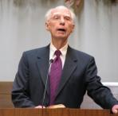
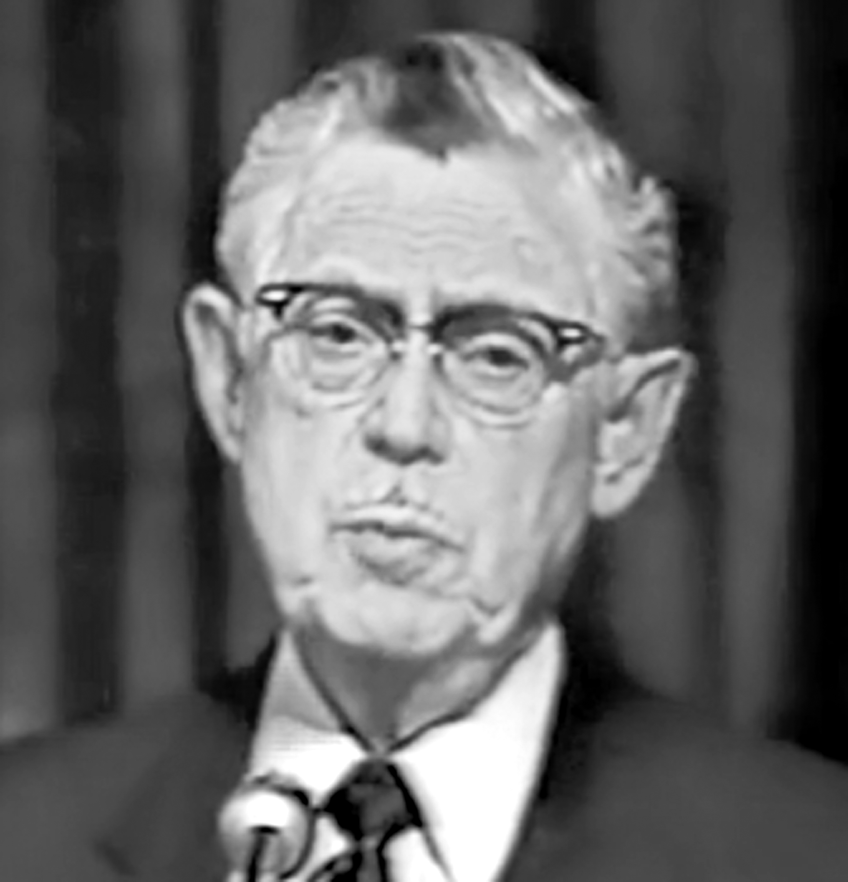
Re-Examining Minneapolis 1888
Robert J. Wieland & Donald K. Short
Notes:
The story of 1888 remained carefully guarded by the church until 1950 when Wieland and Short came on to the scene. But before we look at some of their concerns, we need to understand their history.

Slide 3
Robert J. Wieland & Donald K. Short
Wieland was born in 1916 into a Lutheran home. After his mother died when he was two the family attended the Methodist and then Presbyterian church. At 12 Wieland discovered the Sabbath truth, and soon thereafter in 1929 he was baptized into the SDA church with his father.
After standing as the lone SDA in his Florida high school, Wieland attended Southern Junior College (now SAU) and Washington Missionary College (now WAU). While at WMC in 1938 Wieland discovered The Glad Tidings, and fell in love with the gospel. He knew nothing of Waggoner, 1888 or EGW’s endorsement of their message. He copied on his typewriter large portions of Waggoner’s book, then out of print, and eventually took it to Africa.
Wieland graduated in 1939, went to Florida as literature evangelist for a year, then joined the conference evangelistic team. After marriage to Grace in 1942, Wieland held his first pastorate. A short time later (1944) he was called to be the Mission director for the Uganda field in the Southern African Division. A year and a half later he was appointed as president of the Uganda field. Donald Short, whom Wieland had been acquainted with since high school days, was already in Kenya.
Notes:
Summary description of Wieland and Short history. Numbers just indicate progression of each paragraph. Information taken from: (“Wieland, Pre-1950,” in Bradley Roy Williams, “Robert J. Wieland Before 1888 Re-examined, and Some of His Effect on Adventists,” A Report Presented in Partial Fulfillment of the Requirements for the Course CHIS 574, Development of Seventh-day Adventist Theology, Andrews University, Autumn 1978)

Slide 4
Robert J. Wieland & Donald K. Short
In 1947 or 1948 Wieland was challenged by a false revival, “Abalokole,” which came from the Church of England African churches and swept into Uganda, even into the Adventist churches, into which many converts from the church of England had come. Although initially there seemed to be a great revival of joy in the gospel, there was an emphasis on a purely legal or forensic declaration only of justification by faith. Wieland went along with the “revival” for a short while, but was confronted by older pastors who pointed out the increasing immorality among the movement.
After some serious study and counsel with other missionaries, Wieland discovered the concept of Agape love in the cross of Christ, and confronted the false revival by presenting the genuine message of righteousness by faith paralleled with the concept of the cleansing of the sanctuary.
Soon after successfully meeting this challenge of a false evangelical revival in Africa, Wieland took furlough in 1949 and returned to America. Donald Short returned on the same passage and they became more fully acquainted. While on layover in England, Wieland obtained by providential happenings a copy of The Glad Tidings for himself and re-read the entire book on his voyage to the U.S.
Notes:
Rosa Spicer, a old lady in her nineties that Wieland ran into in England, knew Waggoner, and so Wieland asked if she had a copy of the Glad Tidings. She did and finally agreed to give it to him right before he left for US.

Slide 5
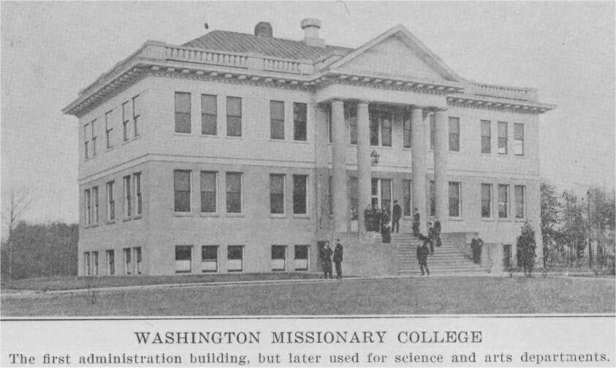
Re-Examining Minneapolis 1888
SDA Theological Seminary Fall 1949

Slide 6
Robert J. Wieland & Donald K. Short
Upon arrival in the U.S. Wieland and Short enrolled in the Theological Seminary in Washington D. C. and began classes. Wieland was particularly excited to be taking a special class then offered, on Righteousness by faith. The teacher referred the students to an 1888 Conference and to the literature then available on the topic: Christian’s, Spalding’s and Pease’s works, along with the 1893 GC Bulletin. For the first time Wieland was introduced to the fact that there was a special message sent the church in 1888, which he discovered from reading the 1893 Bulletin articles, which was the beginning of the latter rain and coincided with the message of Waggoner that he had just read.
Wieland’s heart thrilled as he was personally studying the 1888 message of R by F, which was to him more than just a re-emphasis of the 16th century Reformation gospel. However, he began to sense that the lessons from his class were promoting Evangelical concepts of R by F with seemingly spiritualistic concepts similar to the false Abalokole revival he had dealt with in Africa, and the contrast between the two gospels was accentuated in his mind by his personal studies of the 1888 message. Wieland soon discovered that much of the material, concepts and even illustrations presented in the R by F class were taken from E. Stanley Jones’ works.*
Notes:
Wieland left his wife in TN while he went to the seminary, and he spent his time reading and studying.
“So I read up on all these things. And I was thrilled to find that the author of my book, The Glad Tidings, was one of the messengers that the Lord had used to bring the 1888 message, the beginning of the latter rain.” (Williams, Appendix K, p. 8)
*We will step aside briefly from Wieland's and Short’s history to look at E. Stanley Jones.

Slide 7
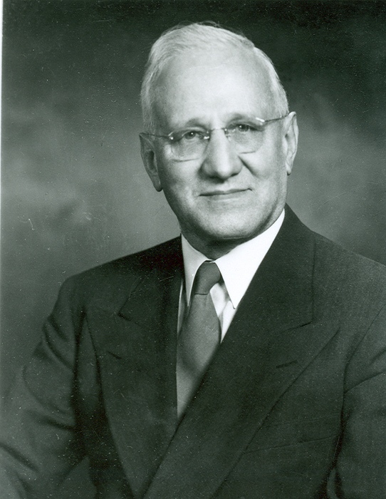



E. Stanley Jones
Notes:
"Eli Stanley Jones (1884–1973) was a 20th-century Methodist Christian missionary and theologian. He is remembered chiefly for his interreligious lectures to the educated classes in India…. He spent much time with Mohandas K. Gandhi, and the Nehru family. Gandhi challenged Jones and, through Jones' writing, the thousands of Western missionaries working there … to include greater respect for the mindset and strengths of the Indian [culture and religion] in their work.
This effort to contextualize Christianity for India was the subject of his seminal work, The Christ of the Indian Road which sold more than 1 million copies worldwide after its publication in 1925." (http://en.wikipedia.org/wiki/E._Stanley_Jones)
He wrote over 30 books; The Way to Power an Poise was published in 1949.
Ashram, Definition: “a place where a person or a group of people go to live separately from the rest of society and practice the Hindu religion.” “The residents of an ashram regularly performed spiritual and physical exercises, such as the various forms of yoga. Other sacrifices and penances, … were also performed.” (http://en.wikipedia.org/wiki/Ashram)

Slide 8
E. Stanley Jones
“His work became interdenominational and world-wide. He helped to re-establish the Indian ‘Ashram’ (or forest retreat) as a means of drawing men and women together for days at a time to study in depth their own spiritual natures and quest, and what the different faiths offered individuals. In 1930, along with a British missionary and Indian pastor and using the sound Christian missionary principle of indigenization (God’s reconciliation to mankind through Jesus on the cross. He made Him visible as the Universal Son of Man who had come for all people. This opening up of nations to receiving Christ within their own framework marked a new approach in missions called ‘indigenization’ [ESJones, Christian Ashram, p. 2])[,] Dr. Jones reconstituted the ‘Ashram’ with Christian disciplines. This institution became known as the ‘Christian Ashram.’” (http://en.wikipedia.org/wiki/E._Stanley_Jones, accessed Nov. 18, 2013).
Notes:
The Christian Ashram movement had its beginnings with a Jesuit in the 19th century, who tried to reach Hindus through an ecumenical marriage of Christianity and Hindu practice. (http://en.wikipedia.org/wiki/Christian_Ashram_Movement)

Slide 9
E. Stanley Jones
“’Our call, they say, is to share with non-Christian faiths, and this sharing means not only giving out what one has to non-Christians, but sharing what they have in their own faiths…. It means that Christ Himself has deficiencies, which are to be supplied by other faiths.’” (E. Stanley Jones, The Message of Sat Tal Ashram, p. 291; in W. A. Spicer, Review and Herald, Nov. 9, 1950, p. 13)
Notes:
Quoted in Spicer's 1950 article.

Slide 10
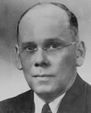
Denton E. Rebok
Notes:
President of the SDA Theological Seminary at Washington Missionary College, and Chair of the White Estate Board in 1952.

Slide 11
Robert J. Wieland & Donald K. Short
In Dec. 1949 Wieland was called into D. E. Rebok’s office, Seminary President, to clear up an issue with his registration. While Wieland was there, he decided to share some of his concerns over what was being taught in the class on Righteousness by faith:
“I communicated with him quite frankly my concern that the so-called righteousness by faith that was being taught there in the Seminary was not what the Lord had sent to Seventh-day Adventists in the 1888 message; that this was rather a concept borrowed from the popular churches—not the real thing that the Lord wants Adventist to understand. And, of course, I was full of enthusiasm, I was only 33. I had just been caught up on the thrill of the 1888 history and had been immersing myself in the 1893 message. I saw its importance and communicated that to Elder Rebok and I am sure I was very outspoken in my declaration that what was being taught by our workers there in the Seminary was not that message. Well, his reaction was negative—very, very decidedly so. And right quickly he made up his mind that I should leave the Seminary.” (Williams, B. R., "Robert J. Wieland Before 1888 Re-examined", Appendix K, pp. 9, 10)*
Notes:
*(Robert J. Wieland, “Wieland, Pre-1950,” in Bradley Roy Williams, “Robert J. Wieland Before 1888 Re-examined, and Some of His Effect on Adventists,” A Report Presented in Partial Fulfillment of the Requirements for the Course CHIS 574, Development of Seventh-day Adventist Theology, Andrews University, Autumn 1978), Appendix K, pp. 9, 10.

Slide 12
Robert J. Wieland & Donald K. Short
Before Wieland left the Seminary he finished reading the 1893 Bulletin, typing many pages on his portable typewriter: “The more I read the more I copied and the more thrilled I was with the truth of this history, that really the 1888 message was not accepted. If it had been, we’d be in the kingdom by now. This leaped at me from the pages of this 1893 Bulletin.
“Now this was not generally known or recognized, and as I read Spalding and Christian I found that they had an entirely different view of the significance of the 1888 history. To them, the message had been accepted at least in the end, and all was pretty well. And the blessings of the message were with us.” (Ibid., p. 11)
Notes:
(Ibid.)

Slide 13

White Estate, GC Office Takoma Park
Notes:
The Ellen G. White Estate had been moved to the General Conference Office in Jan. 1938, following the death of W. C. White.

Slide 14
Robert J. Wieland & Donald K. Short
As Wieland realized there was such a contrast between what he was reading in regard to this 1888 message which he had just come to learn about, and the more Evangelical message of Righteousness by faith in his seminary class, which he had now been expelled from, he decided to go to the White Estate and see if he could get to the bottom of this.
When Wieland arrived at the White Estate he was told that the EGW material on 1888 was a sensitive subject and people were not generally allowed to access it. After some deliberation he was allowed to look at one of the document files which he began to copy. But when he returned the following day his access to the file was denied. Now he was kicked out of the Seminary, unable to access Ellen White’s material on the subject of 1888, yet the incredible interest into the subject from what he had already read was a fire burning in his bones.

Slide 15
Robert J. Wieland & Donald K. Short
“As I walked out to the hall into the sunshine that December morning, I was determined in my heart that, if God would help me, that I would get to the bottom of this. I couldn't understand why I couldn’t finish that file. Why this reticence, why the desire to cover up this tremendous history of the beginning of the latter rain—the outpouring of the Holy Spirit that was to finish God’s work in all the earth? Why must this be covered up?
“I just couldn’t understand it. Here’s what Ellen White called ‘a most precious message’, and the White Estate was maintaining secrecy about it, covering up what Ellen White had to say about it. And it was obvious that what Ellen White said was in complete contradiction of what Spalding and L. H. Christian and our textbooks had been saying about it.” (Ibid., pp. 12, 13)
Notes:
Wieland quote

Slide 16
Robert J. Wieland & Donald K. Short
So as Wieland headed out from Takoma Park back to Tennessee and then to Florida he began contacting any old Adventist pastors who might have known Ellen White and who might have information on 1888 and possible letters regarding the subject. Thus Wieland amassed a large collection of unpublished EGW material regarding 1888 and its aftermath. The more Wieland read the more he realized that his observations from his earlier reading were correct.

Slide 17
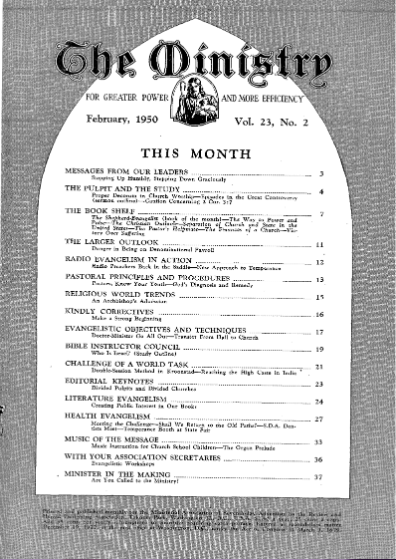
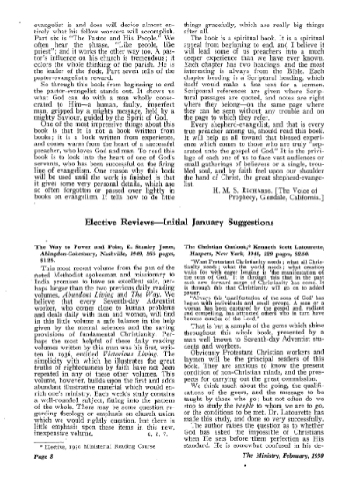
The Ministry: Book Review
Notes:
Then in Feb. 1950, Ministry Magazine, published a book review of the newest E. Stanley Jones book, “The Way to Power and Poise,” (published 1949), recommending the book to all Seventh-day Adventists. The reviewer was a popular Evangelist at the time and the same teacher of the class over which Wieland had been expelled from the Seminary.

Slide 18
E. Stanley Jones for Every SDA
“We believe that every Seventh-day Adventist worker, who comes close to human problems and deals daily with men and women, will find in this little volume a safe balance in the help given by the mental sciences and the saving provisions of fundamental Christianity. Perhaps the most helpful of these daily reading volumes written by this man was his first, written in 1936, entitled Victorious Living. The simplicity with which he illustrates the great truths of righteousness by faith have not been repeated in any of these other volumes.” (George E. Vandeman, “Elective Reviews—Initial January Suggestions,” The Ministry, February, 1950, p. 8)

Slide 19
E. Stanley Jones for Every SDA
So Wieland bought a copy of the book and saw the book as laced with spiritualistic Evangelical concepts that could bring serious confusion regarding the gospel of righteousness by faith, particularly when compared to the message which came to the church in 1888. Wieland expressed his concerns in a letter to General Conference president J. L. McElhany, and the Ministerial Association leaders. In general, Wieland’s letter was not well received, although he received a letter of appreciation from the president.

Slide 20
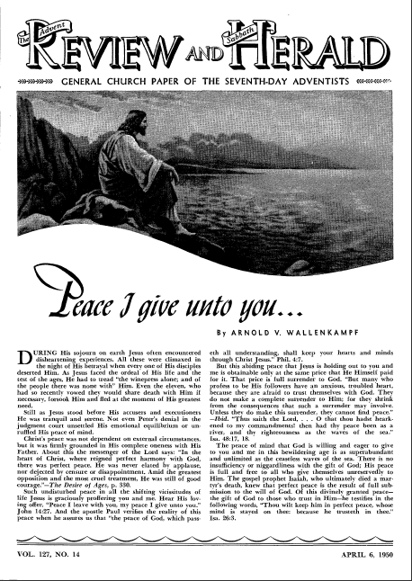
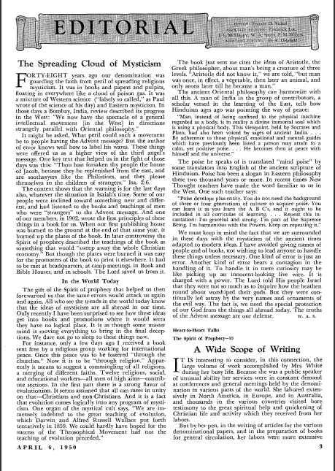
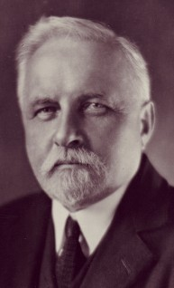
“Spreading Cloud of Mysticism”
Notes:
Then in April 1950 the Review and Herald ran an editorial article title “The Spreading Cloud of Mysticism,” by W. A. Spicer, former General Conference president from 1922 until 1930.
Even though I did not address the issue when I gave this presentation at Andrews, fall of 2014, it would be well to note that the ‘religious mysticism’ Spicer wrote of is a counterfeit of the genuine mystical truths in the true message of righteousness by faith, mystical in the sense in which Ellen White sometimes used the term: “with a divine meaning beyond human understanding” and “with supernatural or spiritual significance or power” (Encarta World English Dictionary 1999). For examples of Ellen White writing of the genuine, see DA 417.2; CH 220.1; FLB 194.2; for examples of her writing of the counterfeit, see DA 257.3; Ed 63.1; Ev 213.2; 606.1 When there is a genuine and a counterfeit, just attacking the counterfeit alone makes it much more likely that one who does not know that both exist will also reject the genuine (throwing the baby out with the bath water). There is a fundamental issue with Kellogg’s mysticism that needs addressing, if but briefly. And that is that his mysticism is a counterfeit of the genuine mystical. This brings up the issue again that is more and more pertinent today: We cannot accurately oppose the counterfeit (omega incarnation of the alpha of apostasy) with a pre-Minneapolis view (that was deficient in the true mystical); we must oppose the counterfeit with the genuine (the true mystical). Note this Ellen White statement for a blazing example of the genuine: “Selfishness is death. No organ of the body could live should it confine its service to itself. The heart, failing to send its lifeblood to the hand and the head, would quickly lose its power. As our lifeblood, so is the love of Christ diffused through every part of His mystical body. We are members one of another, and the soul that refuses to impart will perish. And ‘what is a man profited,’ said Jesus, ‘if he shall gain the whole world, and lose his own soul? or what shall a man give in exchange for his soul?’”{DA 417.2}For more information on this topic contact Fred Bischoff at: bischoff@netbox.com

Slide 21
“Spreading Cloud of Mysticism”
“Forty-eight years ago our denomination was guarding the faith from peril of spreading religious mysticism. It was in books and papers and pulpits, floating in everywhere like a cloud of poison gas. It was a mixture of Western science (‘falsely so called,’ as Paul wrote of the science of his day) and Eastern mysticism.... It might be asked, What peril could such a movement be to people having the Advent message? But the author of error knows well how to label his wares. These things were offered us as a higher view of the third angel's message.…
“The gift of the Spirit of prophecy that helped us then forewarned us that the same errors would attack us again and again. All who see the trends in the world today know that the ideas of mysticism are all abroad in our time. Only recently I have been surprised to see how these ideas get into books and promotions where it would seem they have no logical place. It is as though some master mind is moving everything to bring in the final deceptions. We dare not go to sleep to these things now.” (cont.)
Notes:
1 of 2

Slide 22
“Spreading Cloud of Mysticism”
“For instance, only a few days ago I received a book sent free by a religious group working for international peace. Once this peace was to be fostered ‘through the churches.’ Now it is to be ‘through religion.’ Apparently it means to suggest a commingling of all religions, a merging of different faiths…. [several quotes from book]
“The poise he speaks of is translated ‘mind poise’ by some translators into English of the ancient scripture of Hinduism. Poise has been a slogan in Eastern philosophy these two thousand years or more….
“I have avoided giving names of people and of books, not wishing to lead anyone to handle these things unless necessary.… To handle it in mere curiosity may be like picking up an innocent-looking live wire. It is charged with a power. The Lord told His people Israel that they were not so much as to inquire how the heathen round about worshiped their gods. But they were continually led astray by the very names and ornaments of the evil way. The fact is, we need the special protection of our God from the things all abroad today. The truths of the Advent message are our defense” (W. A. Spicer, “The Spreading Cloud of Mysticism,” Editorial, Review and Herald, April 6, 1950, p. 3)
Notes:
2 of 2

Slide 23
“Spreading Cloud of Mysticism”
After Wieland read this article, in which Spicer had quoted from E. Stanley Jones, Wieland wrote a letter to Spicer and asked if he was responding to the Ministry book review which recommended Jones’ books for all Adventists? Wieland also told him about his experience at the Seminary and concern about what was being taught there, and how he had voiced his concerns there and over the Book Review. Spicer immediately wrote back.
Notes:
Much has changed in 63 years when one considers the current editorial policy at the Review. See: Eric Anderson, “What is a Mystic? Seeking Companionship With Christ,” Adventist Review, Jan. 10, 2013, pp. 16-20; and, Bill Knott, “Reclaiming the Library,” Editorial, Adventist Review, March 14, 2013, p. 6, a response written after many letters of concern were sent to the Review in regard to Anderson’s article in support of mysticism.

Slide 24
“Spreading Cloud of Mysticism”
“Elder Spicer replied immediately and said—yes, that’s exactly what he had referenced to. That he regarded E. Stanley Jones as doing about the worse work of any modern religious agent. He felt deeply concerned for our people who were being confused by it, and was so happy that I had discerned the evil in that book and had protested to the General Conference as I had. He added that if others would protest as I had done, it might do some good. I wrote back immediately and said, Elder Spicer, why don’t you protest? I’m nobody, I can’t say anything; nobody will listen to me, but you’re somebody, they’ll listen to you.”*
Notes:
*(Robert J. Wieland, “Wieland, Pre-1950,” in Bradley Roy Williams, “Robert J. Wieland Before 1888 Re-examined, and Some of His Effect on Adventists,” A Report Presented in Partial Fulfillment of the Requirements for the Course CHIS 574, Development of Seventh-day Adventist Theology, Andrews University, Autumn 1978), Appendix K, pp. 17, 18
Spicer did finally write another appeal published in the Review Nov. 1950 (after the General Conference during the summer of 1950, which he said everyone would be distracted with).
But how far reaching is E. Stanley Jones' influence today?

Slide 25
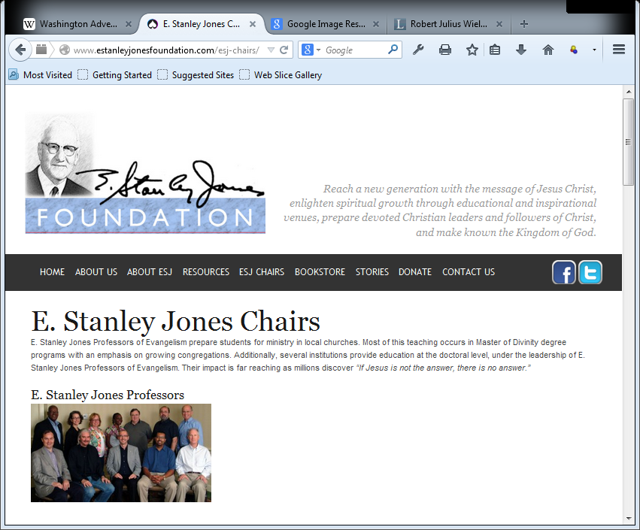
E. Stanley Jones Foundation:
Notes:
Strangely enough, E. Stanley Jones has influence even today in the Evangelical world around the world.
Places with E. Stanley Jones Chairs:
Duke Divinity School
Reutlingen School of Theology
Africa University
Russia United Methodist Theological Seminary
Methodist Theological School in Ohio
Wesley Theological Seminary
Boston University School of Theology
Drew University School of Theology
Garrett Evangelical Theological Seminary
Southern Methodist University School of Theology
Candler School of Theology

Slide 26
E. Stanley Jones Foundation:
“E. Stanley Jones Professors of Evangelism prepare students for ministry in local churches. Most of the teaching occurs in Master of Divinity degree programs with an emphasis of growing congregations. Additionally, several institutions provide education at the doctoral level under the leadership of E. Stanley Jones Professors of Evangelism. Their impact is far reaching….” (http://www.estanleyjonesfoundation.com/esj-chairs/)
Notes:
(There is a picture that kept popping up when I was looking for images of E. Stanley Jones—Next Slide)

Slide 27
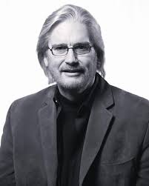
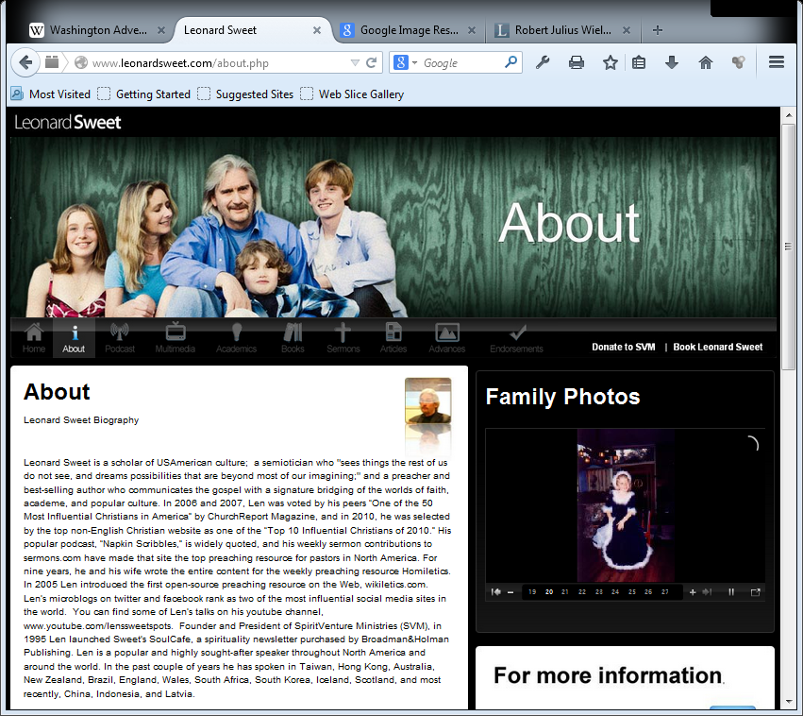
Leonard Sweet
Notes:
Leonard Sweet’s Image kept popping up while searching for E. Stanley Jones images.
A search for “E. Stanley Jones and Leonard Sweet” brought up Leonard’s personal website near the top of the list: (http://www.leonardsweet.com/about.php)

Slide 28
Leonard Sweet’s Personal Website:
“Leonard Sweet is a scholar of USAmerican culture; a semiotician who ‘sees things the rest of us do not see, and dreams possibilities that are beyond most of our imagining;’ and a preacher and best-selling author who communicates the gospel with a signature bridging of the worlds of faith, academe, and popular culture….”
“Currently the E. Stanley Jones Professor of Evangelism at Drew University, Madison, NJ and a Visiting Distinguished Professor at George Fox University, Portland, Oregon, Len was Vice President of Academic Affairs and Dean of the Theological School at Drew University from 1995 to 2001.” (http://www.leonardsweet.com/about)

Slide 29
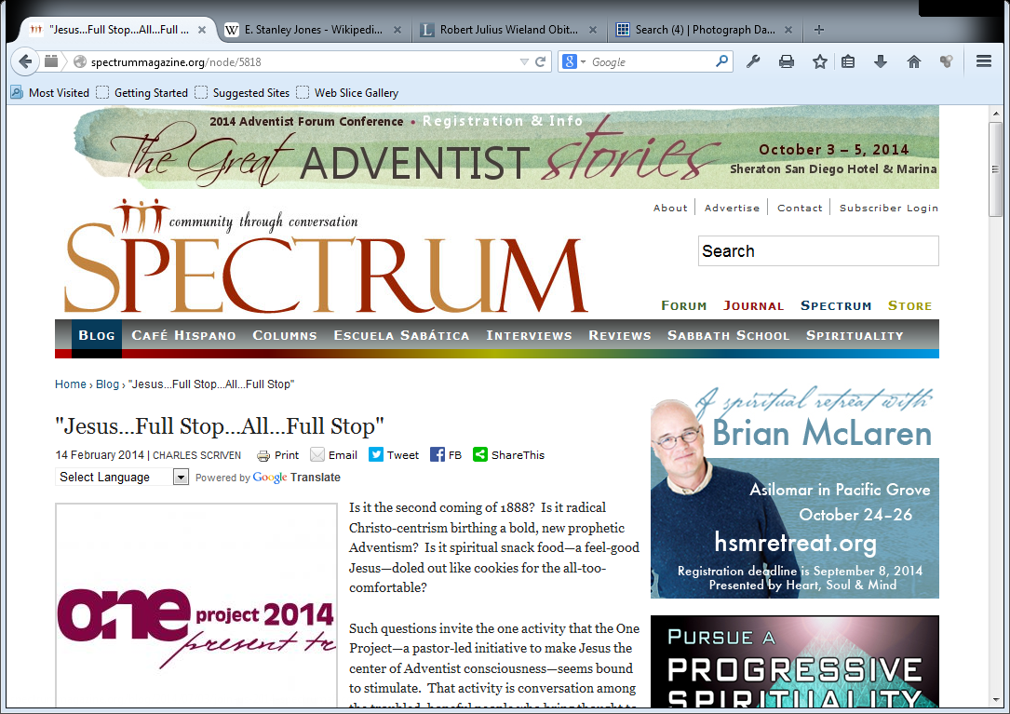
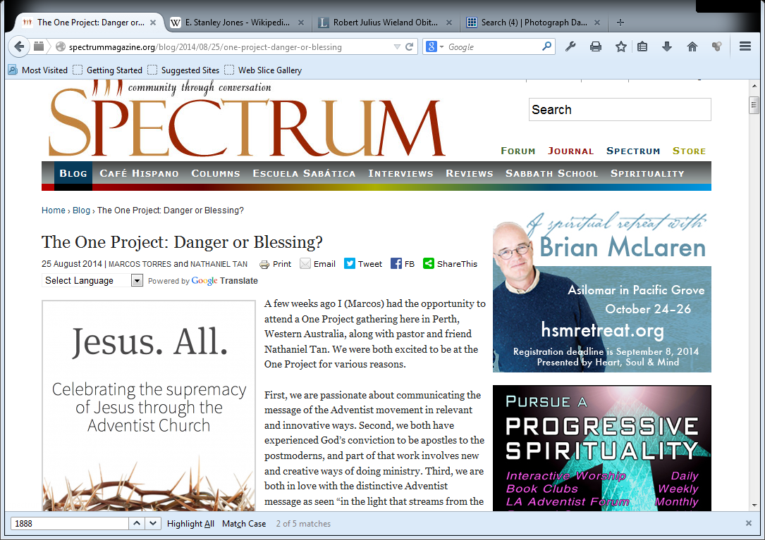

The ONE Project
Notes:
4 of the 5 initial leaders of the One Project graduated from George Fox University with degrees mentored by Leonard Sweet.
Alex Bryan
Sam Leonor
Tim Gillespie
Terry Swenson
The One Project has elicited many responses that perhaps this is the new 1888 message for the 21st century! Two articles in 2014. One in Feb. Spectrum Magazine, the other posted on blog site Aug. 2014.

Slide 30
The ONE Project
“Is it the second coming of 1888? Is it radical Christo-centrism birthing a bold, new prophetic Adventism? Is it spiritual snack food—a feel-good Jesus—doled out like cookies for the all-too-comfortable? Such questions invite the one activity that the One Project … seems bound to stimulate.” (Charles Scriven, “Jesus...Full Stop...All...Full Stop,” Spectrum, Feb. 2014; http://spectrummagazine.org/node/5818)
“I had no intention of attending the One Project…. However, being familiar with those who argued that we stick to the ‘old landmarks’ in 1888, we were not willing to embrace a position that would find us fighting against God…. We must also remember as Adventists that this anti-Jesus-only thought pattern, this ‘suspicion’ of doctrinal dissolution in the name of ‘Christ-centeredness,’ is exactly what took place during the 1888 crisis. Those who opposed the message that Jones and Waggoner were preaching did so partly because they felt that it was a threat to Adventist identity…. It is from this crisis that the One Project appears to build some of its philosophy. Many of its statements actually reflect the thought pattern of Ellen White’s life-long ministry, especially the ones she made following the 1888 crisis.” (Marcos Torres and Nathaniel Tan, “The One Project: Danger or Blessings?” Spectrum Blog, Aug 25, 2014; http://spectrummagazine.org/blog/2014/08/25/one-project-danger-or-blessing)
Notes:
The One Project has elicited many responses that perhaps this is the new 1888 message for the 21st century! Two articles in 2014. One in Feb. Spectrum Magazine, the other posted on blog site Aug. 2014.
Soooo, is the One Project the new 1888 message for the 21st Century? Take a look at a 1 min clip from a gathering in CA in 2010, the same year the One Project started (not a One Project Gathering though). 4 of the five leaders in this video are pastors, 3 of the 5 are leaders in the One Project.

Slide 31
The ONE Project Leaders in Action
This video can be viewed on YouTube:
https://www.youtube.com/watch?v=d300Z0aWxiI
Notes:
This gathering (concert) took place in 2010, at an SDA church in Southern CA. This was not at a One Project gathering, but was the same year the One Project was started by some of these same men. 4 of the 5 band members are pastors. 3 of the 5 band members are leaders in The One Project.
At that time:
Roy Ice (drums/vocals) Associate Pastor and College Chaplain at Pacific Union College;
Sam Leonor (bass/vocals) Pastor at La Sierra University;
Tim Gillespie (vocals), Youth Pastor at Loma Linda University, ReLive Church service.
Michael Knecht (guitars) Pastor at Crosswalk SDA Church in Redlands, CA;
Jason Hutchinson (guitars) from ReLive Church Praise Band where Tim Gillespie pastored.
For more information on The One Project, see: Ron Duffield, “The Emerging One Project?” PowerPoint presentations 1 through 10, at www.slideshare.com/ronduff
For more videos like the above used in the PowerPoint presentations, see: http://www.youtube.com/channel/UC-rFyZQ7Xecu-43P6Ut-5pw

Slide 32
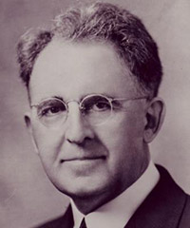
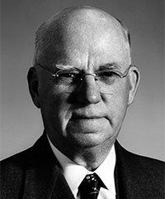
James L. McElhany
William H. Branson
Notes:
McElhany was General Conference President 1936-1950. He was replaced in 1950 by William H. Branson GC President 1950-1954.
Both Wieland and Short attended the GC in San Francisco in early July 1950.

Slide 33
The 1950 General Conference
Attending the General Conference session in San Francisco in early July, 1950, both Wieland and Short once again shared a sense of concern as some of the same spiritualistic sounding concepts were shared in the “Christ-centered preaching” meetings held by the Ministerial Association. Spurred on by J. L. McElhany’s exiting presidential address (which warned Adventists not to set aside, modify or compromise their foundational principles of truth), and by a public announcement that delegates share any concerns they might have, Wieland and Short submitted a letter of concern to the members of the General Conference Committee. Their two-pronged concern was that the message of 1888 had in fact never been accepted, and that another gospel was being imperceptibly promoted in its stead.

Slide 34
A Letter of Concern
Wieland and Short’s letter was submitted to the General Conference officers. Concern over sending Wieland and Short back to Africa before clearing up their charges, led to their call to a meeting with a small General Conference committee, made up in part by, A. V. Olson, vice president, J. I. Robison, associate secretary, A. L. White, associate secretary of the White Estate, one associate secretary from Ministerial Association, and a few others. No official action was taken following the meeting, but sensing that they must explain themselves further as clearly as possible or face dismissal from the ministry, Wieland and Short spent the next six weeks producing 1888 Re-examined, a private manuscript of 204 legal size pages with over five hundred Ellen White exhibits, most of which they had collected over the previous few months, voicing their convictions to the leadership of the church.
Notes:
That is the context of the producing of 1888 Reexamined. Wieland and Short had known of 1888 for less than a year, and now they were driven to confront the church to choose between the 1888 message of the past or a new Evangelical message.
*The original 1888 Re-examined did not have the 10 points of the 1888 message, which was added to the preface in the 1987 edition. Also, the last 100 pages of the original manuscript dealt in depth with the true and false Christ, and Baal worship coming into the church. These last three chapters where edited down to 30 pages in the 1987 edition.

Slide 35
1888 Re-examined & the Response
The 1888 Re-examined manuscript was submitted six weeks later and was soon passed on by the General Conference Officers to the Defense Literature Committee, W. E. Read as chair, Frank H. Yost as secretary, with L. E. Froom, H. W. Lowe, A. L. White, D. E. Rebok, and J. I. Robison, among others, as members. Fourteen months later and long after Wieland and Short had been cleared to return to Africa, the official report came in December of 1952, fully upholding the 1888 acceptance theory, and censuring Wieland and Short for being critical of the church and misrepresenting Adventist history.
Notes:
A lawsuit was at first threatened by some in the church against Wieland and Short for quoting from so many unpublished Ellen White letters and manuscripts and for their collecting of this material. This was later dropped, but, as Wieland states, shows the length to which some were willing to go to keep 1888 out of the public eye.

Slide 36

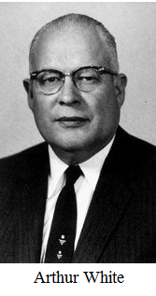
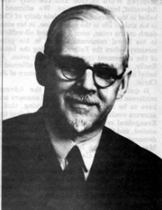
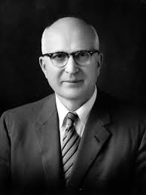
Some of Those Who Reviewed
1888 Re-Examined
D. E. Rebok
H. W. Lowe
W. E. Read
L. E. Froom
Notes:
Some of the members of the General Conference Defense Literature Committee that critiqued Wieland and Short’s 1888 Re-Examined.
D. E. Rebok, Theological Seminary President (1943-1951), Chair of White Estate Board (1952).
A. L. White, Secretary (Director), Ellen G. White Estate board of trustees (1937-1978).
Frank H. Yost, Chairman of the department of theology, SDA Theological Seminary (1950-1954), Editor Liberty, (1955-1958), associate secretary of GC Religious Liberty Dept. (1946-1950, 1954-1958).
H. W. Lowe, Chairman of the Bible Study and Research Group of the General Conference.
J. I. Robison: Associate Secretary of the General Conference. (President's Secretary)
W. E. Read, Field Secretary of the General Conference.
L. E. Froom, author, editor, teacher and founder of Ministry magazine.

Slide 37
1888 Re-examined & the Response
But the topic did not rest. One of the private copies of 1888 Re-examined was leaked by a member of the Defense Literature Committee, and soon mimeographed copies were making their way around the world, although against the wishes of Wieland and Short. Copies of the manuscript created considerable discussion among some church members and leaders, and in September 1958, a second General Conference report was delivered to Wieland and Short, and made available to the world church. This response, “Further Appraisal of the Manuscript ‘1888 Re-examined,’” prepared by A. L. White, A. V. Olson, and H. W. Lowe, upheld the earlier Defense Committee findings, with added charges of misrepresentation of Ellen White’s writings.

Slide 38
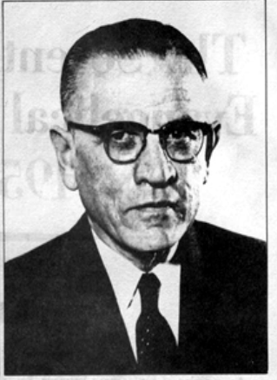
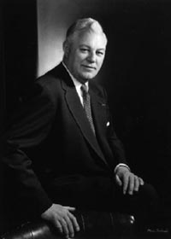
Adventist and Evangelical Dialog
T. E. Unruh
Donald Grey Barnhouse
Notes:
While the General Conference was grappling with the calls to Laodicean repentance through the manuscript 1888 Re-examined, and being challenged to make a choice between the 1888 message of Righteousness by faith and the teachings of E. Stanley Jones, dialog had already began between certain Adventist and Evangelical leaders. This began quite innocuously in the fall of 1949, through correspondence between Adventist T. E. Unruh, president of the East Pennsylvania Conference, and Presbyterian Donald Barnhouse, Calvinist Evangelical editor of the influential Eternity magazine,.
The dialog began with a letter of special appreciation (November 28, 1949) from T.E. Unruh to Dr. Donald Barnhouse, after hearing his radio address on “righteousness by faith” in 1949. Barnhouse was astonished that an Adventist leader would commend him when Barnhouse was convinced that Adventists believed in “righteousness by works.” Barnhouse also noted that Adventists had a “satanic and dangerous” Christology.*
*(Donald Grey Barnhouse, “Are Seventh-day Adventists Christians? A New Look at Seventh-day Adventism,” Eternity, September 1956; T. E. Unruh, The Seventh-day Adventist Evangelical Conferences of 1955-1956, Adventist Heritage, fourth quarter, 1977).

Slide 39
Steps to Christ?
“In one of [his letters to Barnhouse, Unruh] enclosed Steps to Christ, ‘affirming the evangelical character of Adventist doctrine.’ And Barnhouse fired back, in an Eternity article on ‘How to Read Religious Books,’ stating that Steps to Christ was ‘false in all its parts.’ bearing the ‘mark of the counterfeit’ from the first page. He also charged that Steps to Christ promoted ‘universalism. . . half-truths and Satanic error. . . so much emphasis on God’s love to unregenerate men smacked of universalism.’ Unruh decided there was no point of continuing the correspondence.” (Donald G. Barnhouse, “How to Read Religious Books,” Eternity, June 1950; quoted in Dr. Herbert E. Douglass, “The QOD Earthquake—Attempted Merger of Two Theological Tectonic Plates,” Questions on Doctrine 50th Anniversary Conference, October 24-27, 2007, Andrews University, Berrien Springs, MI; www.qod.andrews.edu/docs/11_herbert_douglass.doc)
Notes:
This is how Herbert Douglass describes Barnhouse’s response to the book Steps to Christ. It should be of interest that Steps to Christ it is claimed, is proof that the 1888 message was fully accepted and taken up by Ellen White in a new emphasis for the church in 1892.
*** If Barnhouse responded to Steps to Christ this way, why should Adventist have started more dialog between the two groups trying to bring together these two?

Slide 40
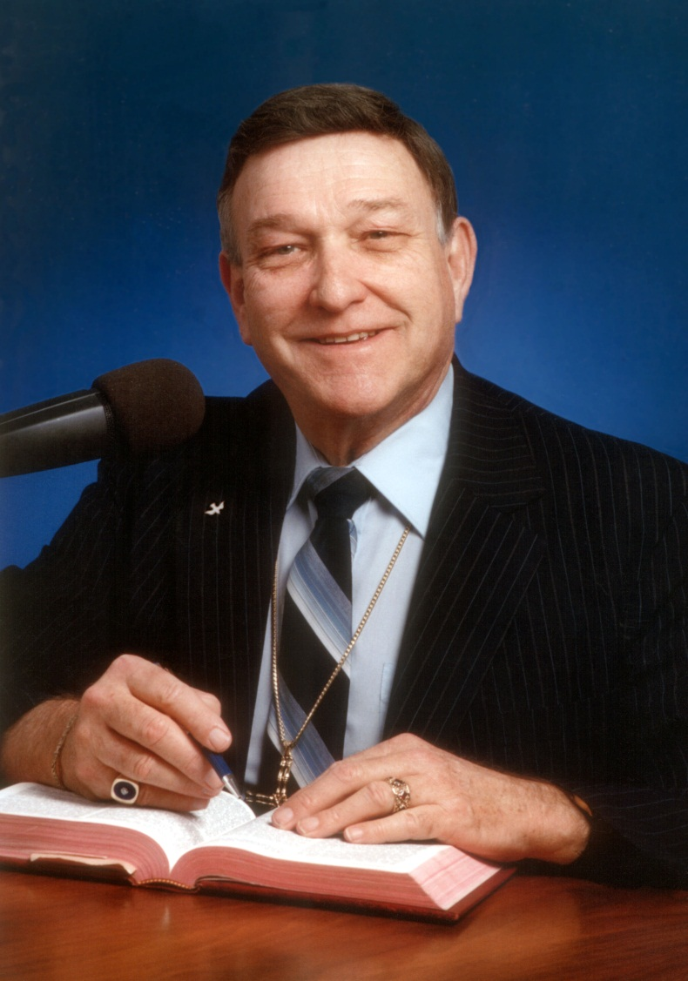
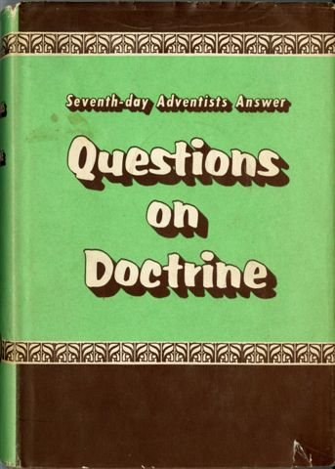
More Adventist Dialog
Notes:
In the spring of 1955, Baptist Walter Martin, a young researcher considered in the Evangelical world to be a specialist in non-Christian cults, and a consulting editor of Eternity magazine, entered into what would become a much more formal dialog with Adventists. Martin was just finishing up his next book on The Rise of the Cults, in which he was categorizing Seventh-day Adventists as one of “The Big Five,” alone with Jehovah’s Witnesses, Christian Science, Mormonism, and Unity. Knowing of the correspondence between Unruh and Barnhouse, and being aware of the major work on the history of prophetical interpretation by Leroy E. Froom—author, editor, teacher and founder of Ministry magazine—Martin asked Unruh for a meeting in Washington with Froom and other Adventist leaders in preparation for his upcoming book on the cults. Unruh and Froom asked Walter E. Read, a field secretary of the General Conference and biblical linguist, to join them, and later, Roy Allan Anderson, editor of Ministry. Meetings began in March 1955 and ended in May 1956. The book Questions on Doctrine was the result of this dialog.
**** Some of the same men who were sitting on the committees dealing with 1888 Re-Examined, were at the same time dialoging with Evangelicals.
In another dimension, it was planned to demonstrate consensus by submitting the questions and answers to Adventist leaders in North America, and then around the world, using a mailing list of more than 250 names. The document by this time had grown to some sixty questions and answers, and was beginning to be thought of as having book possibilities - a definitive statement of contemporary Adventist theology, in convenient reference book form. A committee of fourteen members was appointed with General Conference approval, to prepare the document for distribution to church leaders, then to analyze and evaluate the feedback. Figuhr, the president of the General Conference, was chairman of this committee.* Correspondence relating to the project was entrusted to J.I. Robison, the president's secretary. The response was good, the consensus was demonstrated, and the decision to publish was made. Thus Questions on Doctrine came into being.
* -- Members of the committee: R. R. Figuhr (chairman), A. V. Olson, W. B. Ochs, L. K. Dickson, H. L. Rudy, A. L. Ham, J. I. Robison, W. R. Beach, C. L. Torrey, F. D. Nichol, T. E. Unruh, R. A. Anderson, L. E. Froom, W. E. Read.

Slide 41
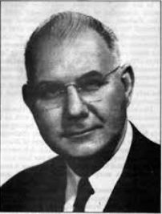
Those Involved in Dialog with Evangelicals
Roy Allan Anderson
W. E. Read
T. E. Unruh
L. E. Froom
Notes:
Some of the same men dialoging with the Evangelicals Barnhouse and Martin, were during the same time sitting on Committees that were reviewing 1888 Re-Examined”
Roy Allan Anderson, Ministry Magazine editor
T. E. Unruh, President of the East Pennsylvania Conference
W. E. Read, Field Secretary of the General Conference
L. E. Froom, author, editor, teacher and founder of Ministry magazine—Martin

Slide 42
Dialog with Martin
“[Walter Martin’s questions] covered a wide range of Adventist theology, but four areas stuck out in Martin’s mind: ‘(1) that the atonement of Christ was not completed upon the cross; (2) that salvation is the result of grace plus works of the law; (3) that the Lord Jesus Christ was a created being, not from all eternity; (4) and that He partook of man’s sinful fallen nature at the incarnation.’” (Walter Martin, Our Hope, November 1956, p. 275; in George R. Knight, A Search for Identity, p. 165)
Notes:
These are the four charges Martin brought against the SDA church.
This was in part the result of Martin’s issue with the Sanctuary doctrine. That there was a cleansing of the sanctuary or final atonement or end time sealing, final generation, etc. was his major contention. All falls under this heading of atonement.
This was an issue with Martin because of the way Adventism mixed justification and sanctification all under the heading “righteousness by faith.” He believed in a strictly legal or forensic justification only righteousness by faith. Anything otherwise was considered Roman Catholic.
This issue was over some of the early pioneers who took an Arian view.
This was an issue because of the SDA church’s stance that Jesus took upon His sinless nature our sinful fallen human nature, the accepted view at the time (see J. R. Zurcher, Touched with Our Feelings; Ralph Larson, The Word was Made Flesh). Martin, a Calvinist, believed that it was not even a possibility that Christ could sin or fall to temptation. Of course underlying all of this was Walter Martin’s belief in “Original Sin”.
A fifth area not mentioned here was Martin’s belief that Ellen White was responsible for these untrue doctrines not found in the Bible and that Adventists had given her writings authority above the Bible. The significance of this is seen in the next two slides:

Slide 43
Issues with the Spirit of Prophecy
“There are other concerns stemming from the evangelical/fundamentalists/dispensationalist orientation of Barnhouse and Martin that might not be obvious from the above discussion. One was the issue of a modern prophet. Those with a dispensationalist background have generally held that the gift of prophecy came to an end with the death of the last of the apostles. In fact, the fundamentalist definition of a cult often includes a claim to the gift of prophecy….
“With that in mind, it is little wonder that the fundamentalists held Adventism to be suspect or that the Adventists, for their part, had a desire to demonstrate that their doctrinal views were biblical and not based upon the writings of Ellen White.” ( Questions on Doctrine, annotated edition, xxxii)
Notes:
One of the underlying issues with Martin and Barnhouse was over the writings of Ellen G. White.
The problem with all of the dialog that took place in the 1950s, is that when we were seeking to defend ourselves in a way to look good with Evangelicals, it is almost impossible to come away from such discussions without compromise and without marginalizing the place of the SOP.
In response to the slide’s statement, “Adventists, for their part, had a desire to demonstrate that their doctrinal views were biblical and not based upon the writings of Ellen White,” consider the following. The pioneers' view, however, was that the Bible taught that there would be the gift of prophecy in the last day church, and although Adventist doctrines were not based on EGW’s writings, they were certainly supported and defended by her writings.
**** READ THE FOLLOWING BEFORE CLICKING ON THE NEXT SLIDE **** (just to show how significant the EGW issue was to Barnhouse and Martin)
Kenneth R. Samples worked alongside Walter R. Martin for many years, Martin being Samples’ mentor. When Walter Martin died or was no longer in good enough health to work, Samples was commissioned to write a follow up on Adventism and how far they had come in truly becoming Evangelical. His lead article in Christian Research Journal, dealt with all the theological issues that Adventist and Evangelicals had discussed, highlighting the four main theological issues. But notice what front cover illustration was picked for this 1988 article. What really was THE MAIN UNDERLYING ISSUE with Evangelicals in regard to Adventism? How has their opinion affected Adventism during the nearly 60 years that have followed the initial dialog? (See Alberto R. Timm, “A History of Seventh-day Adventist Views on Biblical and Prophetic Inspiration (1844-2000),” Journal of the Adventist Theological Society, 10/1-2 (1999): pp. 486-542; and “Issues on Ellen G. White and Her Role in the Seventh-day Adventist Church,” a lecture presented at the First International Conference on Ellen G. White and Adventist History, Battle Creek, MI, May 15-19, 2002, pp. 1-19).

Slide 44
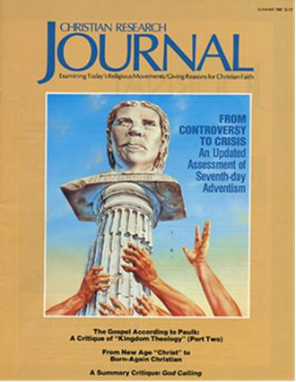
The Real Underlying Issues?
Notes:
**** READ THIS BEFORE CLICKING ON SLIDE
Kenneth R. Sample worked along side Walter R. Martin for many years, Martin being Sample’s mentor. When Walter Martin died or was no longer in good enough health to work, Sample was commisioned to write a follow up and Adventism and how far they had come in truly becoming Evangelical. His lead article in Christian Research Journals, dealt with all the theological issues that Adventist and Evangelicals had discussed, but notice what front cover illustration was picked for this 1988 issue:

Slide 45
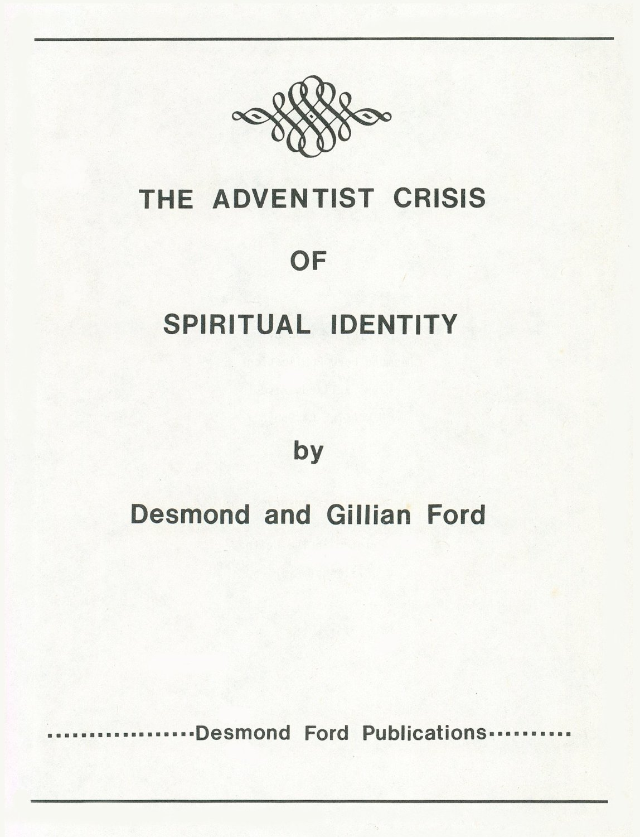
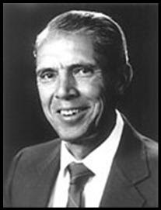
The Effect of Evangelical Dialog?
Desmond Ford
Notes:
Desmond Ford became the link between QOD and the theological upheaval in Adventism in the 1970s and 1980s, and to our present day.

Slide 46
The Effect of Evangelical Dialog?
“The [R. R.] Figuhr administration of the Church in the 1950’s marked an era of increasing openness toward new ideas and approaches by Seventh-day Adventism. Walter Martin came to Takoma Park, Washington, DC with his inquiries and found hospitality, cooperation and comparative frankness. As a result, Questions on Doctrine, was published, undoubtedly the greatest forward step theologically in decades.
“For the first time in Adventist history, leaders repudiated the sinful nature of Christ concept, the exclusive remnant church theology, sectarian bias against other Christian bodies, the ceremonial uncleanness basis for abstaining from certain foods, literalistic extremes regarding the heavenly sanctuary, etc. With great emphasis the book rejected the idea that the Ellen G. White writings had doctrinal authority, and the Protestant position of ‘the Bible only’ was strongly affirmed.” (cont.)
Notes:
This is how Desmond Ford would later describe the meetings which led to Questions on Doctrine. He praised this move as that which began to free Adventism from some of its heretical doctrines.

Slide 47
The Effect of Evangelical Dialog?
“The center of the earthquake, however, is a doctrinal one—the gospel and the sanctuary. [1] That the Pauline righteousness by faith is the technical term for justification alone, [2] that Christ’s human nature was spiritually like that of Adam before the fall, [3] that believers have the verdict of the Last Judgment the moment they believe and for as long as they believe, and [4] that the investigative judgment has no basis in Scripture, nor the date 1844—these revelations have left many reeling and dazed, while having an opposite impact on others who are worshipping in the same pews. The new doctrinal convictions have also aroused interest in the New Testament teaching on church government and the priesthood of all believers.” (Desmond and Gillian Ford, The Adventist Crisis of Spiritual Identity [Newcastle, CA: Desmond Ford Publications, 1982], pp. 20, 3-5; bracketed numbers added)
Notes:
This is how Desmond Ford would later summarize the main issues Evangelicals had and which he now had with Adventism. All of these were directly related to the Evangelical dialog which took place during the 1950s and 1960s.
Thus Ford would side with Martin and Barnhouse’s issues against Adventism! This book which was originally written in 1982, is still being sold on Amazon Kindle at: http://www.amazon.com/The-Adventist-Crisis-Spiritual-Identity-ebook/dp/B00BBZAZFS

Slide 48


The Effect of Evangelical Dialog?
Geoffrey Paxton
Notes:
Geoffrey Paxton, non Adventist Anglican minister from Australia, sided with Desmond Ford in identifying the same four key concerns with historic Adventist doctrine. They were the same issues as Barnhouse and Martin had brought against the church some 20 years before. Paxton rejoiced that Adventism was, in some circles, now coming around to a new Evangelical understanding of the plan of Salvation. He was actively involved in promoting Desmond Ford theology amongst Adventists and spoke before Adventist congregations in the 1970s.

Slide 49
The Effect of Evangelical Dialog?
“Belief that both the destiny of the Church and its preparation of the world for Christ’s long-delayed second advent hinge upon a true conception of righteousness by faith, demands the commitment of every effort to expose what is seen as serious confusion regarding this heart of the gospel. Affirmation of the doctrine of original sin underlies each of the three primary challenges to traditional Adventist theology: 1) repudiation of perfectionism, 2) denial of Christ’s assumption of sinful flesh, and 3) restriction of the doctrine of justification by faith to strictly forensic, objective factors.” (cont.)

Slide 50
The Effect of Evangelical Dialog?
“As we have already noted, Ford was explicit in his affirmation of the doctrine of original sin. He taught this consistently through the 1960’s and into the 1970’s. Ford also [1] strongly repudiated perfectionism as being contrary to the gospel. Likewise, [2] he maintained the Protestant view of forensic justification and [3] the Protestant stance on the sinlessness of Christ’s human nature. . . . Thus, it would not be far from the truth to say that, already in the 1960’s, Dr. Ford anticipated the clear Reformation stream that was to emerge within Adventism in the 1970’s.” (Geoffrey Paxton, The Shaking of Adventism (1977), pp. 20, 117)

Slide 51

The Effect of Evangelical Dialog?
Kenneth R. Samples
Notes:
Kenneth R. Samples worked along side Walter R. Martin for many years, Martin being Samples’ mentor. Before Walter Martin died, and was no longer in good enough health to work, Samples was commissioned to write a follow up about Adventism and how far they had truly come in becoming Evangelical Christians. His lead article in Christian Research Journals, dealt with all the theological issues that Adventist and Evangelicals had discussed in the 1950s and unscored the four main issues still troubling Adventism, with the issue of the inspiration of Ellen White underscoring all of them.

Slide 52
The Effect of Evangelical Dialog?
“The roots of Evangelical Adventism can certainly be traced to the Adventist scholars who dialogued with Barnhouse and Martin. When QOD repudiated such commonly held traditional doctrines as the sinful nature of Christ, literalistic extremes of the heavenly sanctuary, and the writings of Ellen White as an infallible doctrinal authority, they laid a critical foundation for those who would later carry the torch for this reform movement.” (Kenneth R. Sample, “From Controversy to Crisis: An Updated Assessment of Seventh-day Adventism,” Christian Research Journal, Summer 1988, Volume 11, No. 1, p. 9)
Notes:
1 of 3 slides
Notice how Samples summarizes again, in slightly different words, the issues that were raised with Barnhouse and Martin, published in Questions on Doctrines (QOD), and promoted by Ford, Brinsmead, and McMahon, with the support of Paxton, and now in 1988 by many other SDA ministers and administrators.

Slide 53
The Effect of Evangelical Dialog?
“There were also a good number of American Adventist scholars who were sympathetic to the Brinsmead/Ford position. The major doctrinal issues which united this group were:
1) Righteousness by faith: This group accepted the reformation understanding of righteousness by faith (according to which righteousness by faith includes justification only…)
2) The human nature of Christ: Jesus Christ possessed a sinless human nature…. Though Christ certainly suffered the limitations of a real man, by nature He was impeccable (i.e., incapable of sin). Jesus was primarily our substitute. (cont.)
Notes:
2 of 3 slides
In the same article Samples is very specific of the 4 main theological issues, with the underlying concern of removing the influence and authority of the writings of Ellen White, the SOP. He clearly sides with Desmond Ford whom he sees as the redeemer of Adventist theology. Of course, as with Barnhouse and Martin, all of Samples theological concerns with Adventism are built upon the Augustinian doctrine of Original Sin.

Slide 54
The Effect of Evangelical Dialog?
“3) The events of 1844: Jesus Christ entered into the most holy place (heaven itself) at His ascension; the sanctuary doctrine and the investigative judgment (traditional literalism and perfectionism) have no basis in Scripture.
4) Assurance of salvation: Our standing and assurance before God rest solely in Christ's imputed righteousness; sinless perfection is not possible this side of heaven….
5) Authority of Ellen G. White: Ellen White was a genuine Christian who possessed a gift of prophecy. However, neither she nor her writings are infallible, and they should not be used as a doctrinal authority.” (Kenneth R. Sample, “From Controversy to Crisis: An Updated Assessment of Seventh-day Adventism,” Christian Research Journal, Summer 1988, Volume 11, No. 1, pp. 9-)
Notes:
In the same article Samples is very specific of the 4 main theological issues, with the underlying concern of removing the influence and authority of the writings of Ellen White, the SOP. He clearly sides with Desmond Ford whom he sees as the redeemer of Adventist theology.
Numbers 3 and 4 are one and the same issue dealing with perfection and an endtime generation.
Number 5, the authority of Ellen White, is stated such because the idea is that the Bible does not support the above 4 false doctrines, but have come from Ellen White instead. However, Ellen White’s authority is not found in creating such doctrines but in pointing to the truth of such teachings in the Bible.

Slide 55
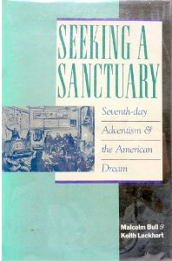

The Effect of Evangelical Dialog?
Keith Lockhart
Malcolm Bull
Notes:
Still trying to find a picture of Keith Lockhart. Not 100% certain this is a picture of the author Malcolm Bull.
Malcolm Bull and Keith Lockhart, Seeking a Sanctuary: Seventh-day Adventism and the American Dream, [1982], written by non-Adventist and ex-Adventist authors. They have a leaning toward Desmond Ford theology but write objectively on some issues within Adventism. See interview of Keith Lockhart on Spectrum blog: http://spectrummagazine.org/node/3059

Slide 56
The Effect of Evangelical Dialog?
“A multitude of factors contributed to Ford’s rejection of the Sanctuary doctrine. A biblical scholar with a particular interest in the book of Daniel, Ford found the traditional Adventist interpretation of certain crucial texts unsatisfactory. The influence of Ellen White had been undermined by the historical research of the 1970s, with the result that Ford, himself an Ellen White enthusiast, felt able to qualify the scope of her authority in the light of her ‘error’ on the Sanctuary question.
“But the root of his attack on the doctrine was his conviction that the blotting out of individual sins is no part of salvation history. Ford took the implications of Question on Doctrine to their logical conclusion. If the atonement was completed on the cross, then the sanctuary can only mediate its benefits to humans. If Christ did not have a fallen human nature, then there is no precedent for the perfection of humans.” (cont.)
Notes:
Notice how the authors link the trajectory of Desmond Ford to the undermining of the Spirit of Prophecy in Adventist education following dialog with Evangelicals in the 1950s which led to QOD.
(Malcolm Bull and Keith Lockhart, Seeking a Sanctuary: Seventh-day Adventism and the American Dream, [1982], non Adventist.)

Slide 57
The Effect of Evangelical Dialog?
“Thus the benefits of the atonement mediated to men and women in the sanctuary service cannot be such as to bring them to perfection. If they are not brought to perfection, they are saved as sinners. If they are saved as sinners, their sins do not need to be individually eradicated. There are thus no supplementary benefits of the atonement that need to be mediated to humans, and the heavenly ministry of Christ becomes superfluous.”
“The sequence of events that leads from Question on Doctrine to the dismissal of Desmond Ford is a remarkable example of the way in which a web of theological ideas can unravel once a single thread has been cut.” (Malcolm Bull and Keith Lockhart, Seeking a Sanctuary: Seventh-day Adventism and the American Dream [Bloomington, IN: Indiana University Press, 2nd edition, 2007], pp. 88-89).
Notes:
The logical conclusion of the Evangelical dialog which brought Questions on Doctrine, which in turn spawned the Desmond Ford movement, ultimately did away with the need for a most holy place ministry of Christ in a cleansing of the sanctuary. What are the results of such a change in Adventist doctrine? How does this relate to what Ellen White saw in her vision recorded in Early Writings, contrasting those who worshiped at the throne in the Holy Place with those who followed Christ into the Most Holy Place? (p. 54-56)

Slide 58

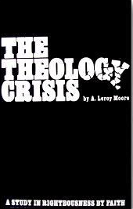
The Effect of Evangelical Dialog?
A. LeRoy Moore
Notes:
A. LeRoy Moore played a pivotal role in turning the tide during the discussions between Desmond Ford and church leaders, by the submission of his thesis “The Theology Crisis.” Here too Moore clearly identified the same four key issues that had arisen with Evangelicals and now were being pushed by Desmond Ford, Robert Brinsmead, Geoffrey Paxton, David McMahon and company, into what many felt was an unprepared and unsuspecting church.

Slide 59
The Effect of Evangelical Dialog?
“Advocated first in Australia by Brinsmead and Ford during the early 1970s and, following a period of insemination by way of Brinsmead’s Present Truth, this view has been vigorously promoted in the U. S. by Ford; the primary Reformationist charge is that the doctrine of righteousness by faith has been confused in the SDA church by the denial of the doctrine of original sin. This, they hold, has given rise to three related heresies: a) that the gospel includes sanctification as well as justification; b) that Christ took the fallen nature of Adam; and c) a ‘final generation’ must develop perfect characters before Christ’s return.” (A. Leroy Moore, Theology in Crisis, p. 23)
Notes:
Moore identified the 4 main areas of theological disagreement that developed following dialog with Evangelicals in the 1950s, which were now being pushed by so called Reformationist Adventists.

Slide 60
The Ultimate Effect of Evangelical Dialog?
Rewriting Adventist History to Fit the New Evangelical Understanding of the End-time Adventist Message

Slide 61
Objections to A. G. Daniells’
Christ Our Righteousness
“With [A. G.] Daniells, Reformationists contend that the [1888] message [of righteousness by faith] has never been accepted, and identify it with the loud cry….
“Significantly, Daniells is seen [by Desmond Ford, Geoffrey Paxton and SDA Reformationists] not to have transmitted the light of righteousness by faith, but Jones-Waggoner error; thus, together with Andreasen, introducing the ‘omega’ of apostasy, concerning which [Ellen] White warned in 1904.”* (A. Leroy Moore, Theology in Crisis, pp. 293, 294).
Notes:
Moore was one of the first to note that Adventist Reformationist were re-writing history to fit their new theological perspectives, and linking supposed error from Jones and Waggoner through Daniells and M. L. Andreasen to Adventism in the 20th century. This of course brought into question Ellen White’s endorsements of Jones and Waggoner, but the new views of Ellen White and her inspiration coming into the church would alleviate any concern over what some have considered her questionable endorsements.
* See Desmond Ford Palmdale “Documents, p. 32[?],” Paxton’s Shaking of Adventism, pp. 70, 75, 140.

Slide 62
The Ultimate Effect of Evangelical Dialog?
“Considering themselves to be the true proponents of righteousness by faith, Reformationists hold that Jones and Waggoner, acknowledged 1888 exponents of that message, embedded four heresies in SDA doctrine: [1] rejection of the historic doctrine of original sin; [2] inclusion of sanctification in righteousness by faith; [3] claiming that Christ connected sinful flesh with His own sinless nature; [4] and holding the doctrine of perfection.
“[Ellen] White’s unusual endorsement of Jones and Waggoner, whose earliest printed works reflect the above concepts [as truth not heresy], requires overwhelming evidence to prove that she recognized their theological errors immediately after Minneapolis, reflecting Roman Catholic heresy. Developments before, during and after Minneapolis deny such claims.” (A. Leroy Moore, Theology in Crisis, p. 294)
Notes:
Desmond Ford
Robert Brinsmead
David McMahon
Burt Haloviak
George Knight
Woodrow Whidden
All the above have presented the ideas as described by Moore in their writings.

Slide 63
The Ultimate Effect of Evangelical Dialog?
Claims in Regard to Jones & Waggoner
Toward the end of the dark ages, God sent the Reformation as a full revelation of the plan of salvation.
The significance of 1844 is that it represents the date at which God raised up an end time people to share the Reformation Gospel combined with the Sabbath truth, the law, the immortality of the soul, etc., with the world.
Adventism got sidetracked on the law and became very legalistic.
God sent a message in 1888 through Jones and Waggoner who were errant from day one, but it was the best God could find.
The “1888 message” is what was shared at Minneapolis only, not what was shared in 1889, 1893, 1895, etc.
Notes:
Revisionist writers of Adventist history have summarized the 1844 and 1888 history as follows. 1 of 4 slides.

Slide 64
The Ultimate Effect of Evangelical Dialog?
Claims in Regard to Jones & Waggoner
Soon after the Minneapolis meetings in 1888, which Ellen White endorsed, Jones and Waggoner began to include elements of false doctrines. Their aberrant theology began with a confusion over the nature of man and sin which spread into four theological areas:
  A Denial of Original Sin
  The teaching that Christ took a fallen sinful nature
  That justification and sanctification make up righteousness by faith, which also “makes” a person righteous.
  All the above lead to the teaching perfectionism, and an end time generation concept.
Notes:
Revisionist writers of Adventist history have summarized the 1844 and 1888 history as follows. 2 of 4 slides.

Slide 65
The Ultimate Effect of Evangelical Dialog?
Claims in Regard to Jones & Waggoner
Also, Jones especially imbibed the concept of verbal inspiration by attributing inspiration authority to Ellen White.
The four main heresies mentioned above are seen as early as the 1889 campmeetings in Jones and Waggoner’s teachings. The heresies from Jones resulted in the Holy Flesh movement. The heresies from Waggoner resulted in Pantheism, the alpha apostasy.
These fundamental errors of Jones and Waggoner were passed on to the church through A. G. Daniells and M. L. Andreasen, bringing the church to a crisis in 1950.
Questions on Doctrine, helped free Adventism from these four main heresies and the misuse of Ellen White.
Notes:
Revisionist writers of Adventist history have summarized the 1844 and 1888 history as follows. 3 of 4 slides.

Slide 66
The Ultimate Effect of Evangelical Dialog?
Claims in Regard to Jones & Waggoner
The resurrection of the teachings of Jones and Waggoner, including their main theological heresies, ultimately constitutes the Omega apostasy.
Notes:
Revisionist writers of Adventist history have summarized the 1844 and 1888 history as follows. 4 of 4 slides.
Desmond Ford wrote a paper, “The Doctrinal Decline of Dr. E. J. Waggoner: Its Relationship to the Omega Apostasy,” which expressed these concepts. They have been echoed by others, although not as explicitly.

Slide 67
Areas of Disagreement?
1. Application of Ellen White’s Remarks Related to 1888?
3. Ellen White’s Endorsements of Jones and Waggoner?
4. Historic Accuracy?
Notes:
I was asked to present here at Andrews addressing 3 of the 10 areas of disagreement found in the Primacy of the Gospel Committee’s majority report. The past three presentations are my “Introduction” to these 3 areas of disagreement. And Here is why! How we answer the questions in regard to these disagreements all depends on which river of thought we have subscribed to. How have we as a church answered these 3 questions over the past three generations, now going on four?

