Slide 1

Two Rivers of Thought Flowing Out of 1888:
Application of Ellen White’s Comments Relative to 1888?
Ellen White’s Endorsements of Jones & Waggoner?
Historical Accuracy Relative to 1888?
Part 2
Gospel Study Group, October 10-11, 2014
Ron Duffield

Slide 2
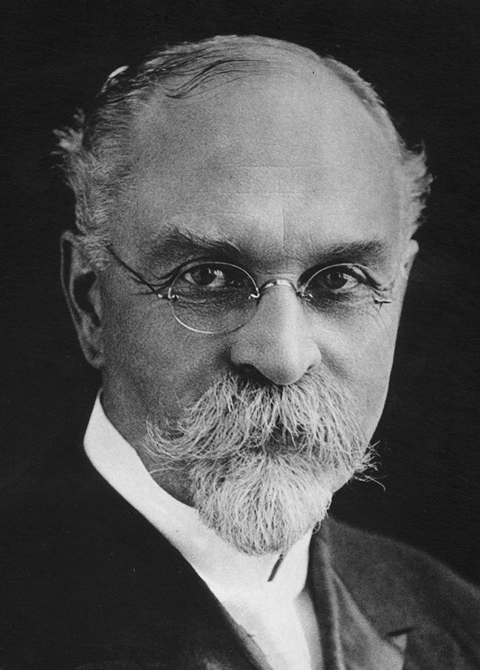
Christ Our Righteousness
A. G. Daniells
Notes:
We will now take a look at the 2nd generation of Adventists post 1888 (3rd generation since 1844). How did they do answering the three questions we have been looking at?
In 1924, nine years after the death of Ellen White, the Ministerial Association Advisory Council voted to have Elder A. G. Daniells, former General Conference President, arrange a compilation of her writings on the subject of justification by faith.

Slide 3

Christ Our Righteousness
Notes:
As A. G. Daniells began his “exhaustive research,” he was “amazed and awed at the solemn obligation resting” upon him. This study of the subject of righteousness by faith from the writings of Ellen White led Daniells to the “settled conviction” that her instruction presented “two aspects: primarily, the great amazing fact that by faith in the Son of God sinners may receive the righteousness of God; and secondarily, the purpose and providence of God in sending the specific message of receiving the righteousness of God by faith to His people assembled in General Conference in the city of Minneapolis, Minnesota, in the year 1888.”

Slide 4
Christ Our Righteousness
“How sad, how deeply regrettable, it is that this message of righteousness in Christ should, at the time of its coming, have met with opposition on the part of earnest, well-meaning men in the cause of God! The message has never been received, nor proclaimed, nor given free course as it should have been in order to convey to the church the measureless blessings that were wrapped within it.
“The seriousness of exerting such an influence is indicated through the reproofs that were given. These words of reproof and admonition should receive most thoughtful consideration at this time [in 1926].…” (cont.)
Notes:
Quoting from Ellen White’s November 22, 1892, Review article and Early Writings, 85 and 86, Daniells concluded that it “places the latter rain visitation with the loud cry, the revelation of the righteousness of Christ, and the flooding of the earth with the light of the third angel’s message.” It was evident to Daniells that “the beginning, or opening, of all these events is at the same time. The appearance of one is a signal for all to appear.” (Christ Our Righteousness, p. 62). Yet, as Daniells surveyed the thirty-eight years since the Minneapolis message, he was led to a sorrowful conclusion:

Slide 5
Christ Our Righteousness
“O that we had all listened as we should to both warning and appeal as they came to us in that seemingly strange, yet impressive, way at the Conference of 1888! What uncertainty would have been removed, what wanderings and defeats and losses would have been prevented! What light and blessing and triumph and progress would have come to us!” (Arthur G. Daniells, Christ Our Righteousness, pp. 47, 69).

Slide 6
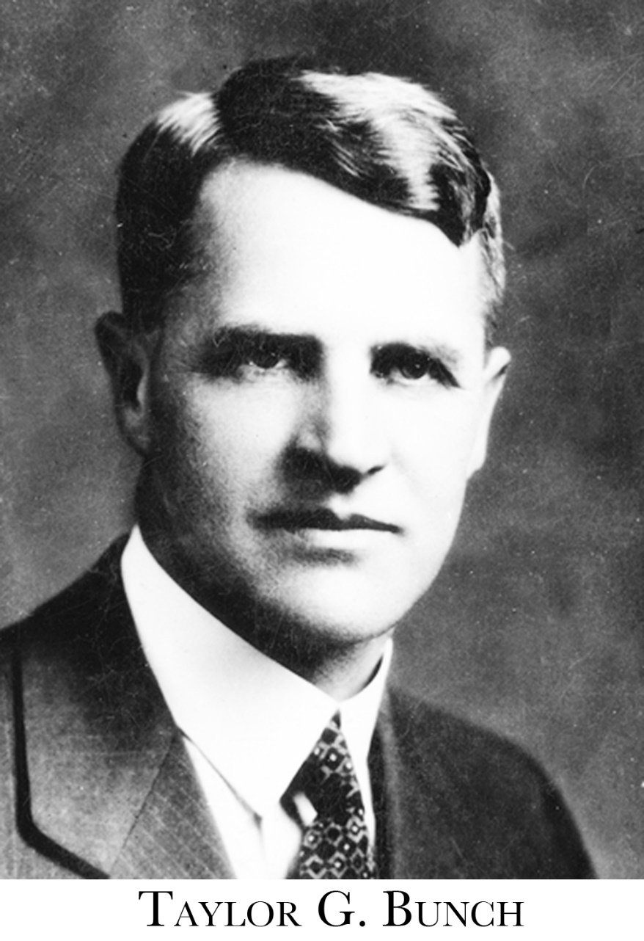
Forty Years in the Wilderness
Notes:
Only a few years after Daniells’ book was printed, Taylor Bunch, pastor, Bible teacher, and author, produced a pamphlet titled, Forty Years in the Wilderness in Type and Antitype, which put forth similar views on the latter rain and loud cry. In this pamphlet, Bunch presents the parallels between the Seventh-day Adventist Church and the children of Israel in their journey from Egypt to Canaan.

Slide 7

Forty Years in the Wilderness!
Notes:
The small 40 page pamphlet was printed in 1928 after Bunch had read Daniells’ book Christ our Righteousness and studied more deeply into the subject. The first 10 pages Bunch spends on the story of Egypt to Kadesh-barnea. Then he makes the following observation:

Slide 8
Forty Years in the Wilderness
“The Advent movement reached its Kadesh-barnea at the Minneapolis General Conference in the fall of 1888. For two or three years previous to that notable gathering, the Lord, through the Spirit of Prophecy, sent message after message to this people, declaring that they were on the boarders of the heavenly Canaan and calling for a great spiritual awakening in preparation for the coming of Christ….”
“From the above statement [TM 91, 92] it is evident that the Lord intended to pour out His spirit in the latter rain and quickly finish the work. This is also evident from the statement in the Review and Herald of November 22, 1892.” (Taylor G. Bunch, Forty Years in the Wilderness: In Type and Antitype, pp. 10-11, 12) (cont.)
Notes:
The pamphlet was most likely printed in 1928 after Bunch had read Daniells’ book Christ our Righteousness. The first 10 pages Bunch spends on the story of Egypt to Kadesh-barnea. Then he makes the following observation: 1 of 5 slides.
“The Lord in His great mercy sent a most precious message to His people through Elders Waggoner and Jones. This message was to bring more prominently before the world the uplifted Saviour, the sacrifice for the sins of the whole world. It presented justification through faith in the Surety; it invited the people to receive the righteousness of Christ, which is made manifest in obedience to all the commandments of God.” (TM 91-92)
“The time of test is just upon us, for the loud cry of the third angel has already begun in the revelation of the righteousness of Christ, the sin-pardoning Redeemer. This is the beginning of the light of the angel whose glory shall fill the whole earth.” (RH Nov. 22, 1892)

Slide 9
Forty Years in the Wilderness
“But many began to fear fanaticism and the [1888] meeting that began with a signal manifestation of God’s presence and blessings ended in wrangling and confusion. Many felt that the message being given was a departure from the good old doctrines that had made us a people and they rejected it. (See Christ Our Righteousness, pp. 63-68).
“In Testimonies to Ministers, pp. 89-98, is a chapter entitled ‘Rejecting the Light,’ and contains a most scathing rebuke to those who rejected the message. It must have been as terrible in the sight of the Lord as the rebellion at Kadesh-barnea, for it resulted in the same punishment, a turning back into the wilderness….”(Taylor G. Bunch, Forty Years in the Wilderness: In Type and Antitype, p. 12) (cont.)
Notes:
2 of 5 slides
Notice how Bunch speaks of rejection, but does not apply it here to “Denominational” rejection which seems to infer an action on the part of church leadership. But it was rejection by many of the leaders which, like with the 10 spies, lead to the whole nation being held responsible for the rebellion that followed.

Slide 10
Forty Years in the Wilderness
“Because of their unbelief manifested in the rejection of the message sent to prepare them for the heavenly Canaan, the Lord had to alter His purpose and turn the Advent people back into the wilderness of sin till they learn the lesson of faith….”
“It is very evident that the rejection of God’s special message in 1888, which resulted in the altering of His purpose to take His people directly into the promised land, marked the beginning of a spiritual retreat toward the world or Egypt….”
“Like ancient Israel after being turned back from Kadesh-barnea, the Advent movement did not go all the way back to Egypt or the world. But they have gone a long way and there have remained in the Laodicean condition, neither going back into the world nor progressing towards the heavenly Canaan, but wondering about in the wilderness,…”(Taylor G. Bunch, Forty Years in the Wilderness: In Type and Antitype, pp. 15, 17, 18) (cont.)
Notes:
3 of 5 slides

Slide 11
Forty Years in the Wilderness
“In like manner, notwithstanding modern Israel’s wilderness wandering in the awful Laodicean condition, the Lord loves the remnant of the church above all people, for they are His chosen people, and He will not forsake them nor start a new movement. He will finally purge out the rebels and take the movement through to the heavenly Canaan….”
“Now as we are nearing the end of our wilderness wandering, how cheering is the heaven sent message,… The Lord is again giving to this people the message of 1888, calling for a spiritual revival and a reformation of true godliness and exalting the righteousness of Christ as the only hope of victory. How cheering this message should be to modern Israel, showing as it does that we are nearing the end of our pilgrimage and that the Lord has set His hand to finish His work and deliver His people….” (Taylor G. Bunch, Forty Years in the Wilderness: In Type and Antitype, pp. 21-22) (cont.)
Notes:
4 of 5 slides
Yet it was very clear that Bunch, unlike offshoots, did not consider the SDA church abandoned by God.

Slide 12
Forty Years in the Wilderness
“The present message of righteousness by faith and calling attention to Christ and Calvary is another sign that we are again on the borders of the heavenly Canaan. On the banks of the Jordan the history of God’s dealing with Israel during the forty years were reviewed and all the instruction given through Moses…. He made it clear why they had been kept out of the promised land so long. Things that had puzzled them before were now made plain. Repenting of their past mistakes they set their faces with renewed hope and courage toward Canaan.”
“The time has come for the Advent people to carefully review their past history and profit by the mistakes made. Especially should we study the 1888 experience and learn the reasons for our wilderness wanderings.” (Taylor G. Bunch, Forty Years in the Wilderness: In Type and Antitype, pp. 26-27) (cont.)
Notes:
5 of 5 slides.
Clearly he saw the need for a church-wide acknowledgement of the past.

Slide 13

From Egypt to Canaan
Notes:
Several years later in 1937, Bunch presented a series of thirty-six sermons at the Battle Creek Tabernacle during the Sabbath afternoon vesper services. These sermons were published in book form under the title The Exodus and Advent Movement in Type and Antitype, for “the special accommodation of those who heard them, and also because of requests from ministers and other gospel workers who desire them.” This series was an expanded version of Bunch’s early pamphlet. The book being over 100 pages, 8.5 x 11 single space.

Slide 14
Forty Years in the Wilderness
“Through the efforts of Satan the glorious message that began in 1888 at the Minneapolis General Conference was made of none effect. It was rejected and despised by many, and while others acknowledged it to be true they failed to take it to heart and enter into the experience of righteousness by faith. This is paramount to a rejection….”
“To assent to the truthfulness of a message and not act upon it is equivalent to a rejection. A message that is not accepted is rejected even though it may be acknowledged as the truth.” (Taylor G. Bunch, The Exodus and Advent Movements in Type and Antitype, p. 97) (cont.)
Notes:
1 of 3 slides.
Again, Bunch does not state this as “denominational“ rejection as was later claimed.

Slide 15
Forty Years in the Wilderness
“The message of righteousness by faith was preached with power for more than ten years during which time the Minneapolis crisis was kept before the leaders. This message brought the beginning of the latter rain [quotes EGW Review and Herald Nov. 22, 1892 statement]”
“Why did not the latter rain continue to fall? Because the message that brought it ceased to be preached. It was rejected by many and it soon died out of the experience of the Advent people and the loud cry died with it. It can begin again only when the message that brought it then is revived and accepted.” (Taylor G. Bunch, The Exodus and Advent Movements in Type and Antitype, p. 107) (cont.)
Notes:
2 of 3 slides.

Slide 16
Forty Years in the Wilderness
“Since ‘we are repeating the history of that people,’ we too must get a vision of the past just before our pilgrim journey is ended. Just before the end, the Advent people will review their past history and see it in a new light. … We must study and understand the antitypes of the two Kadesh-Barnea experiences of ancient Israel and profit by the mistakes of our fathers especially during the 1888 crisis.”
“We must acknowledge and confess the mistakes of our fathers and see to it that we do not repeat them and thus further delay the final triumph of the Advent Movement. The history of the past must be reviewed and studied in the light of these mistakes and their consequence in a long delay of the coming of Christ. Such a vision will explain many puzzling questions and will greatly strengthen our faith in the divine leadership of the Advent Movement.” (Taylor G. Bunch, The Exodus and Advent Movements in Type and Antitype, p. 168)
Notes:
3 of 3 slides.
Again, a realization of the past so that we can move forward with the future.

Slide 17
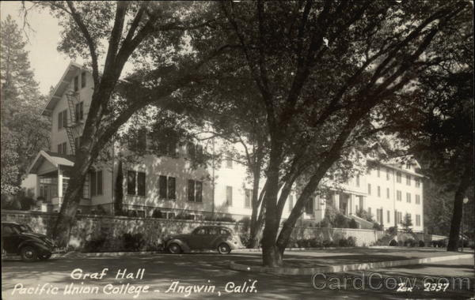
PUC Week of Prayer 1930
Notes:
Seven years earlier, with the help of his wife, Taylor Bunch presented the fall and spring weeks of prayer at Pacific Union College during the 1930-1931 school year, where he presented the subject matter from his pamphlet. November 16-22 (Pacific Union Recorder, Nov. 27, 1930, p. 2). The Spring session was written up in the Review with mention of the fall week of prayer as well (May 21, 1931, pp. 24-25)

Slide 18
Forty Years in the Wilderness
“The Lord came very near during these occasions, and by His Spirit witnessed to the timeliness of the Laodicean message. Special emphasis was placed upon the remedy for the Laodicean condition, and the results that will follow a personal application and acceptance of the counsel of the True Witness….
“The spirit of repentance and confession gave evidence of the genuineness of the revival that swept through the school. No appeal was made to human emotions, but as the Saviour was uplifted in the beauty of His imputed and imparted righteousness, the Holy Spirit came in and touched the sacred emotions of the heart.” (Taylor G. and Mrs. Bunch, “Pacific Union College,” Review and Herald, May 21, 1931, p. 25)
Notes:
Article written by both Taylor and his wife following Spring Week of Prayer. There appeared to be a true revival as students moved to reach the unconverted on and off campus.

Slide 19
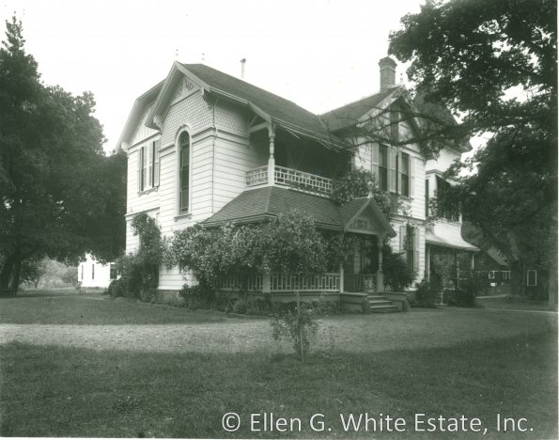
Response From the White Estate
Notes:
The White Estate was at the time located in Elmshaven and it didn’t take long before word made its way down the White Estate and questions arose in regard to 1888 and the message of righteousness by faith and the possible rejection and delay of Christ’s coming.

Slide 20
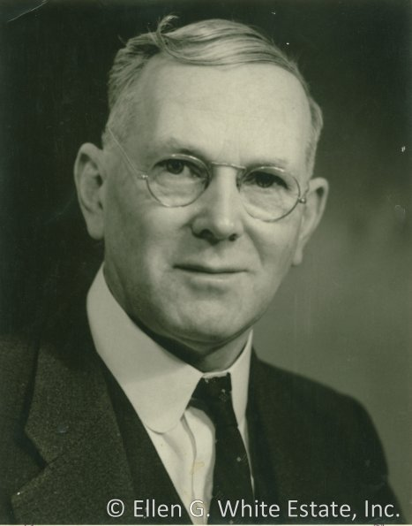
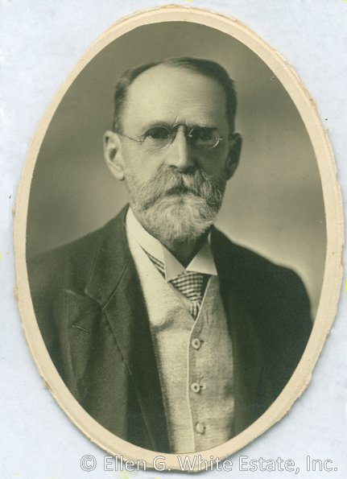
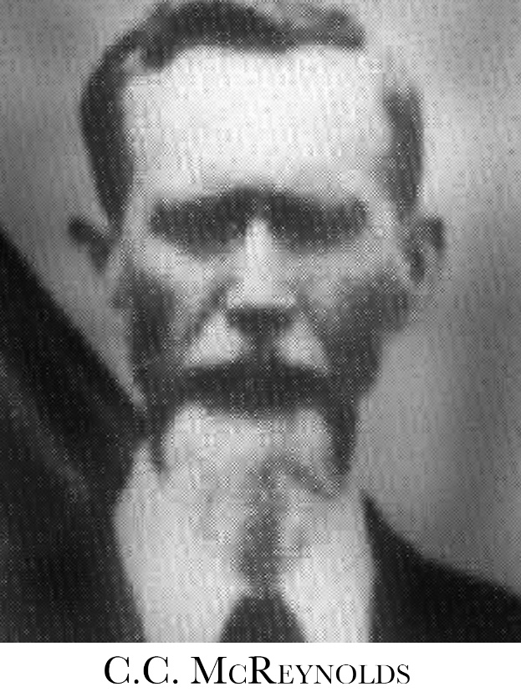
Response From the White Estate
D. E. Robinson
C. C. McReynolds
A. T. Robinson
Notes:
D. E. Robinson, one of the White Estate staff, was first to write to Taylor, and although writing cordially, took exception to several of Bunch’s comparisons and conclusions between ancient Israel and the Advent movement. This began an era of seeking to free Adventism from charges that the 1888 rejection/resistance and years following, had brought about a delay in Christ’s return. D. E. Robinson had not attended 1888 Conference, as his father A. T. and C. C. McReynolds had

Slide 21
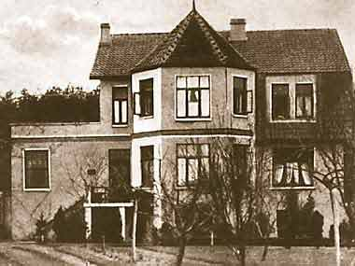
SDA Reform Movement
Things We Ought to Know
Notes:
BUT BEFORE WE MOVE ON WE NEED TO TAKE NOTE OF THE FOLLOWING.
(In 1926, the SDA Reform General Conference office was installed in this building, Isernhagen, near Hannover, Germany)
In light of D. E. Robinson’s response we would do well to try and understand why he and others in the years that followed sought to make 1888 out as a victory and thus defend the church from what they felt were false accusations. The Seventh-day Adventist Reform movement started primarily as a result of issues in Germany surrounding World War I (1914-1915). By July 1925, after some failed attempts at reconciliation, the SDA Reform movement was officially organized. In July, 1929, the movement was officially Incorporated. Although not stated during the beginning controversy in 1915, by the mid 1920s the Reform movement in print, pointed back to 1888 as the time when “the first open opposition and rejection of the message of righteousness” took place and was “at that time rejected by the leaders” (D. Nicolici, The History of the Seventh-Day Adventist Church, c.1923, p. 9).
In the minds of the SDA Reform leaders this led to the church’s complete downfall and ultimately to becoming part of Babylon in 1903, thus their excuse to separate from it. D. E. Robinson had personally dealt with the SDA Reform movement in an article published in the Advent Review and Sabbath Herald, May 22, 1930, titled: “Has the Seventh-day Adventist Church Become Babylon?” This was just a few months before Taylor Bunch presented his series at the week-of-prayer meetings at Pacific Union College, which must have caused D. E. Robinson to fear Bunch was presenting ideas that would cause others to go to such extremes.
It was the same with other movements: As a Sabbath school teacher Houteff began advancing his peculiar and erroneous ideas during the years of 1928 and 1929, and produced his book, The Shepherd’s Rod, in the spring of 1930 in which he discussed the subject of the 144,000. He would also suggest that 1888 was the beginning time at which Adventism became Babylon. (see: Taylor R. Bunch, “The Sealing and the Latter Rain,” unpublished document, n.d., pp. 25-26)
1937 Taylor Bunch presented his series of meetings comparing Adventism and Ancient Israel at the Battle Creek Tabernacle. 1937 the Roger’s Brothers began their work “Christ Our Righteousness Church” claiming the church rejected RbF in 1888 and became Babylon. They soon started a church in Auburn WA.
Norval Pease happened to move to Auburn WA as Pastor and Bible teacher at Auburn Academy in 1937. He wrote his Master’s thesis in 1945 from which was later published his book By Faith Alone (See paper “Robert J. Wieland Before 1888 Re-examined and Some of His Effect on Adventists,” appendix B, p. 34-36; NPUGleaner, March 16, 1937, p. 3).
“My interest in this topic was first stimulated in 1937 when, as a young pastor, I was confronted with the claims of a splinter organization that taught the theory that the Seventh-day Adventist Church rejected the doctrine of justification by faith in 1888.” (Norval Pease, By Faith Alone [1962], p. x-xi)
L. H. Christian, who would later write a defensive history of Adventism (The Fruitage of Spiritual Gifts, 1947) worked with SDA Reform in mid 1920s: “Others involved in working with SDA Reform: After the war, the Seventh-day Adventist church sent a delegation of four brethren from the General Conference (Arthur G. Daniells who was president of General Conference of Seventh-day Adventists, L. H. Christian, F. M. Wilcox, M. E. Kern) in July 1920, who came to a Ministerial Meeting in Friedensau with the hope of a reconciliation. Before the 200 Pastors and the Brethren from the General Conference present at this meeting, G. Dail, L. R. Conradi, H. F. Schuberth, and P. Drinhaus withdrew their statement about military service and apologized for what they had done. The Reformers were informed of this and the next day saw a meeting by the Adventist brethren with the Reform-Adventists. A. G. Daniells urged them to return to the Seventh-day Adventist church, but the Reform-Adventists maintained that the church leaders had forsaken the truth and the reconciliation failed.” (http://en.wikipedia.org/wiki/Seventh_Day_Adventist_Reform_Movement; accessed 10/3/2014)
Arthur Spalding dealt with Sheperd’s Rod and/or Roger’s Brothers who identified 1888 as starting point of Church becoming Babylon, which may have affected his views on 1888? He wrote his book Captains of the Host, 1949. He had the paper, "Shepherd's Rod" Propaganda. N.p.: General Conference Committee, Dec. 15, 1946, in his library collection.
SDA Reform Movement incorporated in the United States in Sacramento, California in April 1949. The 1950 General Conference was in San Francisco, CA where Wieland and Short presented their manuscript 1888 Re-Examined, summer of 1950.
Robert Brinsmead would start his fanatical perfectionistic movement in the late 1950s early 1960s and after obtaining portions of a retyped copy of 1888 Re-examined would reference 1888 and the works of Jones and Waggoner (See paper “Robert J. Wieland Before 1888 Re-examined and Some of His Effect on Adventists,” appendix B, p. 14-15)

Slide 22
SDA Reform Movement
Things We Aught to Know
“1888: The first open opposition and rejection of the message of righteousness came when it was told them a new era should commence in the history of the church. The message of Righteousness by Faith was at that time rejected by the leaders….”
[Following RH fire, Jan. 1903] “Since this [EGW] statement was made [1903] we find not repentance and reformation there, but a more pronounced condition of apostasy….”
“The Great War of 1914 was indeed a great crisis to the church of God for it tested them in an extreme measure. It proved leaders and people who took wrong positions and was the means of giving birth to the work of Reform in God’s own appointed way and time.” (D. Nicolici, “The History of the Seventh-Day Adventist Church,” [c1923], pp. 9, 17, 19)
Notes:
SDA Reform Quote about 1888 and Church becoming Babylon. (1923 book was written from Australia, my copy has some quotes from 1930 RH. Must be a later printing?) Here there seems to be no differentiation between those who accepted and those who rejected.

Slide 23
SDA Reform Movement
Things We Aught to Know
“As the great reformation carried on by Luther in the 16th century had actually had its beginning two centuries earlier (GC 78), so the prophesied Reform Movement among SDA’s, in existence today [1949], had its embryonic beginning in 1888, when the Lord sent the message of Christ’s Righteousness to the General Conference delegation assembled in Minneapolis, Minnesota, USA…. [TM 91-92 quoted] Unfortunately, the top leaders rejected this message and thereby offended the Spirit of God….”
“The Lord has always given the first opportunity to the leaders, but sad to say they missed the chance and ignored God’s call. And when a great crisis came to the church in 1914, it found them unprepared.” (“The SDA Reform Movement: Origin and Early Experiences,” [1949?], p. 3, 5)
Notes:
By 1949, the newly incorporated USA Reform Movement did not openly call the SDA Denomination Babylon, but still promoted the idea that 1888 was the beginning of the Reform Movement.

Slide 24
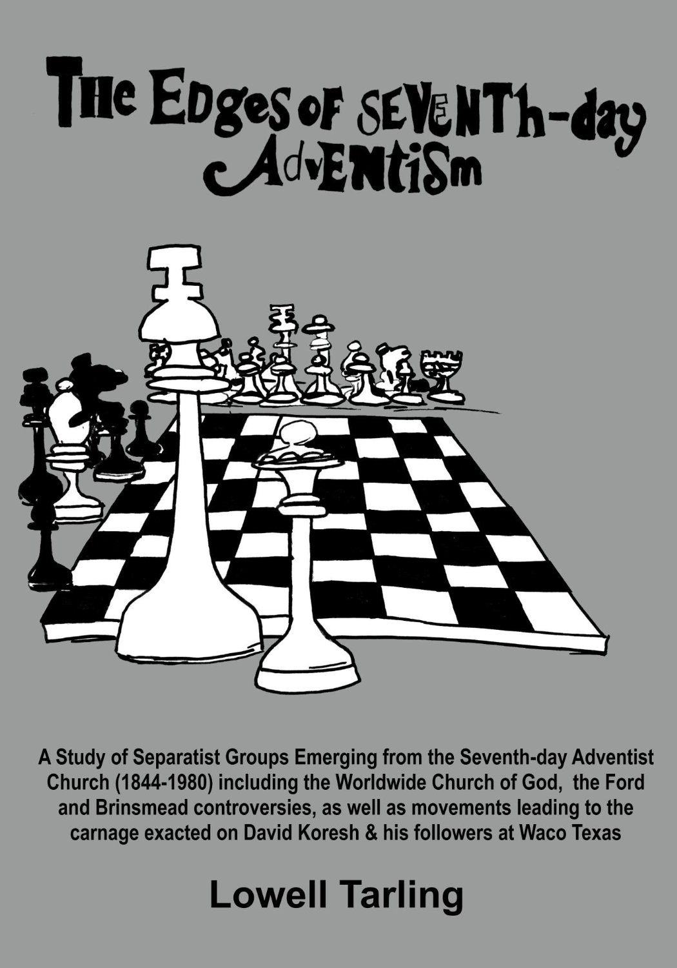
1888: When the Church Became Babylon?
Notes:
Notice how this author summarizes how most of the offshoot groups have used 1888 as their starting point. (author seems to be a Des Ford supporter from the positive way he speaks of the movement, but his insight on his point is worth taking notice).

Slide 25
1888: When the Church Became Babylon?
“These testimonies from Ellen White [1888 to 1892] have been interpreted by some as her saying that the Waggoner-Jones message of 1888 was completely rejected by the church hierarchy. The result of this - they say - is that the Holy Spirit is now withdrawn from the Seventh-day Adventist Church. Most of the movements which have separated from the church have used these quotations in this way.” (Lowell Tarling, The Edges of Seventh-day Adventism [1981], p . 161-162, emphasis supplied)

Slide 26
Response From the White Estate
D. E. Robinson
C. C. McReynolds
A. T. Robinson
Notes:
With the above in mind it will better help us understand why there seemed to be such a desire to defend the church against any accusation that all did not go well at Minneapolis. Now we will summarize the responses from those who sought to correct Taylor Bunch’s presentation of 1888 history and its results. This would set the stage for the next 20 years of depiction of Adventist history, especially in regard to 1888.

Slide 27
“The Temple of the Lord are We”
An attempt to blame the controversy at the Minneapolis Conference on a fatal flaw in the personalities of Jones and Waggoner and their doctrines.
An attempt to direct attention to Ellen White’s counsel to Jones and Waggoner, especially that in their years of departure from the church, that seeks to support the fatal flaw theory.
An attempt to marginalize the endorsements Ellen White gave of Jones and Waggoner and the message they brought. (“seemed”)
An attempt to prove that only “some” resisted/rejected the message, thus the effects of which could not embrace the entire church/world.
Notes:
Summary of points by Ron Duffield found in the three responses to Bunch.
The emphasis of those that defended the church had several points in common and set the trend for many years to come.
These may be honestly sincere points of concern, but how has this emphasis affected Adventism’s views of those concerns listed in the Primacy of the Gospel majority report?:
1.Use of EGW statements in regard to 1888.
3. View of EGW’s endorsements of Jones and Waggoner.
4. Accuracy in regard to Adventist history and the results of 1888.

Slide 28
“The Temple of the Lord are We”
An attempt to show that the message of R. by F. was widely received after 1888 proving the message was overall accepted, and a grand victory for the Church.
An attempt to show that the vast majority of the few who resisted/rejected the message soon repented and became full supporters of the message. (Uriah Smith being one of the last ones in 1891)
A strong reaction against the idea of acknowledging a resistance or rejection of the 1888 message at any level, that resulted in a delay of Christ coming, and a call for repentance for the past for which we are not personally responsible.
A great aversion to the comparison of some of Israel’s mistakes and wanderings to Adventism, particularly in regard to the future; Baal-peor. And warnings of time-setting for the 40 year comparison.
And yet, a reluctant admittance that all has perhaps not gone as well as planned.
Notes:
Summary of points by Ron Duffield found in the three responses to Bunch.

Slide 29
“The Temple of the Lord are We”
“Last Sabbath afternoon, by happy chance, Elder W. C. White, Elder C. McReynolds, and my father [A. T. Robinson] were together, and I had the privilege of hearing them give their recollections of the meeting and of what followed. From what I have read, and their story, I should reconstruct that meeting something as follows….”
“The prejudice and feeling against Elders Waggoner and Jones that was based upon the doctrines taught was accentuated, especially in the case of the latter, by a pomposity and egotism that seemed out of place in such young men as they were at that time.” (cont.)
Notes:
D. E. Robinson Response 1 of 2. Remember that Robinson was not at 1888 GC. He was writing based on what he had heard and how he interpreted what he had heard.
We will come back to Robinson’s description a little later.

Slide 30
“The Temple of the Lord are We”
“Had the message been generally rejected, either at Minneapolis or soon after as is inferred, by some, and as is stated in your book, would we find that Elder Jones and Sister White labored together in camp-meetings and institutes, preaching this doctrine, of course with the sanction and endorsement of Conference officials?”
“I think we may, however, grant that there was not that entering into the experience either by ministers or people, to the extent that God was calling for, and after a few years, without any open rejection or repudiation of the doctrine, a formalism and apathy prevailed. I would not deny that this experience may be likened to the wanderings of Israel in the wilderness when they might have entered into the promise much earlier had they but believed.” (D. E. Robinson to Taylor G. Bunch, Dec. 30, 1930; in Manuscripts and Memories of Minneapolis, pp. 333-335)
Notes:
D. E. Robinson Response 2 of 2. Notice that Robinson overstates Bunch’s charge defending the church from the idea of “generally rejected”. Yet, EGW uses the word generally 17 times in the 4 volumes of the 1888 material. She stated that “The spirit and influence of the ministers generally who have come to this meeting is to discard light.” (1888 p. 86).

Slide 31
“The Temple of the Lord are We”
“I have heard, and seen in print, recent references to what is treated a historical fact, that at the time of the Minneapolis General Conference in 1888, the doctrine of righteousness by faith was rejected by Seventh-day Adventists, as a denomination….”
“I heard no statements made that could rightly be construed as rejecting the doctrine of justification by faith.” (cont.)
Notes:
T. Robinson Response 1 of 2
Robinson may have OVERSTATED the charges of Taylor Bunch. The doctrine was never officially or otherwise rejected by the “Denomination,” but the experience of it was never realized… "Rejected": A. T. Robinson himself was most likely among those who were in the rooms speaking against Jones and Waggoner at Minneapolis. It is not unlikely then, that he still held some bias against them unless by 1930 he had let that go. The statement from his son who was not there (D. E. Robinson) indicate that there was still feelings against Jones and Waggoner.

Slide 32
“The Temple of the Lord are We”
“I have read carefully the testimonies of reproof from the pen of Sister White, following that meeting, in which she charges our leading men with having stood in the way of light and blessing that God intended should have been cherished and accepted at that time. But that righteousness by faith, as a doctrine held by our leading men, and on which their belief has never changed, was rejected, at that time, is not a warranted conclusion….”
“[I]t appeals to me that so important a Bible doctrine as justification by faith, has never been set aside or rejected by this denomination.” (A. T. Robinson “Did the Seventh-day Adventist Denomination Reject the Doctrine of Righteousness by Faith?” 1931; in Manuscripts and Memories of Minneapolis, pp. 336-337)
Notes:
A. T. Robinson Response 2 of 2.
Yet Ellen White’s response was different as found in the 4 volumes. Notice for instance: “The danger has been presented to me again and again of entertaining, as a people, false ideas of justification by faith. I have been shown for years that Satan would work in a special manner to confuse the mind on this point. The law of God has been largely dwelt upon, and has been presented to congregations, almost as destitute of the knowledge of Jesus Christ and His relation to the law as was the offering of Cain. I have been shown that many have been kept from the faith because of the mixed, confused ideas of salvation, because the ministers have worked in a wrong manner to reach hearts. The point which has been urged upon my mind for years is the imputed righteousness of Christ. I have wondered that this matter was not made the subject of discourses in our churches throughout the land, when the matter has been kept so constantly urged upon me, and I have made it the subject of nearly every discourse and talk that I have given to the people.” (1888 pp. 810, 811)
“I spoke in regard to matters that were deeply impressing my mind. I referred to the fear that had been expressed by some who were not members of the ministerial institute, and who had not been present at all the Bible classes of the school—a fear that there was danger of carrying the subject of justification by faith altogether too far, and of not dwelling enough on the law. Judging from the meetings that I had been privileged to attend, I could see no cause for alarm; and so I felt called upon to say that this fear was cherished by those who had not heard all the precious lessons given, and that therefore they were not warranted in coming to such a conclusion.” (1888 p. 890)
“‘Christ Our Righteousness. I am sorry that so many are doubtful in regard to justification by faith, and that some are standing in opposition to the light that God has given on this subject.” (1888 p. 1782)
Other examples could be given. It is clear that the doctrine of JbyF was not fully understood or accepted.

Slide 33
“The Temple of the Lord are We?”
“The much talked of debate was opened by Elder Morrison after Elder Waggoner had finished his eleven studies,… In the opening it was stated ‘We have always believed in Justification by Faith and preached it.’ That was true in theory and with some of the older ministers it was true that they knew by experience what it is, but in many cases the theory was about all they had, and I know that some of our dear old brethren contend to this day that there was no confusion and really no debate.”
“Well, I, was there and was in the midst of it, both in the public meetings and in our private quarters, and I know the spirit of debate and controversy ran high and some very bitter feelings were developed, but the conference closed with a dark shadow over many minds.” (cont.)
Notes:
C. C. McReynolds Response 1 of 2
Although McReynolds expressed some of the same ideas, that most of the rejecters confessed and things eventually turned out ok, he was more objective and honest about the rejection that did take place.
He started his paper by telling his own experience at Minneapolis, a died-in-the-wool supporter of Butler, who came expecting to find error with Waggoner’s presentations, but was converted by the message. He told of the home he stayed in with 25 other delegates and the criticism and terrible atmosphere that prevailed. A. T. Robinson was one of those in that same home.

Slide 34
“The Temple of the Lord are We?”
“I am sorry for any one who was at the Conference in Minneapolis in 1888 who does not recognize that there was opposition and rejection of the Message that the Lord sent to His people at that time. It is not too late yet to repent and receive a great blessing.” (C. C. McReynolds, “Experience While at the General Conference in Minneapolis, Minn. In 1888,” 1931; in Manuscripts and Memories of Minneapolis, pp. 340-342)
Notes:
C. C. McReynolds Response 2 of 2
He ended his paper by ultimately supporting Bunch's conclusions, and recommended “all to read” A. G. Daniells’ book which had much, much more evidence that made the subject plain.

Slide 35

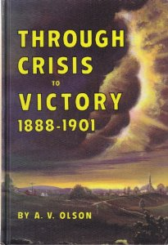
“Examples of Historical Inaccuracy that Developed From These Responses”
Notes:
How have the three responses to Bunch been used over the years? We will start with D. E. Robinson’s letter.
A copy of D. E. Robinson’s original letter can be found in Document File 371, at the Ellen G. White Estate, in Silver Spring, MD. At some point, Robinson’s letter was retyped, one paragraph being removed which clarified him as the writer, and A. L. White’s name was penciled in. A. L. White’s name was then erased and replaced with W. C. White’s name, in what appears to be A. L. White’s handwriting. The original copy of this retyped letter is found in Document File 331, and is the copy published in Manuscripts and Memories of Minneapolis, pp. 333-335, and attributed to W. C. White (Tim Poirier from the White Estate verified these findings). It seems that this letter falsely attributed to W. C. White, did not surface until it appeared as “Appendix D” in Thirteen Crisis Years: 1888-1901, in 1981. It seems clear that A. L. White retyped the letter years later to add credibility to the “victory” river of thought that he supported.
This book was a reprint of A. V. Olson’s book, Through Crisis to Victory: 1888-1901, first published in 1966. But A. V. Olson died in 1963, three years before his book was published, at which time it came under the sponsorship of the Ellen G. White Estate Board, with A. L. White as Secretary. The 1981 reprint was published under the same auspices. (See: Ron Duffield, The Return of the Latter Rain, p. 129)

Slide 36
Examples of Historical Inaccuracy
“In his sermons the speaker [Taylor Bunch] followed the theme of his pamphlets [Forty Years in the Wilderness], drawing a parallel between the Advent Movement and the expedience of ancient Israel. The Kadesh-barnea rejection of divine leadership was set forth as a type of what the author termed a denominational rejection of the truths presented at Minneapolis in 1888. He predicted a Baal-peor type of experience that would involve Seventh-day Adventist leaders and thousands of church members in terrible and shocking immorality.”
“Three church leaders who had been delegates at the 1888 General Conference session and who in 1930 lived in the environs of Pacific Union College protested such a distortion of history and such a forecast.” (cont.)
Notes:
In Appendix D, Arthur White makes the claim that W. C. White wrote the letter to deal with “the unsupported conjecture from the pen and lips of one [Taylor Bunch].

Slide 37
Examples of Historical Dishonesty?
“In the interest of accuracy in reporting such an important point in denominational history, the eyewitness testimony of responsible church leaders in their prime, as they attended the Minneapolis Conference, may be contrasted with the unsupported conjecture from the pen and lips of one who was at the time a child of three, living far away.”#
“The three from whom we have written statements are W. C. White. A. T. Robinson, and C. Cornell McReynolds. Elder W. C. White, who lived close to the Elmshaven office, where he served as secretary of the Ellen G. White Estate, presented his testimony in a written letter December 30, 1930, to the Week of Prayer speaker. We shall present his clear-cut testimony first. But before doing so, it may be well to look at the credentials of this man who was so very familiar with the General Conference session of 1888….* If anyone was in a position to know what took place in 1888 and could be relied on to bear witness concerning the Minneapolis Conference, it was he.” (Arthur L. White, “Appendix D,” in A. V. Olson, Thirteen Crisis Years, pp. 330-331)
Notes:
#D. E. Robinson was only 9 during 1888 GC session
*Arthur White spends over 5 pages going over these three letters from 1930, seeking to prove the points listed therein. But he relies most heavily on the concept that a letter from W. C. White cannot be refuted.

Slide 38
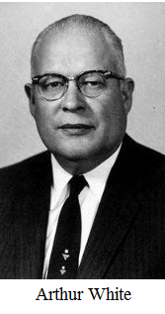

“Examples of Historical Inaccuracy that Developed From These Responses”
Notes:
In Jan. 1984 Arthur White’s 3rd volume of his biography on EGW, The Lonely Years: 1876-1891, was published. This book happened to cover the Minneapolis Conference and White made a point to address those who had made an issue over this topic. A letter was soon sent to the White Estate asking for clarification. The letter was forwarded to White who responded:

Slide 39
“Examples of Historical Inaccuracy”
“You ask about a statement in Volume Four, The Lonely Years, and refer to page 396 where I state that the concept of a denominational rejection of the message did not emerge until forty years after the event, or 1928, and you ask what event that could have been.
“I am quite familiar with the facts, and in a footnote refer the reader to statements made by A. T. Robinson, C. C. McReynolds, and W. C. White, found in the Appendix of Thirteen Crisis Years. This is the printing of the Olson book last to come from the press. Here is the story. Elder Taylor Bunch, teacher of religion at the time at Loma Linda, was invited to take the fall Week of Prayer at Pacific Union College in 1928. He had shorty before that published a pamphlet entitled, Forty Years in the Wilderness in which he likened the experience of Seventh-day Adventists to that of Israel, who God turned back at Kadesh-Barnea and projected the concept that this was our experience since we had rejected the message of righteousness by faith at Minneapolis in 1888.”
Notes:
Bunch never used the term “denominational rejection”.

Slide 40
“Examples of Historical Inaccuracy”
“As I recall there is little in the way of good documentation to support the concept. The men named above referred to in the A. V. Olson book who lived in the community took firm issue with him. They were at Minneapolis, Bunch was not, for he was a child two years old in the state of Oregon. But it was a catchy idea and it has become quite popular with some, in spite of the lack of sound documentary support.”
“I have tried most earnestly in my book to deal with the matter of the Minneapolis Conference in an accurate and fair manner, supported with contemporary documentation. I did not, in the preparation of the manuscript read what others in later years have written, for I have never found in their portrayal sound documentation which would counter the image given by the documents I have had available through the years. These documents I studied carefully as I prepared the manuscript.” (A. L. White to Donald K. Short, Aug. 6, 1984, White Estate Digital Resource Center, “Minneapolis—Rejection of Righteousness by Faith,” http://drc.whiteestate.org/files/5298.pdf, accessed Nov. 1, 2011)
Notes:
Turns out the letter is written in response to an inquiry by Donald Short about the stance taken in the EGW biography.

Slide 41
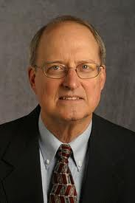
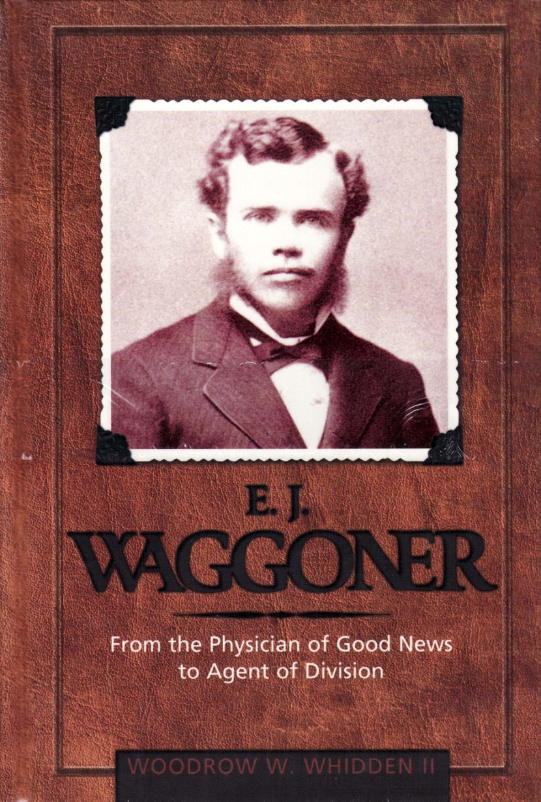
“Examples of Historical Inaccuracy”
Notes:
“I [EGW] insisted that there should be a right spirit, a Christlike spirit manifested, such as Elder E. J. Waggoner had shown all through the presentation of his views; and that this matter should not be handled in a debating style. I urged that this matter should be handled in a Christlike spirit and that there should be no thrust made against the brethren who differed with them. As Elder E. J. Waggoner had conducted himself like a Christian gentleman they should do the same, giving the arguments on their side of the question in a straightforward manner…. Elder Waggoner had taken a straightforward course, not involving personalities, to thrust anyone or to ridicule anyone. He conducted the subject as a Christian gentleman should, in a kind and courteous manner. This was acknowledged to be the case by those who were holding opposite views.” (Ellen G. White Manuscript 24, Dec. 1888; in 1888 Materials, 219-222, emphasis Supplied).
In complete contrast to Ellen White’s description of Waggoner’s conduct at the meetings, Woodrow Whidden offers the following from his research:

Slide 42
“Examples of Historical Inaccuracy”
“Willie White would later recall (in 1930, 42 years after the session) that ‘the pomposity and egotism’ of Jones and Waggoner ‘seemed out of place in such young men’ at the Minneapolis gathering. His is the harshest assessment recorded.… While some reportedly heckled [Waggoner] for his short stature, we have no record that he made any retaliatory retorts or exhibited any of his possible unflattering personality traits as a decisive feature in his public presentations….”
“Ellen White’s observations regarding Waggoner’s conduct, stated publicly at the Minneapolis session itself seems to better reflect his overall demeanor and conduct.” (Woodrow Whidden, E. J. Waggoner, p. 105, emphasis supplied)
Notes:
Give Whidden credit for seeing there was a difference, but he still seems to give the supposed W. C. White letter as of equal weight with EGW. Why?

Slide 43
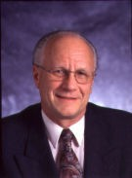
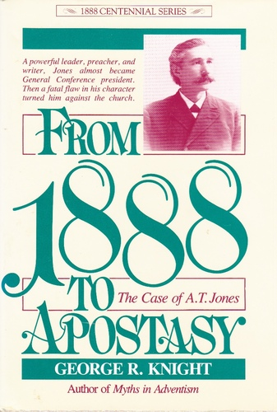
“Examples of Historical Inaccuracy”
Notes:
Whidden cites George Knight for his quotation from the supposed W. C. White letter of 1930. Knight takes a much more cynical approach to the letter falsely attributed to W. C. White.

Slide 44
“Examples of Historical Inaccuracy”
“Personality Conflicts: … The younger men didn’t help matters any. As W. C. White (a participant in the conference) put it: ‘the pomposity and egotism’ of Jones and Waggoner ‘seemed out of place in such young men,’ and did much to develop prejudice and feeling against them. Jones, he noted, was especially pompous. Beyond that, his careless mouth and harsh speech turned many against him….”
“A. T. Jones could preach the greatest truths of Christianity, but he never mastered the art of making Christian kindness a part of his repertoire. That problem, in part, would set the tone for conflict at the Minneapolis General Conference meetings in 1888.” (George R. Knight, From 1888 to Apostasy, pp. 33, 34).
Notes:
Knight is even more flamboyant when writing on Jones and Waggoner. It should be noted that neither D. E. Robinson nor W. C. White ever stated that Jones “was especially pompous”. Did Jones “never” act kindly or speak without harshness as Knight claims?
Although Jones was at times harsh, particularly in his later years, EGW gives a different picture: “We had our meeting. Brother Jones talked very plainly, yet tenderly in regard to their crediting hearsay and not, in brotherly love, taking the matter to the one talked about and asking him if the report were true. Willie, I talked as they had never heard me talk before. I went over again the transactions at Minneapolis and since that time, and I addressed plain remarks to Elder Smith. I told him that it was not so surprising that my brethren who had known but little of the work the Lord had given me to do, should have temptations, but Elder Smith was not excusable.” (1888 p. 642).

Slide 45
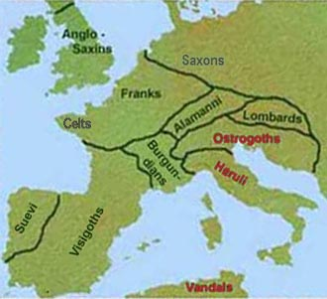
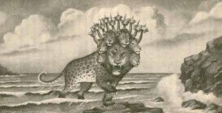
Examples of Historical Inaccuracy
The Ten Kings
Notes:
A. T. Robinson’s response to Taylor Bunch also produced a chain of inaccuracy that is with us to this day. It had to do with the discussion at the 1888 GC on the Ten Kings. But first we need some context:

Slide 46
“Examples of Historical Inaccuracy”
In 1884 the General Conference commissioned Jones to write a series of articles showing the fulfillment of Bible prophecy.
Jones’ study of Daniel and Revelation led him to see an error in the commonly held view of the ten kings found in Uriah Smith’s Daniel and the Revelation.
Jones wrote to Smith twice asking him to look at the new evidence. Smith did not reply to 1st letter and when he responded to the 2nd letter said he was too busy.
When Jones then published his finding in the Signs in 1886 Smith claimed he would have to counter in the Review.
W. C. White reviewed Jones work in 1888 and felt he “had more historical evidence for his position than Eld. Smith.”
Just before the 1888 GC, Butler labeled Jones a trouble maker for bringing up an interpretation “contrary to the long-established faith of our people taken forty years ago.”
Notes:
Much of the contentious spirit Ellen White wrote about, which was coming into the meetings, had to do with a minor issue—the controversy over the ten horns. Back in 1884, the General Conference had commissioned A. T. Jones to “write a series of articles gathered from history on points that showed the fulfillment of prophecy.” (A. T. Jones to Uriah Smith, Dec. 6, 1886.)
This led Jones to a more in-depth study of the book of Daniel, and while examining the commonly held Adventist view on the ten kingdoms of Daniel 7 as printed in Uriah Smith’s Daniel and the Revelation, he found that one kingdom had been identified incorrectly.
Jones wrote to Smith twice, asking him to send evidence for the historical view and requesting that he examine the recently discovered evidence. Smith did not reply to Jones’ first letter and when he finally responded to his second letter, he claimed he had a lack of time for the task.
As a result Jones published his views in the Signs of the Times without Smith being able to critique them, and sent him a copy in October of 1886. Uriah Smith responded irately, telling Jones that he would have to counterattack through the Review since Jones had scattered his views “broadcast through the paper.” Smith was very fearful that thousands of Adventist opponents would “instantly notice the change” in a doctrine held for forty years and claim that, if given enough time, Adventists would acknowledge they were “mistaken on everything.” (Uriah Smith to A. T. Jones, Nov. 8, 1886.) Jones responded by stating that the real battle for truth lay ahead. Soon, because of the Sunday crisis, “every point” of Adventist doctrine and beliefs would be “analyzed and challenged … by the greatest in the land.” Thus, when the three angels' messages were being given, Adventists would need a “better reason” for their faith in Bible prophecy “than that ‘it has been preached for forty years.’” (A. T. Jones to Uriah Smith, Dec. 3, 1886.)
To Jones’ credit, W. C. White, after listening to Jones’ position, spent some time in the summer of 1888 studying into the subject of the ten horns and came to the conclusion that “Eld. Jones had more historical evidence for his position than Eld. Smith.” (W. C. White to Dan T. Jones, April 8, 1890; in Manuscripts and Memories, p. 168.) This, however, made little difference, and as the subject was taken up at the 1888 Institute, a very hostile spirit emerged.
Just prior to the 1888 Institute, Butler had labeled Jones a troublemaker for bringing up an interpretation “contrary to the long-established faith of our people taken forty years ago.” (G. I. Butler to Ellen G. White, Oct. 1, 1888; in Manuscripts and Memories, p. 102.)

Slide 47
“Examples of Historical Inaccuracy”
“Monday, October 15, the situation came to a head during the ten o’clock meeting. Smith declared it ‘utterly unnecessary’ to look into the issue of the ten horns that tended only to evil. He said the old view had ‘stood the test for 40 years,’ and Jones was ‘tearing up old truth.’ He said that he, for one, ‘was not going to sit calmly by and see the foundation stones of our message taken out with ruthless hands.’ Smith did not stop here; he continued speaking falsely by stating that he ‘was laboring at a disadvantage because he did not know the issue was coming up.’ With a bit of irony, he then added that some ‘seem to have known and brought in libraries of source materials.’38” (Ron Duffield, Return of the Latter Rain, p. 94)
Notes:
(The footnote number is the original in The Return of the Latter Rain.) 38 W. C. White, “Notes Made at the Minneapolis Meetings 1888,” Oct. 15, 1888, pp.
27, 29; in Manuscripts and Memories, p. 420; and Ron Graybill, “Elder Hottel Goes
to the General Conference,” Ministry, February 1988, pp. 19-21.
The issue was whether the discussion was a surprise or not!

Slide 48
“Examples of Historical Inaccuracy”
“Finally, on Wednesday, at the close of the Institute prior to the General Conference proper, Smith tried to force a vote to decide the issue of the ten horns. Waggoner blocked this vote suggesting it not be ‘settled until it had been thoroughly investigated.’39 Despite the blocked vote, Smith claimed victory for his view in his Review editorial claiming: ‘the sentiment of the delegates appeared … to be overwhelmingly on the side of established principles of interpretation, and the old view. Whether or not this will make any difference with those who are urging the new position, remains to be seen.’40 What Smith failed to mention was that the delegates had voted that ‘all should study the question faithfully during the year.’ W. C. White saw Smith’s editorial as deceptive, and publicly announced that it ‘was calculated to mislead the people.’41” (Ron Duffield, Return of the Latter Rain, p. 94)
Notes:
(The footnote numbers are the original in The Return of the Latter Rain.) 39. “Talk of a Prophecy,” Minneapolis Tribune, Oct. 18, 1888, p. 5; in Manuscripts and
Memories, p. 549.
40. Uriah Smith, “The Conference,” Review and Herald, Oct. 23, 1888, p. 664; in
Manuscripts and Memories, p. 400.
41. W. C. White to J. H. Waggoner, Feb. 27, 1889; in Manuscripts and Memories, p. 136.

Slide 49
“Examples of Historical Inaccuracy”
“On Tuesday, October 16, Jones again took up the subject of the ten horns and replied to Smith ‘in no uncertain terms.’ He told everyone why he had come with ‘libraries’ of books. He discussed the letters that had passed between Smith, Waggoner and himself, proving that the topic of discussion was no surprise. To underscore his point he admonished the delegates ‘not to blame him for what Uriah Smith said he didn’t know.’ Ellen White was present at the meeting and, being aware of the significance of what was taking place, cautioned Jones saying: ‘not so sharp, Brother Jones, not so sharp.’42 (Ron Duffield, Return of the Latter Rain, p. 94)
Notes:
(The footnote number is the original in The Return of the Latter Rain.) 42 Signed report of “Interview with J. S. Washburn, at Hagerstown, Md., June 4,
1950,” conducted by Robert J. Wieland, p. 1 (This is taken from a copy of the original “Interview” and differs from the paging of the apparently retyped copy on record in Document File 242, at the Center for Adventist Research, James White Library, Andrews University); Ron Graybill, “Elder Hottel Goes to the General Conference,” Ministry, February 1988, pp. 19-21.
W. C. White mentions the situation and Jones’ explanation, but makes no comment of Jones’ being “sharp” or his mother’s caution. EGW never mentioned this incident either, in all her explanations of the Minneapolis conflict. The story never came to light until A. T. Robinson mentioned it in 1931, and years later Washburn clarified it in 1950.

Slide 50
Personalities the Cause of Resistance
A. T. Robinson
Notes:
Unfortunately, this one statement made by Jones at Minneapolis has been used for over 100 years to try to excuse the rejection Jones and Waggoner received there at Minneapolis and afterwards. Robinson, without giving context, gives this rendition of the story 42 years later.

Slide 51
“Examples of Historical Inaccuracy”
“I listened to many things that were said by our leading men concerning the attitude of the men who were leading out in the presentation of the theme of justification by faith. … What was spoken of [was] an offensive attitude on the part of the men who were conducting the studies [Jones and Waggoner] was criticised severely by some, and at times they were made the subject of ridicule. Perhaps I can best give one concrete illustration of what appeared to justify the attitude taken by some of our leading men toward the men who were prominent as teachers of righteousness by faith.” (cont.)
Notes:
The attitude of Jones and Waggoner is held up as justifying the treatment they received.

Slide 52
“Examples of Historical Inaccuracy”
“Elders U. Smith and A. T. Jones were discussing some features in connection with the ten kingdoms into which western Rome was divided. One day, Elder Smith, in his characteristic modesty, stated that he did not claim originality in the view he held on the subject, that he had taken statements [from] such men as Clark, Barnes, Scott, and others mentioned, and drawn his conclusion from such authorities.
“In opening his reply, Elder Jones, in his characteristic style, began by saying, ‘Elder Smith has told you he does not know anything about this matter. I do, and I don't want you to blame me for what he does not know.’ This harsh statement called forth an open rebuke from Sister White who was present in the meeting.”(“Did the Seventh-day Adventist Denomination reject the Doctrine of Righteousness by Faith?” Jan. 30, 1931; in Manuscripts and Memories 336-337)
Notes:
It is clear from the historic records that Smith’s statements that brought out Jones’ response were with regard to the question of whether Smith knew the topic of the kingdoms were going to be discussed at the 1888 conference. Whereas later critics of Jones and Waggoner have incorrectly attributed Jones’ response as to whether Smith knew the identity of the ten kingdoms like he did. A. T. Robinson started this when, 42 years after Minneapolis (and with Jones’ later bitterness and defection still on his mind), wrote of this incident: (The Return of the Latter Rain, p. 102)

Slide 53
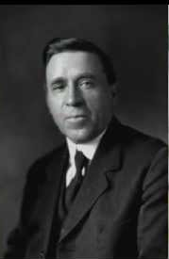

“Examples of Historical Inaccuracy”
LL. H. Christian
Notes:
Lewis Harrison Christian wrote of the incident in 1947. He obviously got it from Robinson.

Slide 54
“Examples of Historical Inaccuracy”
“The two men who especially urged righteousness by faith [Jones and Waggoner] also advanced certain teachings concerning these two topics [law in Galatians and the Ten Horns], which brought in confusion. Their extreme position on these subjects gave others an unwarranted excuse to question what they taught concerning justification by faith.”
“The institute almost took on the form of a public debate…. J. H. Morrison, an honored minister in our ranks and president of the Iowa Conference, took the one side in a discussion with Dr. E. J. Waggoner about the law in Galatians. He was an earnest Christian, and believed in righteousness by faith, but feared the extreme views of Dr. Waggoner on the two laws as taught in Galatians. In later years, when A. T. Jones and others had gone into fanaticism, he defended the advent message with much zeal and success, as is clearly seen by his book on that topic….” (cont.)
Notes:
Young L. H. Christian turned 17 while attending the Minneapolis Conference with his parents in 1888. Nearly 60 years later (and most likely having been influenced by Robinson’s report), Christian wrote of the incident between Smith and Jones, but not as an eyewitness account.
Notice how Christian weaves in Jones and Waggoner’s later years to discredit even what happened at Minneapolis.

Slide 55
“Examples of Historical Inaccuracy”
“Little by little our church came to see that some of Dr. Waggoner's views on Galatians were unsound and should be given up. Mrs. White said little about the points at issue but warned earnestly against the spirit of strife and hatred….”
“Elder Smith was a modest but well-informed man; Elder Jones was more rugged and boastful. At one point he said, ‘The difficulty with Brother Smith is that he does not know who the ten kingdoms are and yet argues for the Huns while I know, and can prove my position.’”
“Mrs. White, who usually did not attend these debates, happened to be there, and she arose and severely reprimanded Elder Jones for his disrespect to an old pioneer in the advent movement. Mrs. White strongly urged our people not to discuss and dispute as they had the doctrinal question of the ceremonial law and the ten kingdoms…. As a result of this instruction to cease all debating concerning the epistle to the Galatians, controversy ceased and little by little the true light came as we have it now.” (L. H. Christian, The Fruitage of Spiritual Gifts [1947], pp. 229-230)
Notes:
In light of the BRI’s list of disagreements with the 1888 MSC we might ask the following questions.
1. Is this accurate use of EGW statements from the 1888 era?
3. Does this description of the events of 1888 put in the proper light EGW’s endorsements of Jones and Waggoner?
4. Is this an accurate account of 1888 history?

Slide 56
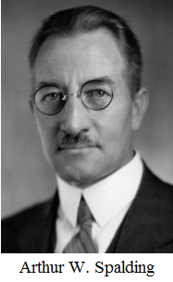

“Examples of Historical Inaccuracy”
Notes:
A. W. Spalding, not present at Minneapolis, quotes Robinson’s statement, likewise adding his own comments.

Slide 57
“Examples of Historical Inaccuracy”
“Jones boldly pushed his views in a series of lectures in which this was only one point….”
“The conflict, indeed, involved personalities quite as much as preaching. Jones, and especially Waggoner, were young men, and their voices, with the note of authority in them, were resented by not a few of the older men….”
“Jones was aggressive, and at times obstreperous, and he gave just cause for resentment,13 yet most of his hearers could forgive occasional crudities in view of his evident sincerity and his forceful presentation. Not so with some of the older ministers. Uriah Smith was a modest man, unobtrusive, retiring. He always preferred an obscure seat to the limelight; yet his ability had kept him in the front ranks of the church's theologians, and his lovable qualities made him friends from high to low. (Arthur W. Spalding, Captains of the Host [1949], p. 593)
Notes:
A. W. Spalding, references Robinson’s quote in his footnote number 13. He concludes that the rejection of Jones and Waggoner was from just cause.

Slide 58
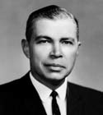

“Examples of Historical Inaccuracy”
Notes:
N. F. Pease quotes Robinson’s statement in his 1962 By Faith Alone which was based on his 1945 masters thesis.
Norval Pease happened to move to Auburn WA as Pastor and Bible teacher at Auburn Academy in 1937. He wrote his Master’s thesis in 1945 from which was later published his book By Faith Alone (See paper “Robert J. Wieland Before 1888 Re-examined and Some of His Effect on Adventists,” appendix B, p. 34-36; also NPUGleaner, March 16, 1937, p. 3).
“My interest in this topic was first stimulated in 1937 when, as a young pastor, I was confronted with the claims of a splinter organization that taught the theory that the Seventh-day Adventist Church rejected the doctrine of justification by faith in 1888.” (Norval Pease, By Faith Alone [1962], p. x-xi)

Slide 59
“Examples of Historical Inaccuracy”
“An interesting sidelight on the discussion regarding the ten kingdoms is found in a statement written by A. T. Robinson [quotes Robinson’s report]….
“The men who promoted the doctrine of justification by faith at the Minneapolis meeting did not always present their views in a discreet, tactful way. This unfortunate situation developed a spirit of prejudice against the men that in many minds obscured the real issues. This argument over the question [of the ten kings] aroused prejudice that militated against the acceptance of the teaching of justification by faith, stressed later during the session.” (Norval F. Pease, By Faith Alone [1962], pp. 130-131).
Notes:
Thus Jones and Waggoner are blamed for the rejection of JbyF. All from the overstated, and inaccurate rendition of an event that happened at Minneapolis, as recalled some 40 years later by one who himself joined in the criticism of Jones and Waggoner in one of the rooms which EGW was lead to see.

Slide 60


“Examples of Historical Inaccuracy”
Notes:
“The Story of Our Church was written by teachers for use in a one-semester course in Seventh-day Adventist secondary schools. It describes in lesson units suitable for daily assignments the origin, growth, and organization of the Seventh-day Adventist Church. Its objective is to lead the student
into a clear understanding of the mission of the church and a confidence in its message.”
Department of Education,
GENERAL CONFERENCE OF
SEVENTH-DAY ADVENTISTS. (Preface, p. v)

Slide 61
“Examples of Historical Inaccuracy”
“During the institute Elders J. H. Morrison and E. J. Waggoner discussed the law as interpreted in the book of Galatians. Elders Jones and Smith discussed the ten kingdoms of Daniel 2 and 7, their disagreement concerning only a detail about one kingdom. This latter controversy was based somewhat on personalities. Smith was a modest, retiring man, whose abilities kept him in high esteem. Jones was unpolished but impressive, depending much on his forceful speech….”
“Ellen White did not take sides. She made no statement about the law in Galatians. She pleaded for all to study the truths of God's word with open minds. She preached Christ and justification only through His merits. The rank and file of the people attending the conference accepted the message joyously, but not some of the leaders.”(cont.)
Notes:
Only a couple pages are allotted the 1888 GC and issues that followed. There is so much misinformation in these few pages it is not hard to see how another generation of Adventist young people was lead to view 1888 through rose-colored glasses.

Slide 62
“Examples of Historical Inaccuracy”
“Ellen White's sermons had supported the views of Jones and Waggoner on righteousness by faith, but she took no stand with them….”
“The conference closed somewhat in confusion and disappointment…. But it became a profitable chapter,… It marked the beginning of a great reform….
“[T]he next summer they [Jones Waggoner and Ellen White] visited camp meetings across the country, preaching on this subject. The men [Jones and Waggoner] were taught to modify their extreme expressions….
“The dissension was largely a conflict of personalities, caused not by irreconcilable differences in doctrine, but by selfishness, pride, and hardness of heart…. (cont.)
Notes:
The concepts expressed in this book are clearly inaccurate when compared to the actually history as told by EGW and others at that time.

Slide 63
“Examples of Historical Inaccuracy”
“After the 1888 conference, unity gradually came; leaders who had opposed the movement toward a deeper, more personal faith, accepted reproof from Mrs. White and confessed their unhappy condition of mind after the conference. Her testimonies of warning went to the other side, too. At the 1892 General Conference, Elder Jones tried to arouse the audience against those who opposed him. From Australia, Ellen White wrote to him, warning him against his critical attitudes and his extreme statements….”
“Though the Minneapolis Conference seemed depressing and alarming, it turned out to be a great victory for the church.” (General Conference of Seventh-day Adventists, Department of Education, The Story of Our Church, [1956], p. 244-247).
Notes:
The only paragraph in the entire book that mentions the 1893 General Conference unfortunately gives an incorrect date and repeats the same claims as Spalding’s earlier book, that Jones tried to arouse the audience against those who opposed him. Once again, however, no evidence is offered for such a claim. Can it be any wonder that Adventist young people have grown up with incorrect perceptions regarding the 1893 General Conference and our Adventist history?”

Slide 64
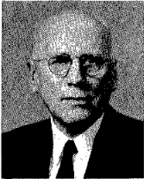
“Examples of Historical Inaccuracy”
Notes:
Albert Victor Olson (1884-1963) Chair of the White Estate 1952-1963, quotes from A. W. Spalding’s quote of Robinson’s statement about Jones.

Slide 65
“Examples of Historical Inaccuracy”
“The opposition that developed at the Minneapolis General Conference session of 1888 against the message of righteousness by faith preached by E. J. Waggoner and A. T. Jones sprang from the weaknesses of human nature….
“It often happens that when a speaker presents some apparently new thought or theme, prejudice on the part of his hearers makes them unable to properly weigh the evidences set forth in its favor. So it was in Minneapolis. Some who heard E. J. Waggoner and A. T. Jones thought they were too young to have such a prominent part in the hours set apart for the study of the Bible, and some felt that the manners and language of one of the young speakers were objectionable.*”(A. V. Olson, Through Crisis to Victory 1888-1901 [1966], p. 44)
Notes:
Then Olsen (A. L. White?) quotes from Spalding’s rendition of the A. T. Robinson quotation in his footnote: *“’The conflict,’ wrote Arthur W. Spalding, ‘. . . involved personalities quite as much as preaching. Jones, and especially Waggoner, were young men, and their voices, with the note of authority in them, were resented by not a few of the older men…. Jones was aggressive, and at times obstreperous., and he gave just cause for resentment, yet most of his hearers could forgive occasional crudities in view of his evident sincerity and his forceful presentation.’—Spalding, Origin and History, vol. 2, pp. 292, 293.”

Slide 66
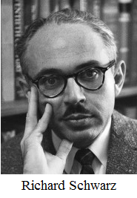

“Examples of Historical Inaccuracy”
Notes:
R. W. Schwarz quotes Robinson in the book used for teaching college classes in Adventist History for years.

Slide 67
“Examples of Historical Inaccuracy”
“Smith admitted having simply followed Millerite and earlier interpreters on this point [ten kings]. In reply Jones remarked rather caustically, ‘Elder Smith has told you that he does not know anything about this matter. I do; and I don't want you to blame me for what he does not know.’ Ellen White immediately rebuked this rash statement, but its impact on many delegates remained. Although they could not controvert Jones's reasoning, they were appalled by his brashness and retreated to the security of the familiar and traditional list.” (Richard Schwarz, Light Bearers to the Remnant, [1979], p. 188)
Notes:
Another misrepresentation of the situation.

Slide 68
“Examples of Historical Inaccuracy”
Notes:
But George Knight more than all the other writers repeated the inaccuracies regarding Waggoner, and particularly Jones, for more than 30 years of misrepresentation.

Slide 69
“Examples of Historical Inaccuracy”
“‘Elder Smith,’ A. T. Jones blurted out early in the Minneapolis meetings, ‘has told you he does not know anything about this matter. I do, and I don’t want you to blame me for what he does not know.’ Such harsh words and pompous attitudes provided part of the backdrop for the conflict that characterized the 1888 General Conference session. They were certainly not phrased in a manner that won friends for the two young editors from California….”
“In a moment of honesty, Smith had modestly stated that he had not had the time to do original research into the historical documents, but had relied on Bible commentaries. It was that admission that had brought forth Jones’s self-confident remark. He had done his homework, knew he was correct, and sought to drive the point home.”
“Smith responded in kind, accusing Jones of ‘coming prepared with Libraries’ and tearing up ‘established positions’ with ‘ruthless hands.’” (George R. Knight, From 1888 to Apostasy [1987], p. 35)
Notes:
Knight starts his chapter 3, “Conflict at Minneapolis” with the statement in the slide.
Knight flips the dates of the exchange around, which are clearly recorded in W. C. White’s notes and in the way he tells the story, makes it appear that Jones told Smith off first for no reason than a “humble” confession by Smith of where he had gotten his ideas, and then Knight tells of Smith responding with the why he was unprepared and Jones “coming with Libraries” statement. This way of telling the story creates an incredibly inaccurate understanding of what took place. When the truth is, Monday Oct. 15, Smith makes his comments as listed in W. C. White notes page 27 (Manuscripts and Memories, p. 420), Tuesday, Oct. 16, Jones responds defending why he came with libraries, in W. C. White notes page 41 (Manuscripts and Memories, p. 422).

Slide 70

“Examples of Historical Inaccuracy”
Notes:
But the worst retelling of this story has to be by the Drama group at CUC. The Canadian Union College Heritage Players take much license in quoting A. T. Jones as follows.
Eric Rajah, Producer;
Keith Clouten, Script;
Denise Dick Herr, Stage Production. Copyright © 1989 Canadian University College.
List of Sources:
Butler, George I. The Law in the Book of Galatians. Review and Herald Publishing Association, 1886.
Ellen G. White 1888 Materials. (4 volumes) Review and Herald Publishing Association, 1988.
Knight, George R. From 1888 to Apostasy: the Case of A. T. Jones. Review and Herald Publishing Association, 1987.
Ministry Magazine, Vol. 61, No. 2, February 1988: Special edition on Righteousness by Faith.
Olson, A. V. Thirteen Crisis Years, 1888-1901. Rev.ed. Review and Herald Publishing Association, 1981.
Pease, Norval F. The Truth As It Is In Jesus: The 1888 General Conference Session, Minneapolis, Minnesota. Adventist Heritage, Vol. 10, No. 1, 1985, pp. 3-10.
Reid, George W. et. al. Meet the Presidents. Adventist Heritage, Vol. 10, No. 1, 1985, pp. 48-55
Spalding, Arthur W. Origin and History of Seventh-day Adventists. Vol. 2, Review and Herald Publishing Association, 1961.
Waggoner, Ellet J. The Gospel in the Book of Galatians. [1888]

Slide 71
“Examples of Historical Inaccuracy”
“Smith: ‘Thank you for that introduction, Elder Haskell. You mention the horns of Daniel 7, but really that topic is an unnecessary one, and tends to argument. I don’t claim any special authority concerning the horns. You see, the Millerites years ago identified all ten of the horns, and their view has stood the test for forty years. My study has merely confirmed their conclusion.’”
“Henderson: (From audience, stands.) ‘Let's hear what Elder Jones has to say on the horns.’”
“Smith: ‘I have no objection to that. Brother Jones?’ (Smith sits down, and Jones steps to the desk.)” (cont.)
Notes:
Canadian Union College Heritage Players takes much license in quoting A. T. Jones as follows:

Slide 72
“Examples of Historical Inaccuracy”
“Jones: ‘I am certainly happy to comment on the horns. Elder Smith has just admitted to us that he is not really an authority on the ten horns. I want to assure you that I have given this subject a great deal of study, and I can make up for Elder Smith’s ignorance’”
“Ellen White: (Stands and steps forward.) ‘Brother Jones, your manner of speaking distresses me. Whatever your knowledge may be on this subject, I do not believe it is in order for you to cast aspersions upon others.’ (To audience) ‘Brethren, we need to respect one another, and treat one another with brotherly love. There is much I could say on this subject, but I will say no more at this time.’ (Sits)” (“The News From Minneapolis 1888,” Playing Our Past [North American Division Office of Education, 1989], p. 126)
Notes:
Canadian Union College Heritage Players takes much license in quoting A. T. Jones as follows:

Slide 73
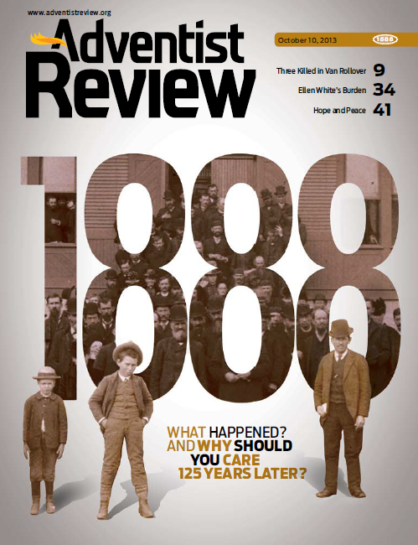
Celebrating 125 years?
Notes:
In 2013, we celebrated 125 years of 1888. George Knight as church historian had the main article. After quoting a statement from EGW where she wrote of the importance of the upcoming 1888 GC session, Knight starts his article in the regular size type, by quoting this incident from the distorted description of A. T. Robinson:

Slide 74
“Examples of Historical Inaccuracy”
“TENSION IN THE CAMP: The tension didn’t take long to surface. ‘Elder Smith,’ A. T. Jones blurted out early in the meetings, ‘has told you he does not know anything about this matter. I do, and I don’t want you to blame me for what he does not know.’ Ellen White responded with ‘Not so sharp, brother Jones, not so sharp.’ Unfortunately, such harsh words and pompous attitudes provided part of the backdrop for the conflict that characterized the 1888 General Conference session. Jones had no monopoly on the harsh words front.” (George R. Knight, “What Happened in 1888?: A Historical Account of a Very Historic Event,” Adventist Review, Oct. 10, 2013, p. 17 )
Notes:
From George Knight’s cover article, “What Happened in 1888?: A Historical Account of a Very Historic Event.”
In the entire 48 pages of this special 125th celebration edition, Jones and Waggoner are not given even one paragraph to speak for themselves. Instead they are held up as defective in personality, theologically fatally flawed, extremists from the past.
Not once was the word “Latter Rain” used in the entire 48 pages, and only twice was the “loud cry” mentioned. First, in Bill and Shawn Brace’s article that the Review entitled “Theological Issues: Another Perspective,” where they indicate that EGW referred to the message as the loud cry (p. 28). The second time was just in passing in an article that mentions the loud cry in the near future (p. 46). Otherwise the fact that the 1888 message was the beginning of the latter rain and loud cry is absent, while the church once again rejoices in the supposed acceptance of that message. Such a celebration after 125 years only proves our Laodicean condition.

Slide 75
Areas of Disagreement?
1. Application of Ellen White’s Remarks Related to 1888?
3. Ellen White’s Endorsements of Jones and Waggoner?
4. Historic Accuracy?
Notes:
From 1930 to 1950 the talk about 1888 was highly shaped by the 3 responses to Taylor Bunch’s work, and the three books written on Adventist history or RbyF, and the offshoot groups who used 1888 as “proof” for their existence. But the question is: How did these effect the above areas of understanding about 1888. How did this second generation past 1888 (third generation since 1844) respond to these questions? How has their response trickled down to our generation today. Are we doing any better? We will look at that in the third presentation.

