Slide 1

Two Rivers of Thought Flowing Out of 1888:
Application of Ellen White’s Comments Relative to 1888?
Ellen White’s Endorsements of Jones & Waggoner?
Historical Accuracy Relative to 1888?
Part 1
Gospel Study Group, October 10-11, 2014
Ron Duffield

Slide 2

Notes:
Introduction (picture of Library)
It was during my time at Weimar Institute, 6 of those years as college librarian, that I became very interested in the topic of the Holy Spirit/Loud Cry and Latter Rain, especially in the context of Adventist history.
With the help of Dr. Douglass and the White Estate I setup a heritage room at the Library and opened up an Ellen G. White Study Center (not to be confused with a research center), where we housed Adventist documents, mostly on microfiche, and most of which can now be accessed online from the GC archives and White Estate.
It was during this time that I began collecting material which eventually was developed into the Return of the Latter Rain vol. 1 and most recently Wounded in the House of His Friends.
What I am sharing today comes from that material.

Slide 3
Primacy of the Gospel Committee Report
“Areas of Disagreement”

Slide 4
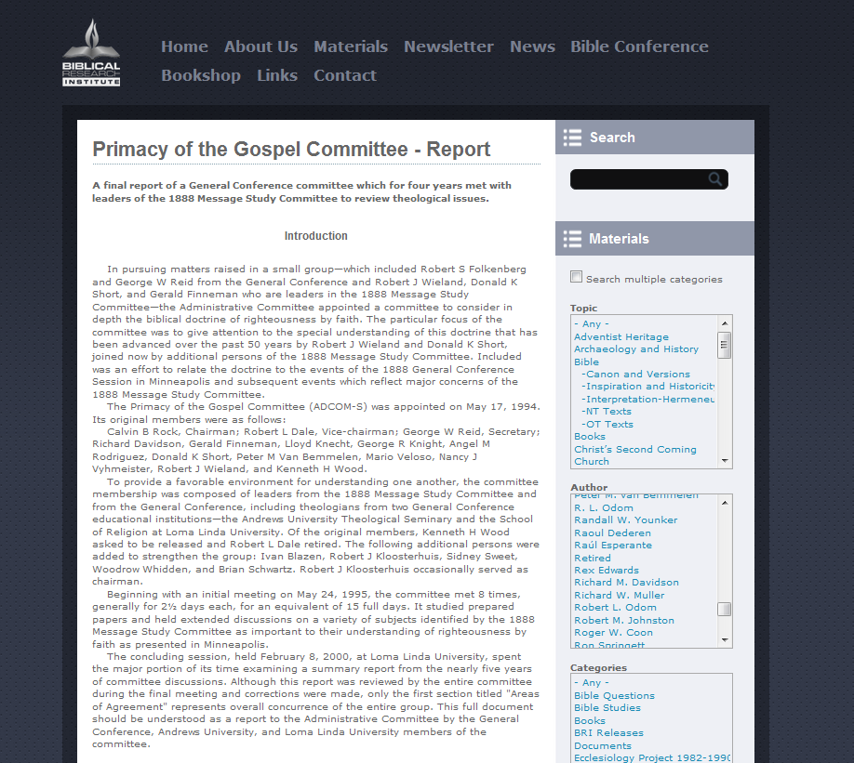

Notes:
I was asked to speak on three areas of disagreement listed in the Primacy of the Gospel final “majority” report.

Slide 5
Disagreement No. 1
“1. Application of Ellen White's Remarks Related to 1888. There is disagreement on how to understand many of Ellen White’s remarks related to 1888 and how they apply to the condition of the Church today. We believe these must be read in the context of the blatant legalism held by Butler, Smith, and their colleagues in beliefs. (cont.)
Notes:
We will read through each one tonight so we have an idea of what my presentations will be addressing.

Slide 6
Disagreement No. 1
“One must be extremely cautious in applying statements that were made in one context to a later period in which some of the factors have changed. Only a fuller understanding of the public teaching of the leading brethren of the Church in the pre-1888 period will enable readers in the 21st century to understand the impact of Ellen White's commendations and condemnations related to 1888 events and personalities.”

Slide 7
Disagreement No. 3
“3. Ellen White's Endorsement of Jones and Waggoner. Ellen White's repeated endorsements of Jones and Waggoner did not mean that she agreed with all their teachings. It would be helpful if the 1888 Study Committee would seriously examine the many areas in which Ellen White differs with Jones and Waggoner or is virtually silent on topics or on a theological linkage that they emphasize. (cont.)

Slide 8
Disagreement No. 3
“It would also be informative to enumerate and explore the ramifications of those areas in which Ellen White explicitly commends (rather than alludes to) specific items in the writings of Jones and Waggoner (TM 91-93 is one example of this). Such explorations might help avoid giving Jones and Waggoner’s theology an across-the-board endorsement. (cont.)

Slide 9
Disagreement No. 3
“On the other hand, it would heighten the importance of those issues she specifically commended. Jones and Waggoner need to be read as theologians who had a ‘most precious message’ that the Church desperately needed to hear, rather than as prophets or infallible guides—even in areas related to righteousness by faith.”

Slide 10
Disagreement No. 4
“4. Historical Accuracy. At times we sense a lack of historical accuracy when claims are made about Jones and Waggoner. History must speak for itself, even if it disagrees with Jones and Waggoner’s evaluation of certain details or modern interpretations of them and their teachings.”
Notes:
But before we can answer the questions raised by the Majority Report, we need to understand what took place back in the beginning and what has brought us to were we are today where are such diverse thoughts in regard to our history, Jones and Waggoner’s endorsement by EGW, and what she stated about 1888 and how it applies today.

Slide 11
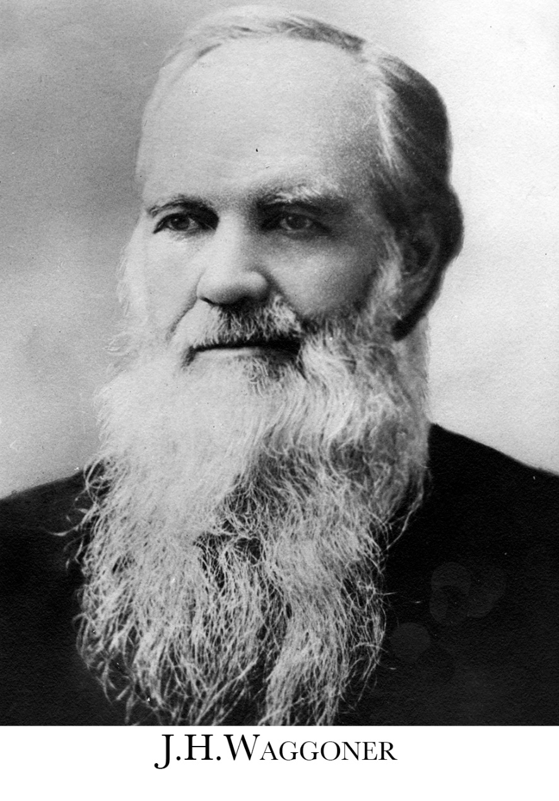
Where it all began!
Notes:
We need to start at the very beginning. Thus we will see the two rivers of thought that developed from the very beginning in regard to 1888.

Slide 12
Where it all began!
“For the same reason we conclude that the same law is spoken of in Galatians and Romans; that the word law, whenever it is used in the epistle of James, or those to the Galatians and Romans, has reference to the moral law of God, the ten commandments, except when directly qualified….
“[R]especting his letter to the Galatians … we have given that our first attention, and proved, we trust, that not a single declaration has been found therein which can be referred to the ceremonial or Levitical law…. Thus it is evident that the law spoken of in Gal. 3:19, 24, is a moral law, one that will detect and convince of sin. . . . As it is evident that none but the moral law is spoken of in Gal. 3.”(J. H. Waggoner, The Law of God, pp. 70, 73-74, 81, 108; in Manuscripts and Memories of Minneapolis, pp. 11, 12, 14, 15)”
Notes:
In his 1856 The Law of God: An Examination of the Testimony of Both Testaments (p.24) J H made the controversial claim that the “schoolmaster” in Galatians 3:24 was the moral only not the ceremonial law. But the real issue was that J. H. Waggoner parted from the view that the law in Galatians referred to both the ceremonial and moral law, to the view that the entire book of Galatians referred to only the moral law. In 1851-1852 J. N. Andrews saw the schoolmaster as referring, at least in part, to the moral law (J. N. Andrews, “Discourse with Brother Carver,” The Review and Herald, Sept. 16, 1851, p. 29; “Watchman, What of the Night,” The Review and Herald, May 27, 1852, p. 15). James White stated a similar view in when addressing Gal. 5:4 in 1852 (James S. White, “Justified by the Law,” The Review and Herald, June 10, 1852, p. 24)

Slide 13
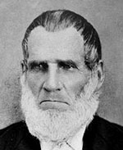
Where it all began!
Stephen Pierce

Slide 14
Stephen Pierce’s Response
“Some will here ask, if in [Gal. 3] verse 19 the Moral Law is not referred to; and others, if the typical, or ceremonial law is not referred to. We answer, no more than any particular sticks of timber which are constituent parts of an edifice, are referred to when only speaking of that edifice, as such. But that great system, or dispensation, or embodiment of law, of which these were constituent parts, is only referred to; and as a system, as a dispensation, as a whole, it was added. . . . Further that the Moral Law alone was our schoolmaster to bring us to Christ we have no evidence. True, it is by this Law we have the knowledge of sin; but how it brings us to Christ we are unable to tell.” (Stephen Pierce, “Answer to Br. Merriam’s Question Respecting the Law of Gal. 3,” Review and Herald, Oct. 8, 1857, emphasis original)”
Notes:
J. H. Waggoner’s book caused quite a stir among Adventists in Vermont, and they sent Stephen Pierce, who like Waggoner was a corresponding editor of the Review, west to Battle Creek to hold a study on the matter and refute Waggoner’s position. Waggoner did not stay for the discussion, so Pierce had the pulpit to himself. Three days were given to an examination of the subject. Here Pierce apparently defended the position that the law in Galatians referred to the whole law system, moral and ceremonial. Even Uriah Smith’s recalls this fact: “Bro. W took the position, (or had taken it in his book) that the law in Galatians was the moral law. Bro. Pierce argued that it was the law system, ‘including the ceremonial law.’” (U. Smith to W. A. McCutchen, Aug. 8, 1901; in Manuscript and Memories of Minneapolis, p. 305)
Shortly after this Ellen White wrote a testimony to J. H. Waggoner stating that his position was wrong and his book was taken out of circulation. Although we don’t have copies of Pierce’s presentations we do have copies of articles he wrote not many years after this situation where he presents the idea that the added law referred to the law system, not to the moral or ceremonial law alone (Stephen Pierce, “Answer to Br. Merriam’s Question Respecting the Law of Gal. 3,” Review and Herald, Oct. 8, 1857).

Slide 15
One Extreme to the Another
“Pierce took somewhat of a mediating position and declined to take a strong either/or stance, although his position was in opposition to that of [J. H.] Waggoner. Mediating positions in theology, though often correct, are notoriously unstable; any popular doctrine that is debated at large tends to be pushed to its logical extreme. Pierce’s ‘both-and’ view was soon forgotten, and since Ellen White had condemned [J. H.] Waggoner’s position, the opposite view prevailed. Hence the generally accepted Adventist position came to be that the law in Galatians three was the ceremonial law exclusively, and articles published in the Review over the next twenty years show a general unanimity of opinion on this point.” (Tim Crosby, “Ellen G. White and the Law in Galatians: A Study in the Dynamics of Present Truth,” unpublished manuscript, Ellen G. White Estate Document file, 61a, pp. 3-4)”
Notes:
It is interesting to note though that Pierce’s view was a very dispensational view and would later lead to many problems for Smith and Butler and the church at large. Not only that but a correction of J. H. Waggoner’s extreme view soon lead to the opposite extreme view.

Slide 16
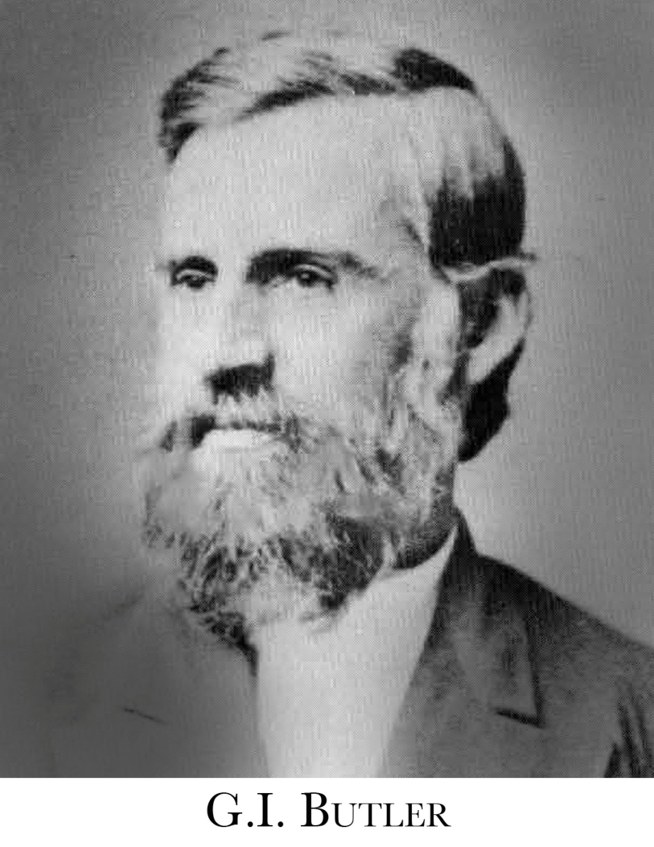
Butler’s View
Notes:
Butler was one of the main leaders who continued to present the extreme view of ceremonial law only, and a dispensational presentation of the plan of salvation. Yet notice Butler’s poor recollection of the issues, and of what he perceived EGW’s position was.

Slide 17
Butler’s View
“I am positive that by far the largest number of our people and of our ministers hold the view that the ‘added law’ added because of the transgression of the moral law is the typical remedial system pointing to Christ, and that law which is the main subject of discussion by the apostle in Galatians is the ceremonial law—Elder J. H. Waggoner was always much opposed to this view, and I judge the young brethren in the office [Jones and E. J. Waggoner] share his sentiments—Your husband, Elder Smith, Canright, myself and many others have held this view.” (G. I. Butler to Ellen G. White, June 20, 1886; in Manuscripts and Memories of Minneapolis, p. 18)
Notes:
Interesting to note is how Ellen White saw Canright’s view
Canright wrote similar views in his book The Two Laws in 1876, and then expanded his coverage of the law in Galatians taken from his 1878 series of Review articles which he later put in the 1882 reprint of his book. W. C. White states that the book was condemned around 1884 (W. C. White to C. H. Jones, Feb. 19, 1886), however, Butler ran “a large edition” in early 1886 before his controversy with Waggoner broke out. Ellen White would later write to Butler after her 1887 impressive dreams: “Elder [D. M.] Canright was presenting his ideas upon the law, and such a mixed up concern I never heard [at 1886 GC?]. Neither of you seemed to see or understand where his arguments would lead to. . . Now, my brethren, I do not feel very happy and reassured when I think you have encouraged Elder Canright in giving lessons to the students in the college, and in pouring into the Review such a mass of matter as though he were bishop of the Methodist Church. . . . I advised his books to be suppressed, especially the one on the law, the very subject he was conversing with you in regard to. If that work is what I believe it to be, I would burn every copy in the fire before one should be given out to our people” (EGW to US and GIB, April 5, 1887; in 1888 Materials, pp. 32-37).

Slide 18
Butler’s View
“This has been a standing question in debate from the beginning of the Cause. At first the position held by Elder [J. H.] Waggoner was considered the true one. But through the efforts of father Stephen Pierce, quite a change of opinion was brought about…. But your husband and Elder Smith listened to what he had to say, and they always held the view afterwards, which he held.” (G. I. Butler to Ellen G. White, August 23, 1886; in Manuscripts and Memories of Minneapolis, p. 21)
Notes:
Butler would continue to push his view even to EGW.

Slide 19
Butler’s View
“The added Law is either the moral or the ceremonial Law systems. You say in substance that Elder [J. H.] Waggoner's position was not correct, his position was that the moral Law was the added Law, hence it must be the other. If our people knew that you had light that the Moral Law was not the added Law, the question would be settled in short order. ” (G. I. Butler to Ellen G. White, March 31, 1887; in Manuscripts and Memories of Minneapolis, p. 70)
Notes:
Butler responding to EGW’s letter of caution to Jones and Waggoner in early 1887 when she perceived they were pushing the issue bringing disunity into the church. Soon after that letter Butler responded with joy. However, EGW soon had “Impressive dreams” where the whole issue of the 1886 conference was revealed to her and who was mostly at fault. Her counsel from then on was primarily directed to Smith and Butler for their part in creating the problem.

Slide 20
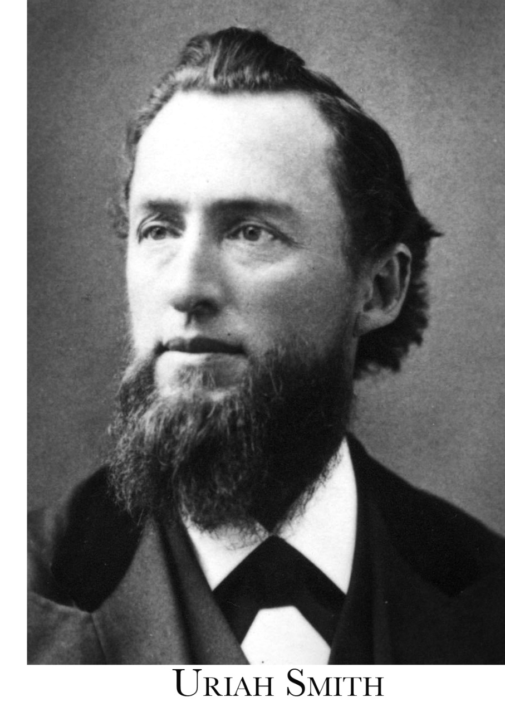
Smith’s View
Notes:
Smith also had a poor recollection of the history of the conflict and of EGW’s position. He would also take the wrong position in regard to the endorsements by EGW of Jones and Waggoner.

Slide 21
Smith’s View
“I supposed the question of the law in Galatians was settled away back in 1856 when Brother Pierce came on from Vermont to have an investigation of the position which Brother J. H. Waggoner took in his first book on the law, namely, that the law in Galatians was the Ten Commandments. At any rate, from that time up to the appearance of the articles in the Signs there was, with a few individual exceptions, unity among our people on that question…. I was surprised at the [Signs] articles, because they seemed to me then [1886], and still seem to me, to contradict so directly what you wrote to J. H. Waggoner on the occasion referred to above. You saw that his position was wrong.” (Uriah Smith to Ellen G. White, Feb. 17, 1890; in Manuscripts and Memories of Minneapolis, pp. 152-153)

Slide 22
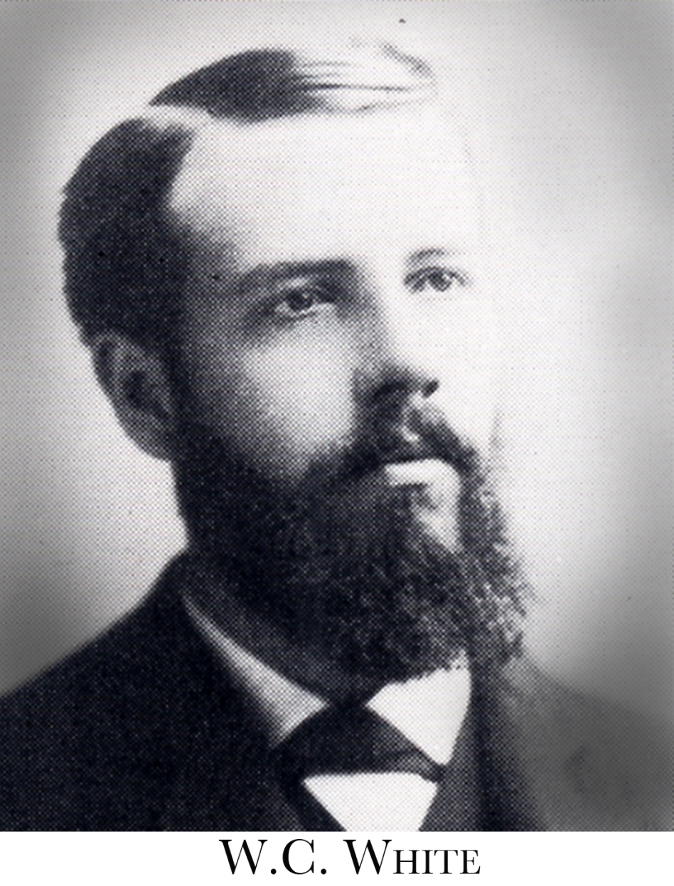
W. C. White’s View
Notes:
W. C. White understood more clearly what the history of the conflicted had been even though he was not involved in the 1850s.

Slide 23
W. C. White’s View
“There is something about the added law on which mother has received light, but it has now passed from her mind. There was something in Eld. [J. H.] Waggoner's position on this which she saw was incorrect. Our brethren may have used this fact to condemn much more than it really referred to.” (W. C. White to C. H. Jones, Aug. 24, 1886; in Manuscripts and Memories of Minneapolis, pp. 25-26)
Notes:
Original controversy arose because of a misapplication of EGW’s comments!

Slide 24
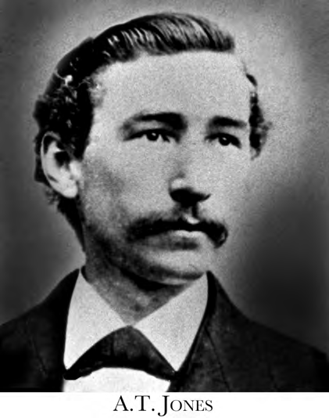
Jones’ View
Notes:
After EGW wrote to E. J. Waggoner and A. T. Jones in early 1887 about the controversy, Jones expressed the opinion that he had not been pushing the issue as he had been accused by Butler and company. He also made it clear the law in Galatians 3 was not the theme of his message but the gospel in Galatians.

Slide 25
Jones’ View
“In my work here, I have not allowed the discussion of the law in Galatians to come up. Several times the question has been asked direct to me in class on that point, and I have told them that I would not undertake to settle it for them at all…. I have told my class here to avoid the discussion of the question of the law in Galatians, on their own part, and to avoid being drawn into any discussion of it by others….
“I thought that if they would keep Christ and the gospel before their minds they would be sure to be on the right side whichever way the question of the law should be finally decided. With Christ before them I could not see how they could possibly go astray. I think however that I have told them I thought they would find both laws there, and the gospel--justification by faith--underlying the whole of it.” (A. T. Jones to Ellen G. White, March 13, 1887; in Manuscripts and Memories of Minneapolis, p. 66)
Notes:
After EGW wrote to E. J. Waggoner and A. T. Jones in early 1887 about the controversy, Jones expressed the opinion that he had not been pushing the issue as he had been accused by Butler and company. He also made it clear the law in Galatians 3 was not the theme of his message but the gospel in Galatians.

Slide 26
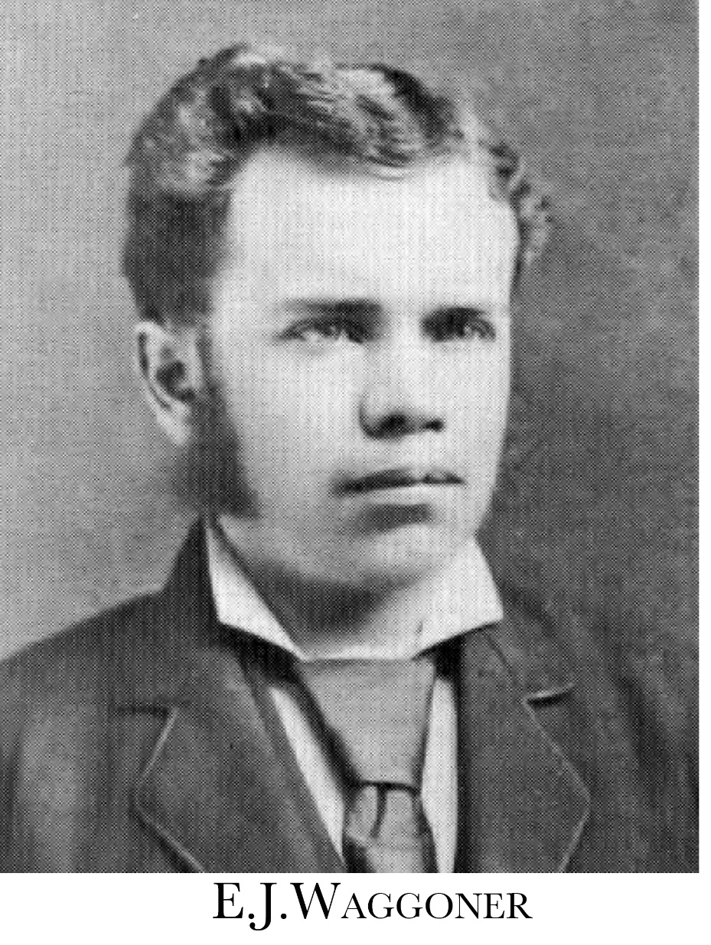
Waggoner’s View
Notes:
E. J. Waggoner wrote to EGW also after her letter of caution to him and Jones. He expressed the opinion that his views differed from his father's.

Slide 27
Waggoner’s View
“I will say also that I have never heard of your having read a testimony to my father in regard to the law. I did not know that you had ever spoken on the subject. If I had known that, the case would have been different. I may state, however, that the view which I have taught is quite materially different from that which father held. I do not know whether or not he now holds the same view.” (E. J. Waggoner to Ellen G. White, April 1, 1887; in Manuscripts and Memories of Minneapolis, p. 71)
Notes:
E. J. Waggoner wrote to EGW also after her letter of caution to him and Jones. He expressed the opinion that his views differed from his father's.

Slide 28
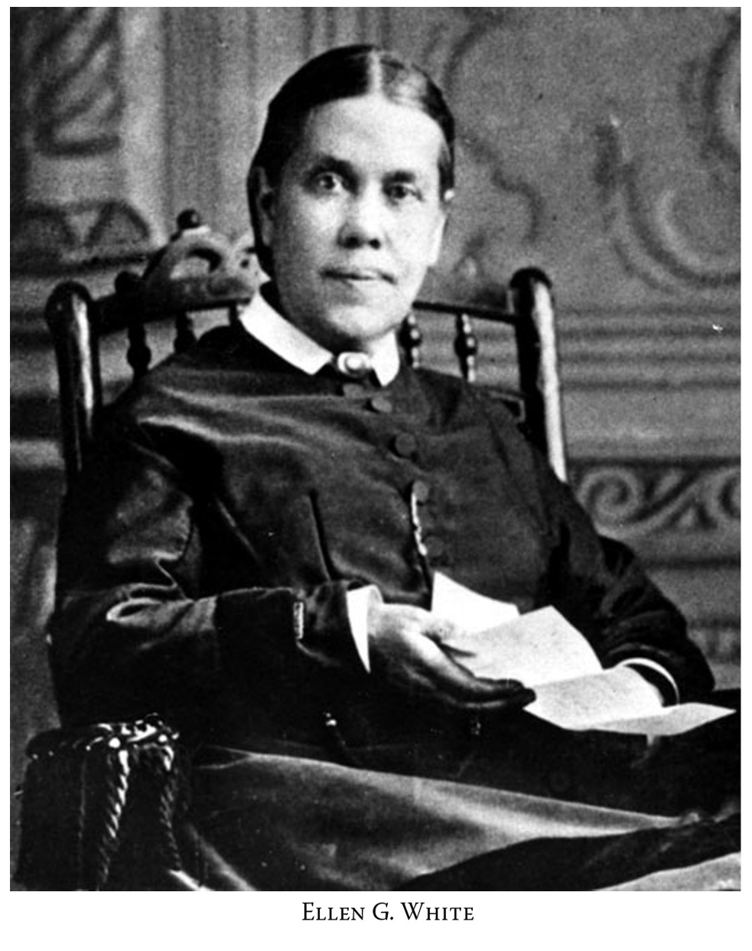
Ellen White’s Response
Notes:
EGW couldn’t find her counsel in regard to the original conflict, nor could she remember what the Lord had shown her. Thus she did not even then support Smith and Butler’s view of the conflict.

Slide 29
Ellen White’s Response
“I am troubled; for the life of me I cannot remember that which I have been shown in reference to the two laws. I cannot remember what the caution and warning referred to were that were given to Elder [J. H.] Waggoner. It may be that it was a caution not to make his ideas prominent at that time, for there was great danger of disunion.” (Ellen G. White to G. I. Butler, April 5, 1887; in 1888 Materials, p. 32)
Notes:
After Butler rejoiced that Ellen White had written a letter of rebuke to Jones and Waggoner for stirring up the issue on Law in Galatians, EGW wrote him with new insight. The issue might not have been so much over which law, but the controversy that would arise if the issue was so pushed.

Slide 30
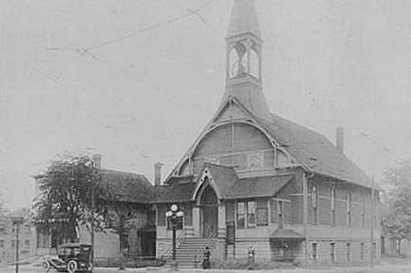
Minneapolis Seventh-Day Adventist Church
Notes:
The controversy spilled into the 1888 GC, with lots of unbelief and questioning of EGW even before the delegates arrived, all because there was a perception that she supported Jones and Waggoner and what they considered new and erroneous views.

Slide 31
Ellen White’s Response at Minneapolis
“When Brother Waggoner brought out these ideas [‘the matchless charms of Christ’] in Minneapolis, it was the first clear teaching on this subject from any human lips I had heard, excepting the conversations between myself and my husband. I have said to myself, It is because God has presented it to me in vision that I see it so clearly, and they cannot see it because they have never had it presented to them as I have. And when another presented it, every fiber of my heart said, Amen.” (Ellen G. White, “Christ and the Law,” Manuscript 5, Sermon June 19, 1889; in 1888 Materials, p. 349)
Notes:
But it was clear to EGW at Minneapolis right off that the issue wasn’t the law in Galatians, but a new, yet old, message of the righteousness of Christ.

Slide 32
Ellen White’s Response at Minneapolis
“Dr. Waggoner has spoken to us in a straightforward manner. There is precious light in what he has said. Some things presented in reference to the law in Galatians, if I fully understand his position, do not harmonize with the understanding I have had of this subject; but truth will lose nothing by investigation….
“I would have humility of mind, and be willing to be instructed as a child. The Lord has been pleased to give me great light, yet I know that He leads other minds, and opens to them the mysteries of His Word, and I want to receive every ray of light that God shall send me, though it should come through the humblest of His servants.” (cont.)
Notes:
Ellen White’s last recorded talk given at the Conference. She wrote down her thoughts so that she could read to them so her words could not be controverted. Even she was willing to learn more from others led by the Lord.

Slide 33
Ellen White’s Response at Minneapolis
“Some interpretations of Scripture given by Dr. Waggoner I do not regard as correct. But I believe him to be perfectly honest in his views, and I would respect his feelings and treat him as a Christian gentleman. I have no reason to think that he is not as much esteemed of God as are any of my brethren,… The fact that he honestly holds some views of Scripture differing from yours or mine is no reason why we should treat him as an offender,…” (cont.)
Notes:
Her statement in regard to Waggoner not being correct in every regard was in the context of the law in Galatians issues. She never held him up as a heretic, nor suggested that her comments were to be used as a blank check by those who wish to condemn anything they want to in Waggoner’s teachings.

Slide 34
Ellen White’s Response at Minneapolis
“I know it would be dangerous to denounce Dr. Waggoner's position as wholly erroneous. This would please the enemy. I see the beauty of truth in the presentation of the righteousness of Christ in relation to the law as the doctor has placed it before us. You say, many of you, it is light and truth. Yet you have not presented it in this light heretofore. Is it not possible that through earnest, prayerful searching of the Scriptures he has seen still greater light on some points? That which has been presented harmonizes perfectly with the light which God has been pleased to give me during all the years of my experience.” (Ellen G. White, “To Brethren Assembled at General Conference,” Manuscript 15, November, 1888; in 1888 Materials, pp. 163-164)
Notes:
Ellen White saw light and truth in Waggoner’s general presentation of righteousness of Christ in relation to the law. This harmonized perfectly with the light God had given her even though she had stated early he had some views that differed from hers. But this was in regard to some of the specific details about the law in Galatians issue which did not line up with what EGW had understood before this time.
Some take these statements out of context, and use EGW's statement about not agreeing as a blank check to condemn all he said.

Slide 35
Ellen White’s Endorsement of Jones & Waggoner
“From Mrs. E. G. White’s attitude and words at that time it was plain she stood one hundred percent with Elders Jones and Waggoner in the message they were presenting at that General Conference meeting” (R. T. Nash, “An Eyewitness Report,” p. 6, emphasis supplied. See also: Manuscripts and Memories, p. 355).
Notes:
R. T. Nash 1955 remembers that EGW was behind them 100%

Slide 36
George Burt Starr
Notes:
Minister G. B. Starr (1854 to 1944), worked with Dwight L. Moody in 1875 as a young minister. Became an Adventist in 1876, ordained in 1879. Worked in Chicago in the 1880s until 1891 when he would later spend ten years with Ellen White in Australia. He was one who received a rich blessing at Minneapolis, where “the subject of Righteousness by Faith was emphasized.”

Slide 37
Ellen White’s Endorsement of Jones & Waggoner
“It was our privilege to attend this meeting and daily to listen to Sister White as she unqualifiedly endorsed the powerful and convincing presentation of this vital subject from the books of Romans and Galatians. Never were clearer proofs given to an assembly that the Lord was speaking through the Spirit of Prophecy. Morning after morning Sister White would reveal the words and conversations of individuals, spoken in their private compartments.” (G. B. Starr, “The Minneapolis General Conference of 1888: Righteousness by Faith Endorsed by the Testimonies,” unpublished paper, Ellen G. White Estate Document Files, Loma Linda Branch Office)
Notes:
G. B. Starr reports on what took place as a result of EGW’s endorsement of Jones and Waggoner, because their teaching differed from others in regard to how they saw Adventist history prior and EGW’s counsel before.

Slide 38
Result of Ellen White’s Endorsement of Jones & Waggoner
“I attended the meeting at Minneapolis, the history of that meeting has passed into eternity with its burden of record and when the judgment shall sit and the books shall be opened there will be found registered a history that many who were at that meeting will not be pleased to meet…. I never felt more decidedly the Spirit of the Lord moving upon me than at that meeting. And I know the angels of the Lord were standing by my side to help me. I seemed to live as in clear light of the Sun of Righteousness, but the spirit that prevailed at that meeting was not the Spirit of God. I had to bear a decided testimony against the spirit that prevailed, … but my testimony was treated with indifference as idle tales. I was charged with being influenced by my son W.C.W., Elder A.T. Jones, E. J. Waggoner.” (Ellen G. White to Brethren, Letter 67, Sept. 17, 1890; in 1888 Materials, pp. 706-707)
Notes:
EGW’s testimony of what took place because of her endorsement of the message and the messenger.

Slide 39
Result of Ellen White’s Endorsement of Jones & Waggoner
“Never before have I seen among our people such firm self-complacency and unwillingness to accept and acknowledge light as was manifested at Minneapolis.” (EGW to F. E. Beldon, Letter 2a, Nov. 5, 1892; in 1888 Materials, p. 1067)
“My testimony was ignored, and never in my life experience was I treated as at that conference;” (Ellen G. White to W. M. Healey, Letter 7, Dec. 9, 1888; in 1888 Materials, p. 187).
“I tell you the work God has given me to do has not suffered and is not likely to suffer half as much from open opposers as from my apparent friends, those who appear to be defenders of the Testimonies, but are their real assailants; who weaken them and make them of none effect.” (Ellen G. White to G. I. Butler, Letter 18, Dec. 11, 1888; in 1888 Materials, p. 194)
Notes:
The end result of the unbelief which was generated because of her endorsements. Has anything changed?

Slide 40
Result of Ellen White’s Endorsement of Jones & Waggoner
“My guide said, ‘Follow me.’ I was then taken to the different houses where our people made their homes. I heard the conversation, the remarks, made in reference to myself; the testimonies borne at that meeting were commented upon. W.C.W. was talked of and presented in a most ridiculous light. I could define the speakers by their voices. A. T. Jones was commented upon in like manner, so was E. J. Waggoner, Said my guide, ‘Where is the earnest prayer, the seeking of God with humble heart for light?’ I was listening in the different rooms to the sarcastic remarks, unchristian comments, the excitable, exaggerated statements made all because that there was a difference in the views of the law in Galatians.” (Ellen G. White to J. Fargo, Letter 50, May 2, 1889; in 1888 Materials, pp. 296-297)
Notes:
EGW wrote of how she was shown what was going on in the rooms at Minneapolis in a letter to J. Fargo.

Slide 41
Result of Ellen White’s Endorsement of Jones & Waggoner
“Bro. Olsen you speak of my return to America. For three years I stood in Battle Creek as a witness for the truth. Those who then refused to receive the testimony given me by God for them, and rejected the evidences attending these testimonies, would not be benefited should I return….
“While at Minneapolis He bade me follow him from room to room, that I might hear what was spoken in the bed chamber. The enemy had things very much his own way. I heard no word of prayer, but I heard my name mentioned in a slurring, criticizing way.” (Ellen G. White to O. A. Olsen, Letter 81, May 31, 1896; in 1888 Materials, p. 1564)
Notes:
Even in 1896 EGW would refer back to this event.
“and if they judge of me in this light, fired with a zeal that certainly is from beneath, they have thought and said worse things of Brethren Jones and Waggoner.” (1888 Materials, p. 323)

Slide 42
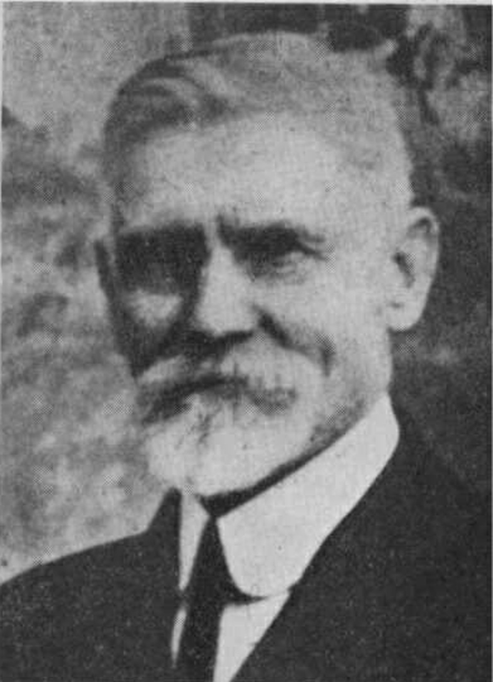
F. H. Westphal
Notes:
F. H. Westphal who attended 1888 Conference and returned home with the belief that the Latter Rain had begun (Movement of Destiny, p. 262)

Slide 43
Result of Ellen White’s Endorsement of Jones & Waggoner
“I will relate what I remember of the 1888 General Conference in Minneapolis, Minn. It rings in my ears still, how Sister White earnestly appealed to the conference to accept the message of Justification by Faith…
“She said that she was carried in vision from room to room where the delegates were located in Minneapolis and heard their conversation and ridicule of the message of justification by faith. They said that Sister White was growing old and getting childish, and that the young men, Jones and Waggoner, had her under their thumb and had influenced her to uphold them in what they were teaching.” (F. H. Westphal to W. C. White, June 29, 1932, White Estate Word Document File 189-C)
Notes:
F. H. Westphal who attended 1888 Conference and returned home with the belief that t he Latter Rain had begun (Movement of Destiny, p. 262), remembered very clearly this event also.

Slide 44
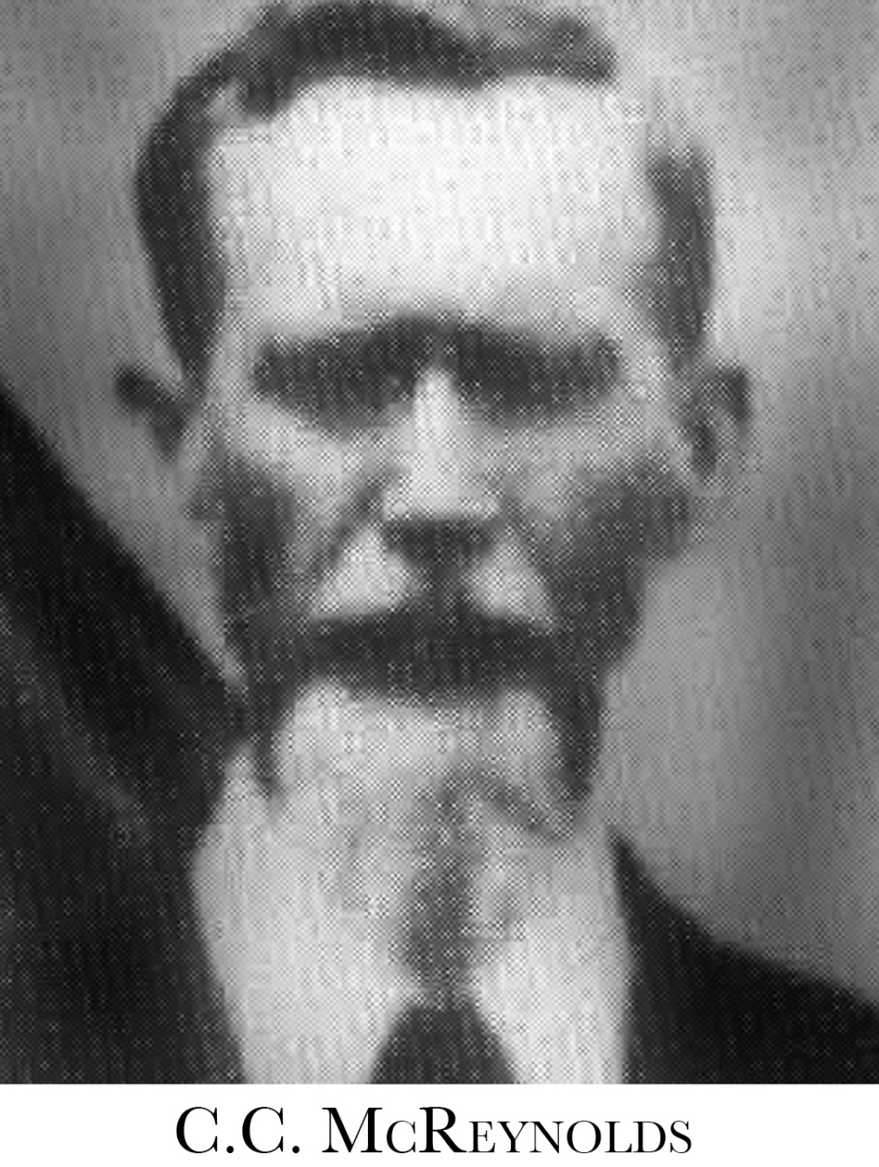
Notes:
Chester C. McReynolds was a delegate from Kansas to the 1888 General Conference. This is what he had to say in 1931 when responding to Taylor Bunch (see 2nd presentation). He couldn’t help but tell the truth about the rebellion that was present there.

Slide 45
Result of Ellen White’s Endorsement of Jones & Waggoner
“Being decidedly prejudiced in favor of Elder Butler and against E. J. Waggoner I went to that meeting with a prejudiced mind…. As Elder Waggoner started in it seemed very different from what I was looking for. By the close of his second lesson I was ready to concede that he was going to be fair and his manner did not show any spirit of controversy, nor did he even mention any opposition that he was anticipating. Very soon his manner and the pure Gospel that he was setting forth had materially changed my mind and attitude and I was an earnest listener for Truth.” (cont.)

Slide 46
Result of Ellen White’s Endorsement of Jones & Waggoner
“In our lodging house we were hearing a good many remarks about Sister White favoring Elder Waggoner, that he was one of her pets. The spirit of controversy was up, and when the delegates came in from the last meeting of the day there was simply Babble, with much laughter and joking and some very disgusting comments were being made, no spirit of solemnity prevailing. A few did not engage in the hilarity. No worship hour was kept, and anything but the solemnity that should have been felt and manifested on such an occasion was present.” (C. C. McReynolds, “Experiences While at the General Conference in Minneapolis, Minn. in 1888,” 1931; in Manuscripts and Memories of Minneapolis, p. 339)
Notes:
By 1931 , McReynolds had forgotten [?] that he had been drawn into the criticism. Notice EGW statement in 1889: “Bro. McReynolds bore testimony that the description given by Sister White was true to the letter. He was unfortunate enough to be one of the number in the room with the Iowa brethren and he was distressed for two weeks. He was not drawn in but the current became too strong and he lost his bearings and confessed he united in the spirit to some degree. He said for two weeks as Sister White has said, there was not a vocal prayer offered in the house. He had before this made humble confessions to me of this matter which he repeated at the meeting.” (1888 Materials, pp. 298-299)

Slide 47
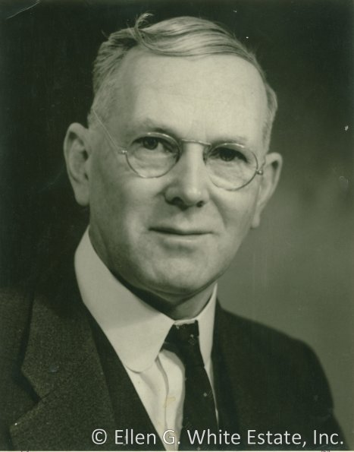
D. E. Robinson
Notes:
D. E. Robinson, born in 1879, was not present at the 1888 Minneapolis conference, but worked at the White Estate in the 1920s. After getting word of the week-of-prayer meetings Taylor Bunch did at PUC, Robinson wrote him a letter of concern. Although he readily admitted that there was opposition, he animatedly opposed the idea that the message of Righteousness by faith had been rejected/resisted to a large degree by the church or denominational leadership.

Slide 48
Result of Ellen White’s Endorsement of Jones & Waggoner
“So far was the feeling carried, that a spirit of levity and sarcasm was manifest among many of the older workers against these individuals [Jones and Waggoner]. But the most serious feature of the disaffection was the fact that, because Sister White urged the importance of the message of righteousness by faith, and because thereby she seemed to be upholding these brethren, contrary to their judgment, it grew into a spirit of rejection of the Testimonies of Sister White. ‘Elder Waggoner was Sister White’s pet,’ was a common remark. (cont.)
Notes:
Robinson remembers the incident only because it was talked about, not because he was there. Thus he uses the word “seemed” regarding EGW’s endorsement of Jones and Waggoner. This seems to express the unbelief even in 1930 in regard to EGW’s full endorsement of Jones and Waggoner.

Slide 49
Result of Ellen White’s Endorsement of Jones & Waggoner
“This contempt of Sister White's testimony is evidenced by the many letters written by her at that time. Her statement that she had not talked these subjects over with either Elder Waggoner or Jones, was openly flouted and disbelieved by some.” (D. E. Robinson to Taylor G. Bunch, Dec. 30, 1930; in Manuscripts and Memories of Minneapolis, p. 334) [Letter falsely attributed to W. C. White]

Slide 50
The Church Always Believed in the Message of Righteousness by Faith
“The position that Brother [E. J.] Waggoner now takes is open to exactly the same objection [as J. H. Waggoner’s 1854 book]. So you see two reasons why I can but look upon it with distrust; namely, because, first, it seems to me contrary to the Scriptures, and secondly, contrary to what you have previously seen. I do not mean his views on justification by faith, and righteousness through Christ, for those we have always believed; but his view on the law in Galatians, which he deduces as a conclusion from his premises on those other points.” (cont.)
Notes:
Uriah Smith claimed that Adventists had always believed in Righteousness by Faith. The issue with Jones and Waggoner, according to Smith, wasn’t RbF but the law in Galatians. He wrote this during the 1890 Ministerial Institute.

Slide 51
The Church Always Believed in the Message of Righteousness by Faith
“The real point at issue at that Conference was the law in Galatians; but Brother Waggoner's six preliminary discourses on righteousness we could all agree to; and I should have enjoyed them first rate, had I not known all the while that he designed them to pave the way for his position on Galatians, which I deem as erroneous.
“I of course do not believe there is any necessary and logical connection between the two, but you know a truth may be used in such a way and with such an apparent purpose, as to spoil the pleasure we would otherwise feel in listening to it. He took his position on Galatians, the same which you had condemned in his father.” (Uriah Smith to Ellen G. White, Feb. 17, 1890; in Manuscripts and Memories of Minneapolis, pp. 154-155)

Slide 52
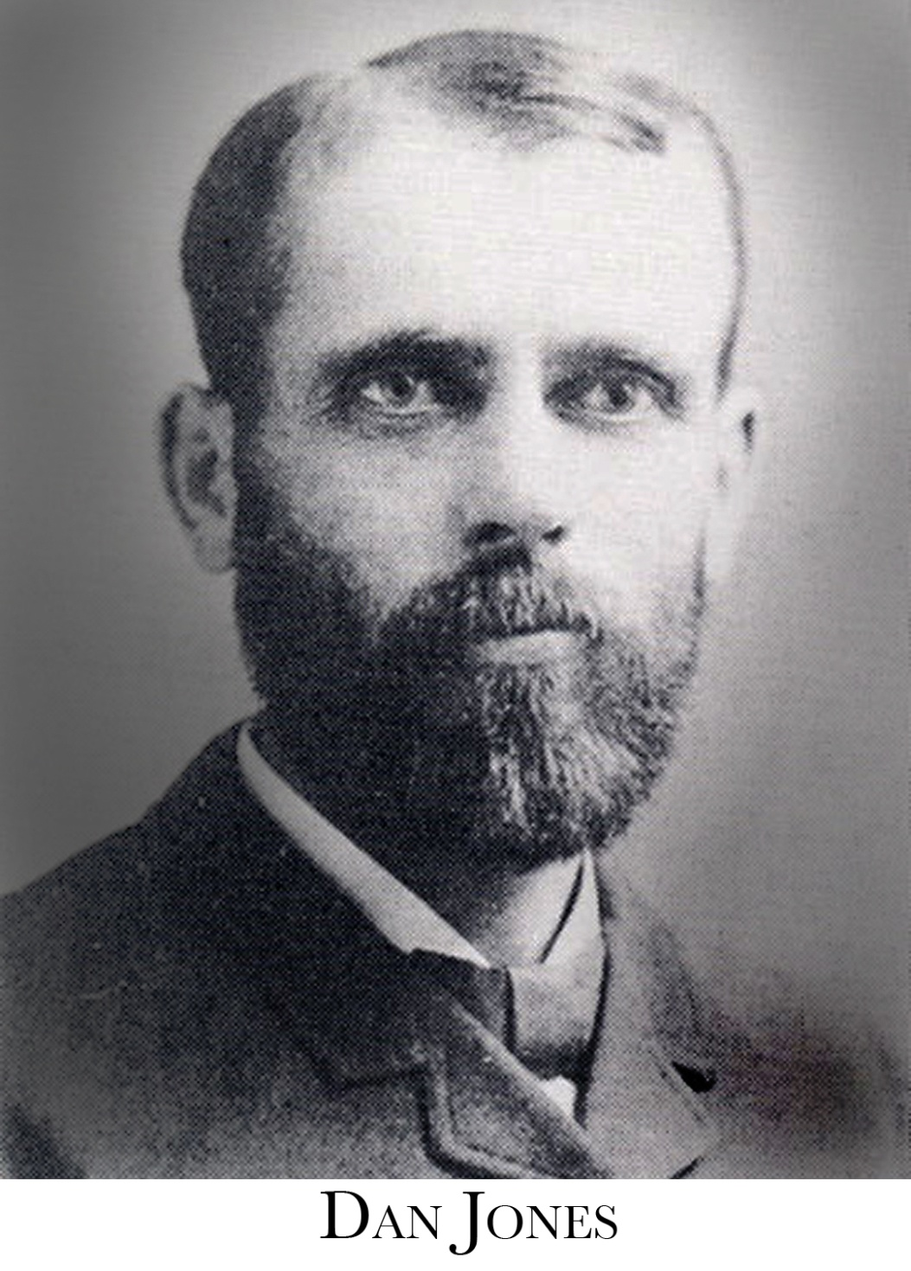
Notes:
1890 Ministerial Institute. Dan Jones, Secretary of the GC, was key player in the opposition to Jones and primarily Waggoner, on the issue of Law in Galatians and the covenants.
EGW had made it clear in letters to Smith and in a Sabbath morning talk that the Covenants as Waggoner had presented them were correct:
“Now I tell you here before God, that the covenant question, as it has been presented [by Waggoner], is the truth. It is the light. In clear lines it has been laid before me. And those who have been resisting light, I ask you whether they have been working for God, or for the devil?” (Ellen G. White Manuscript 4, “Sermon,” March 8, 1890; in 1888 Materials, p. 596.)
That same Sabbath morning she stated most emphatically to Smith: “Night before last I was shown that evidences in regard to the covenants were clear and convincing. Yourself, Brother Dan Jones, Brother Porter and others are spending your investigative powers for naught to produce a position on the covenants to vary from the position that Brother Waggoner has presented. … The Covenant question is a clear question and would be received by every candid, unprejudiced mind.” (Ellen G. White to Uriah Smith, Letter 59, March 8, 1890; in 1888 Materials, p. 604.)
Yet notice how Dan Jones missed this whole point.

Slide 53
The Church Always Believed in the Message of Righteousness by Faith
“I have tried to avoid any prejudice, or wrong spirit, or feeling since the Minneapolis meeting, in reference to Dr. Waggoner, Eld. Jones, yourself or any one else that was specially connected with pushing forward the law in Galatians, the covenant question, etc….
“I thought the doctrine of justification by faith, with which I have agreed theoretically, and with which all our leading brethren have agreed, was only a rider, so to speak, to carry through these other things that were more subject to criticism; and by connecting the two together,—one with which no one found objection,—that rather than reject those that were unobjectionable, our people would be led to accept that which they could not, fully endorse.” (Dan T. Jones to W. C. White, March 18, 1890; in Manuscripts and Memories of Minneapolis, pp. 159, 161)
Notes:
Yet Dan Jones still misunderstood in regard to the message of RbF. He missed the point that Jones and Waggoner’s message was about RbF, and the Law and Covenants only exemplified their teachings or were a part of their teaching which EGW had now endorsed. Dan J. felt, like Smith, that they had always believed in RbF.

Slide 54
The Church Always Believed in the Message of Righteousness by Faith
“Your mother and Dr. Waggoner both say that the points of doctrine are not the matters at issue at all, but it is the spirit shown by our people in opposition to these questions, which they object to.” (Dan T. Jones to W. C. White, March 18, 1890; in Manuscripts and Memories of Minneapolis, p. 161)
Notes:
Yet notice how Dan Jones missed this whole point. Now it wasn’t the doctrine, it was just the spirit that was important.
Many of those who opposed the message presented by Jones and Waggoner
vacillated on the reasons for their opposition. At times the content of the
message was the focus of their objections, while on other occasions the spirit
of the messengers was held up as the reason for opposition.

Slide 55

The Truth about Dan Jones?
Notes:
The Question is how have we done with the Dan Jones and 1890 Ministerial Institute today? Are we still as confused? Are we interpreting EGW’s comments correctly? Are we dealing correctly with EGW’s endorsements? Are we accurate with our history? Or are we just repeating the same confused ideas of Dan Jones.

Slide 56
The Truth about Dan Jones?
“In a subsequent meeting, Ellen White came to grips with the obsession over doctrinal issues. ‘She says,’ Dan Jones reported, ‘it is not what we believe that she feels exercised about; it is not that we should all hold just the same view in reference to the covenants, in reference to the law in Galatians, or in reference to any other point of doctrine; but that we should all have the spirit of Christ, and should be united in building up and pushing forward the third angel’s message’ [DTJ to J. D. Pegg, Mar 17, 1890].
That quotation takes on much more meaning when we realize that a week earlier Ellen White had publicly told the ministers, including Dan Jones, that she had been shown that Waggoner had the truth on the covenants.” (cont.)
Notes:
George Knight quotes from Dan Jones as an authority on the issues of 1888, and uses him as if he speaks Ellen White’s thoughts. Knight does this even going as far to contrast them with her earlier statements, pitting Dan Jones’ recollection against EGW and putting Dan Jones’ ideas above EGW in the end.

Slide 57
The Truth about Dan Jones?
“[Ellen White] was still more concerned with their attitudes than with their acceptance of her and Waggoner’s theological position. It was that fact that had so surprised Dan Jones and opened him up to reconciliation….
“Those explanations [of Ellen White] proved to be a major turning point in the post Minneapolis conflict.… The spirited interchange that led to the breakthrough in March 1890 illustrates Mrs. White’s point that the real crisis at Minneapolis was not theological or doctrinal, but attitudinal.… One result [of the 1890 Ministerial Institute] was a renewed confidence in Ellen White.” (George R. Knight, Angry Saints, pp. 93-94, emphasis in original)
Notes:
George Knight also claims that there was renewed confidence on EGW, even though Dan Jones was obviously misquoting EGW.

Slide 58
The Truth about Dan Jones?
“Ellen White had repeated conversations with [Dan] Jones and urged him to use his influence to help pastors understand the meaning of the doctrine of righteousness by faith presented in Minneapolis in 1888. During a ministerial institute in Battle Creek in the early months of 1890 Jones appeared prejudiced against Ellen White’s ministry until he realized this was a temptation he should resist and, weighing the evidence, accepted that her gift of prophecy is an integral part of the Seventh-day Adventist message.” (“Jones, Dan T.” Ellen White Encyclopedia, p. 432)
Notes:
Sometimes the concepts expressed by Knight are picked up by other authors or books who assume that the facts he presents are true. But are they?
Short Biographical entry on Dan Jones in an Adventist Encyclopedia. Is this true?

Slide 59

The Truth about Dan Jones?
Notes:
Chapter 13-16 in RLR deal with the 1890 Ministerial Institute, primarily chapters 14 and 15. Ron Duffield seeks to deal with the concepts of Dan Jones regarding the 1888 happenings.
I am not lauding my book or my scholarship, just pointing out that sometimes if we let history speak it tells a different story.

Slide 60
The Truth about Dan Jones?
“’If you turn from one ray of light fearing it will necessitate an acceptance of positions you do not wish to receive, that light becomes to you darkness.… I speak what I know.’…
“No greater evidence could be given that Ellen White’s prognosis was correct than the experience of Dan Jones following the 1890 Ministerial Institute. On almost every point, he misunderstood what Ellen White said during her final week at the Institute. Ellen White had clearly endorsed Waggoner’s view on the covenants, warning the brethren that their own view on the law in Galatians was preventing many from receiving light. She herself was not exercised over the matter, for it was not an issue to keep her from accepting advancing light. This Dan Jones had interpreted as evidence that she did not endorse Jones and Waggoner, and that all could believe what they wanted.” (cont.)
Notes:
Ron Duffield summary 1 of 2 from 1890 Ministerial Institute and Dan Jones
EGW Quote….

Slide 61
The Truth about Dan Jones?
“Ellen White had stated that the spirit manifested by the brethren should be of bigger concern than their pet ideas. To this Dan Jones suggested that doctrine was not the important point, but only the spirit one had. Yet in the end he allowed only for his own view.
“Ellen White had stated that there was no organized plan to push the law in Galatians and the covenants, but that the real message was justification by faith. This Dan Jones twisted to mean that a mere assent to justification by faith, which he already espoused, was sufficient without accepting Jones’ and Waggoner’s message.” (Ron Duffield, Return of the Latter Rain, vol. 1, p. 407)
Notes:
When Ellen White’s Patriarchs and Prophets came out that same spring with the new chapter on the covenants, some of the brethren didn’t want to sell the book.

Slide 62
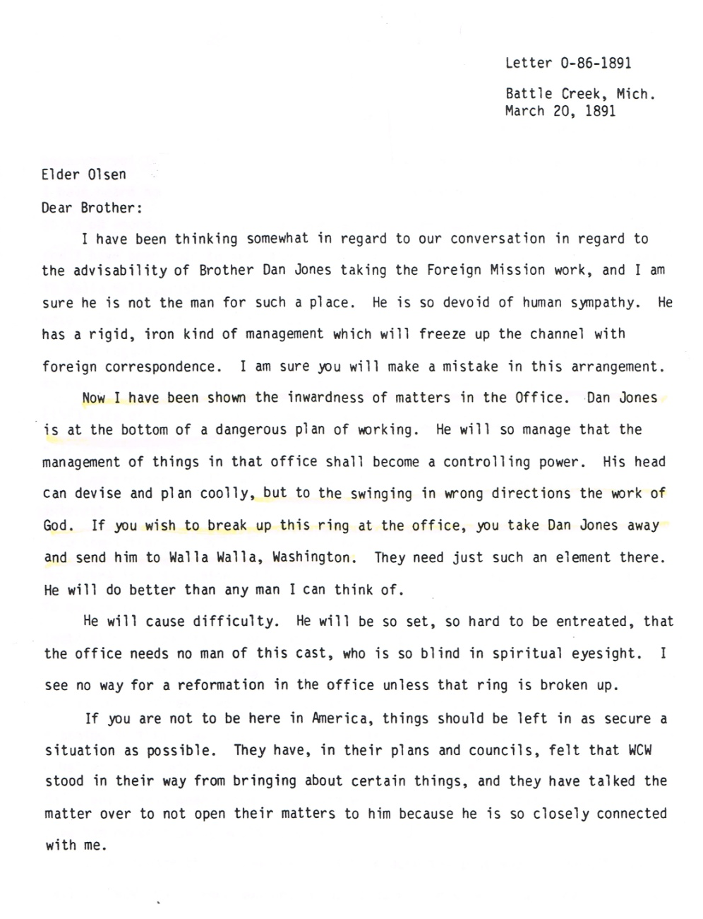
The Truth about Dan Jones?
Notes:
All of this become clearer when we let the SOP have a say! Ellen White wrote 1 year later, after Dan Jones’ supposed conversion etc., at the 1890 Ministerial Institute. Notice what she says!

Slide 63
The Truth about Dan Jones?
“Now I have been shown the inwardness of matters in the Office. Dan Jones is at the bottom of a dangerous plan of working. He will so manage that the management of things in the office shall become a controlling power. His head can devise and plan coolly, but to the swinging in wrong directions the work of God…. He will cause difficulty. He will be so set, so hard to be entreated, that the office needs no man of this cast, who is blind in spiritual eyesight. I see no way for a reformation in the office unless that ring is broken up….
“They have, in their plans and councils, felt that WCW stood in their way from bringing about certain things, and they have talked the matter over to not open their matters to him because he is so closely connected with me.” (cont.)
Notes:
1 of 3

Slide 64
The Truth about Dan Jones?
“Dan Jones, Eldridge, and A. R. Henry do not believe in the testimonies. I know whereof I speak. They have a power, but Dan Jones is THE great instigator. I have heard him talk in reference to WCW. They think he informs me of things going on among them. Very hard speeches have been made in reference to my work, for I have been made to hear them….
“But there is a determined effort on the part of this confederacy at the office to manage so that WCWs voice shall not have influence. He voices his mother’s instruction from Heaven too closely to sit their ideas.
“Since I heard the speech of Dan Jones, I see it is of just the same character as the Lord revealed to me that was at the foundation of their devising and planning in their councils….” (cont.)
Notes:
2 of 3

Slide 65
The Truth about Dan Jones?
“I have been shown [that] the design is to disconnect their work from me, and they think they will then be untrammeled to work on according to their plans. God forbid! is my prayer. Not one of the men—Dan Jones, Eldridge, Henry—have the love of Jesus abiding in their hearts. Not one of these feel as men should who are handling large responsibilities. They do not seek God for counsel. They trust in their own wisdom, and have no use for anyone who shall not accept and voice their suggestions….
“[WCW’s] heart and prayers and Christlike sympathies are interwoven with the work. And Satan is moving in a secret, underhanded manner to separate all who have connection with me and my work, from the great whole. They have no need of me. They think [that] if Sister White were only out of the way, they could do a wonderful thing. I write these things to you because you must know them and act in reference to them. The men in the office are not converted men.” (Ellen G. White to O. A. Olsen, March 30, 1891, unpublished, portions quoted in Jerry Allen Moon, W. C. White and Ellen G. White: The Relationship Between the Prophet and Her Son, p. 111)
Notes:
3 of 3
This letter is unpublished, but you can find it in Jerry Moon’s dissertation which is very enlightening.
(Ellen G. White to O. A. Olsen, March 30, 1891, unpublished, portions quoted in Jerry Allen Moon, W. C. White and Ellen G. White: The Relationship Between the Prophet and Her Son, [Berrien Springs, MI: Andrews University Press, 1993], p. 111)
So we asked the question:
How are we doing as a church today in applying Ellen White’s statements in regard to 1888?
What about her endorsements of Jones and Waggoner, do we take Dan Jones' view or Ellen White’s view?
How are we doing on accurately reporting our history?

Slide 66
The Latter Rain and the Loud Cry Ultimately Resisted
“’The law was our schoolmaster to bring us unto Christ, that we might be justified by faith.’ In this scripture, the Holy Spirit through the apostle is speaking especially of the moral law. The law reveals sin to us, and causes us to feel our need of Christ, and to flee unto him for pardon and peace by exercising repentance toward God and faith toward our Lord Jesus Christ.
“An unwillingness to yield up preconceived opinions, and to accept this truth, lay at the foundation of a large share of the opposition manifested at Minneapolis against the Lord's message through Brethren Waggoner and Jones.” (cont.)
Notes:
Move to 1896 now and look at Ellen White’s final summary of the controversy as far as the law in Galatians goes.
1 of 2

Slide 67
The Latter Rain and the Loud Cry Ultimately Resisted
“By exciting that opposition, Satan succeeded in shutting away from our people, in a great measure, the special power of the Holy Spirit that God longed to impart to them [Latter Rain]. The enemy prevented them from obtaining that efficiency which might have been theirs in carrying the truth to the world, as the apostles proclaimed it after the day of Pentecost [Latter Rain]. The light that is to lighten the whole earth with its glory [Rev. 18:1 - Loud Cry] was resisted, and by the action of our own brethren has been in a great degree kept away from the world.” (Ellen G. White to Uriah Smith, Letter 96, June 6, 1896; in 1888 Materials, p. 1575)
Notes:
EGW used the words "resisted" and "rejected" in describing the response to the message of 1888. "Resisted" seems to be her summary statement although she also used "rejected" in many other statements.
“In Minneapolis God gave precious gems of truth to His people in new settings. This light from heaven by some was rejected with all the stubbornness the Jews manifested in rejecting Christ.” (1888 p. 518)
“By many, the words which the Lord sent will be rejected, and the words that man may speak will be received as light and truth.” (1888 p. 727)
“The God of Israel has opened the windows of heaven and sent to the world rich floods of light, but that light has been rejected. The spirit manifested in Battle Creek has been the spirit of many churches.” (1888 p. 746)
“The true religion, the only religion of the Bible, that teaches forgiveness only through the merits of a crucified and risen Saviour, that advocates righteousness by the faith of the Son of God, has been slighted, spoken against, ridiculed, and rejected. It has been denounced as leading to enthusiasm and fanaticism.” (1888 p. 955, Salamanca vision)
"Rejected" used over 50 times in 1888 materials. But we can be harmless as doves and wise as serpents by using "resisted" when necessary.

Slide 68
Old Views Never Changed!
“I have never seen occasion to change my position [on the law in Galatians] since 1856…. Sr. White had a vision, in which she saw in regard to this investigation, and wrote to Bro. [J. H.] Waggoner, ‘I saw that your position was wrong.’ That settled the question with us…. But now a great many do not know that Sr. W, has over seen anything on this question, and she has lost what she has written, so it cannot be produced….
“At conference in 1888, I attempted to explain these things; and was at once charged with denying justification through Christ, as false a view, and as unjust a charge, as could possibly be made. I then gave up this question in discouragement, and do not intend to say anything more on the subject.” (Uriah Smith to H. J. Adams, Oct. 30, 1900; in Manuscript and Memories of Minneapolis, p. 304)
Notes:
Yet, did that letter change the views of Smith and Butler?

Slide 69
Old Views Never Changed!
“I am sorry that you are not pleased with the remarks of Brother Brickey on Galatians, for I think he is correct. This, if you are acquainted with the past history of our cause, you will remember, used to be the old established view of our people,…
“It seems to me that if any dissatisfaction was aroused, or any injury done, it should have been when this view was ruthlessly broken into by the articles in the Signs Of The Times, and the lectures in Healdsburg College and subsequent articles in the Youth's Instructor and Review.
“We have always believed in Justification by faith; and, how the articles of Brother Brickey militate against that view, I do not see. We have had this battle to fight all along for the past forty years, against the charges of our opponents who claimed the law was abolished, and appealed to Galatians in proof of it.” (Uriah Smith to L. F. Trubey, Feb. 11, 1902; in Manuscript and Memories of Minneapolis, p. 312)
Notes:
As senior editor of the Review, A. T. Jones ran a series of articles on the book of Galatians from July 1899 through Nov. 1900 where he primarily took the stance that the issue in Galatians was over two gospels. He however did teach that the schoolmaster included the moral law that leads us to Christ. When Uriah Smith became senior editor again in 1901 he ran a series of articles by Brother Brickey on the law in Galatians. Here Brickey tried to revive the old conflict over the moral vs ceremonial law claiming the law in Galatians was the ceremonial law alone. He also taught a more dispensational gospel.
Smith died a year later, March 6, 1903.

Slide 70
Old Views Never Changed!
“While attending the Florida camp-meeting a few weeks ago, Brother Butler told me in the course of the interview we were having how he felt about the message Jones and Waggoner brought to this denomination in 1888. He spoke especially of their position on the laws and covenants, and then pointed to the course they are now taking, and told me with considerable emphasis, that he never could see light in their special messages, and that he had never taken his position.
“Now, Brother White, you and I know full well, that those brethren brought light in the laws and covenants, and on righteousness by faith instead of works. The Spirit of Prophecy later endorsed some of the new views they presented. In Patriarch and Prophets, we find the most positive statements regarding the new covenant, and they contradict the former teaching of our brethren on this subject.” (A. G. Daniells to W. C. White, Jan. 21, 1910; in Manuscript and Memories of Minneapolis, p. 325)

Slide 71
Old Views Never Changed!
“It is quite possible that Elder Jones or Waggoner may be overthrown by the temptations of the enemy; but if they should be, this would not prove that they had had no message from God, or that the work that they had done was all a mistake. But should this happen, how many would take this position, and enter into a fatal delusion because they are not under the control of the Spirit of God…. I know that this is the very position many would take if either of these men were to fall,…” (Ellen G. White to Uriah Smith, Letter, 24, Sept. 19, 1892; in 1888 Materials, pp. 1044-1045)
Notes:
Jones and Waggoner did fall to temptation as Ellen White had earlier warned; now Butler expressed that he had never changed.
So again, how were they doing on the three points brought out in the BRI report? How did this first generation that dealt with 1888 (the second generation of SDA’s in general), deal with Ellen White’s comments in regard to 1888? How did they deal with EGW’s endorsements of Jones and Waggoner? How accurate where they with Adventist history?
The answer depends on which River of thought one takes coming out of Minneapolis.

Slide 72
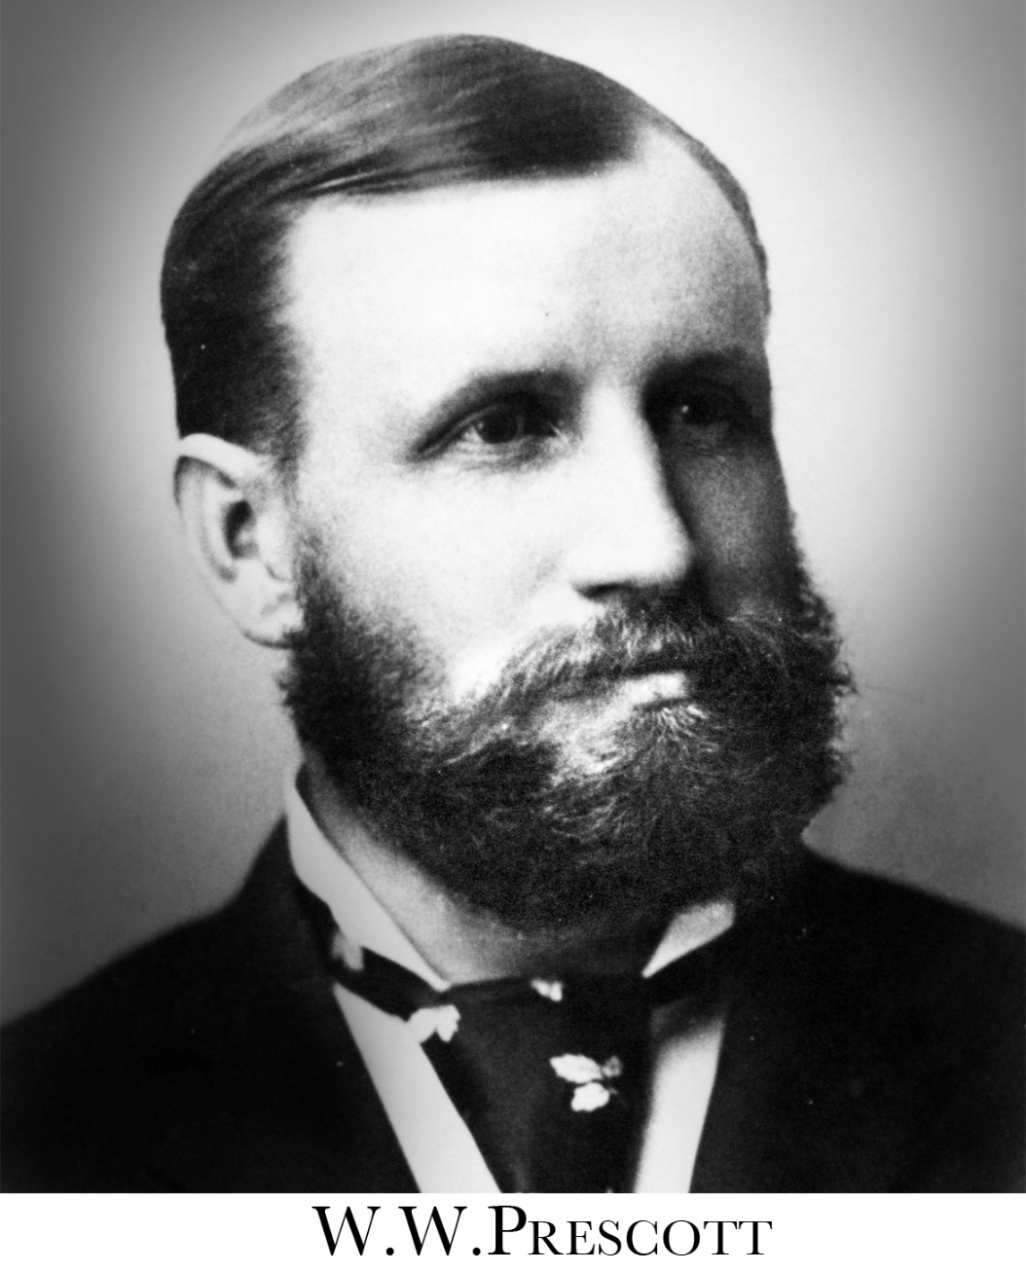
A Message Shorn of its Power
Notes:
What was the result of not applying EGW’s counsel correctly, not seeing the endorsements of Jones and Waggoner and the message correctly, and not viewing the history of the message correctly? W. W. Prescott sums it up.

Slide 73
A Message Shorn of its Power
“I have just been giving some special study to the testimonies which have been borne to this people since the Minneapolis conference, and I have been able to see as never before what a departure there has been from the very principles which the Lord would have His people reveal to the world just now, and how the message has thus been shorn of all its power.
“It seems as though we were traveling over the same ground that the Jews passed over just before the birth of Christ, and that we are as much unprepared for His coming as they were for His coming then, while at the same time laying much outward stress upon the prophecies which speak of the near advent.” (cont.)

Slide 74
A Message Shorn of its Power
“I am sometimes greatly weighed down by the condition of things in the body as a whole.... We are daily praying that the Lord will forgive the past and reveal His power for the furtherance of the truth....
“I know that your position in America must be a most trying one, and we do not forget to pray that the Lord will give you the needed grace to bear your testimony, and that the Lord will remove the rebuke which rests upon His people.” (W. W. Prescott to Ellen G. White, Dec. 14, 1900; White Estate Letter File, Loma Linda Branch Office).
Notes:
Prescott saw that there must be a repentance for the past in order to remove the rebuke. BUT THAT REQUIRED AN ACKNOWLEDGEMENT THAT EGW’S COUNSEL WAS TRUE, THAT HER ENDORSEMENT OF THE MESSAGE AND MESSENGERS WAS TRUE AND A CORRECT VIEW OF THE CONDITION BROUGHT ABOUT BY FAILING TO RECOGNIZE OUR HISTORY.

